Slide 1
2014-15 Electronic Personnel Master File (ePMF)
District Preparation Overview
Managing the Electronic Staff Collection Process

Slide 2
Background & Preparation
The Personnel Master File (PMF) is the instructional (teaching and non-teaching) portion of the BEDS collection.
2014-15 is the first year teaching staff will submit PMF data electronically. Teacher bubble forms (green or brown) were not sent to school districts, charter schools or BOCES this year.
In 2014-15, Non-teaching staff (administrators, counselors…) will continue to complete the paper-based (pink or blue) bubble forms.
New York State Education Department | Office of Information and Reporting Services | 2014

Slide 3
Background & Preparation
The electronic Personnel Master File (ePMF) system collects data submitted by teachers such as their teaching assignments and years of experience. Each teacher will complete an application for each school district in which he/she is employed.
Teachers will access the ePMF application by logging into the Teacher Access and Authorization System (TAA). This is the system through which teachers currently view their rosters.
For assistance with username, password information and other TAA issues, visit the following page: http://eservices.nysed.gov/taa/
New York State Education Department | Office of Information and Reporting Services | 2014

Slide 4
Important Dependencies
It is critical that districts begin uploading Staff Snapshot data to the data warehouse as soon as possible. Access to the ePMF application is tied directly to a valid Staff Snapshot record residing in the data warehouse, for 2014-15.
TAA provides access to the ePMF and TSRV applications. A unique PIN is required for teachers to create new TAA accounts.
For teachers with existing TAA accounts, access to the ePMF application will not be granted until a valid Staff Snapshot record for 2014-15 is uploaded.
PINS will be generated for teachers who do not have active TAA accounts once a school district, charter school or BOCES submits Staff Snapshot data to the State data warehouse (L2). Distribution of NYSED generated PINs will continue to occur centrally through the district’s IRSP as in previous years.
Schools/school districts must provide SED issued PINs to individual teachers.
New York State Education Department | Office of Information and Reporting Services | 2014

Slide 5
Timeline
September 2014
Districts should begin loading Staff Snapshot data using either the 13-14 or 14-15 template formats. Though districts should be preparing for the eventual submission of the 2014-15 template requirements, none of the “new” 2014-15 Staff Snapshot data elements are required at this time.
October 2014
The online application, ePMF, will be available at: https://eservices.nysed.gov/taa/
This will be available to teachers with Staff Snapshot records loaded to L2 and who have active TAA accounts on October 1, 2014.
January 2015
NYSED will leave the ePMF application open to teachers until January 15, 2015. School district and Charter school leaders may impose a local submission deadline, requiring teachers to submit data sooner.
District/school administration (and delegates) may continue the correction process after their locally imposed or state imposed (January 15) teacher submission deadline.
District/school leaders must submit and certify all teacher data by January 31, 2015.
New York State Education Department | Office of Information and Reporting Services | 2014

Slide 6
Teacher Process

Slide 7
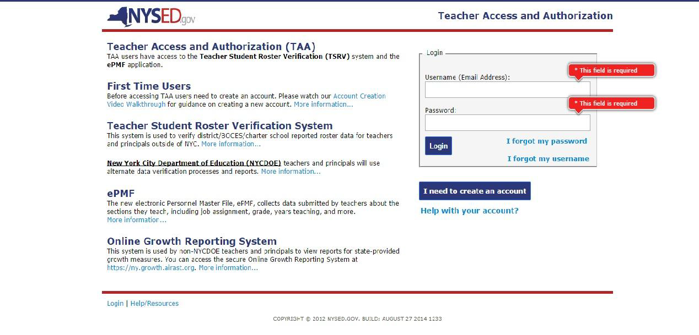
The Login Page
https://eservices.nysed.gov/taa/
New York State Education Department | Office of Information and Reporting Services. | 2014

Slide 8
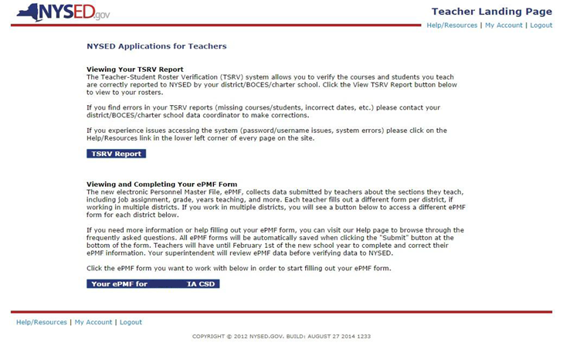
The TAA Landing Page
Once logged in to TAA, the landing page affords teachers the ability to view their TSRV reports and complete and review their PMF data.
January 15
New York State Education Department | Office of Information and Reporting Services. | 2014

Slide 9
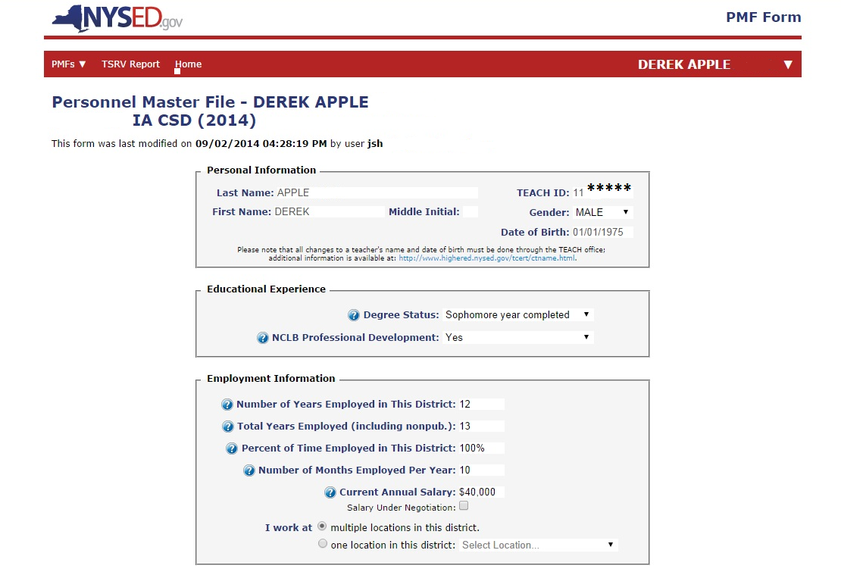
Teacher View of ePMF Screen
New York State Education Department | Office of Information and Reporting Services. | 2014

Slide 10
Adding Assignments
New York State Education Department | Office of Information and Reporting Services. | 2014

Slide 11
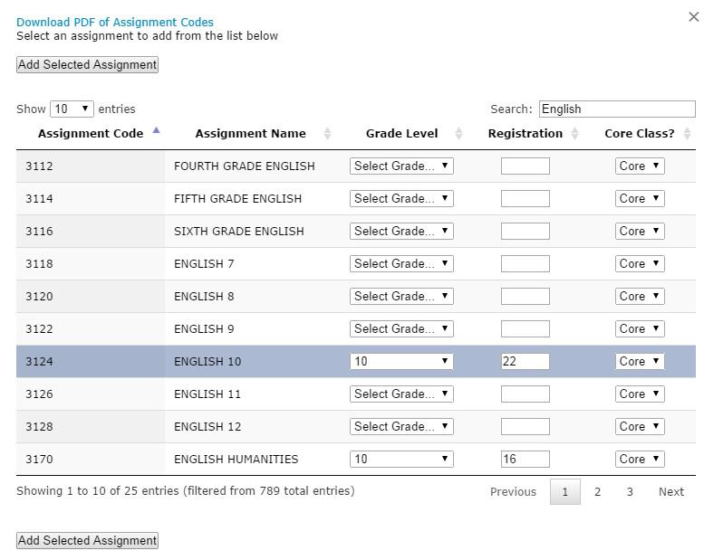
Choosing Assignments
New York State Education Department | Office of Information and Reporting Services. | 2014

Slide 12
Saving and Submitting the ePMF Form
All ePMF forms can be saved when clicking the "Save" button at the bottom of the form. If you are uncertain about some of the information you have entered and need to return to the form, click “Save.” You will have to return to it later and choose “Save + Submit” to finalize your selections.
If the information is complete and accurate you should click, “Save + Submit.” You will not be able to edit the form after you submit it. Your superintendent/principal will then be able to review and edit the data as needed before submitting it to the New York State Education Department.
New York State Education Department | Office of Information and Reporting Services. | 2014

Slide 13
Saving and Submitting the ePMF Form
New York State Education Department | Office of Information and Reporting Services. | 2014

Slide 14
Administrator Review

Slide 15
Administrator Review
Throughout the ePMF collection period (beginning on BEDS Day, October 1, 2014 and ending on January 31st, 2015), Superintendents, and those individuals entitled by Superintendents, will be able to review and revise teacher submitted ePMF data.
To allow district administrators the ability to assist teachers in TAA account creation and ePMF review, the TAA administrator application will provide two SEDDAS (SED Delegated Account System) entitlements:
TAA/TSRV - This role allows administrators to view the submission status of ePMF, view TAA account creation progress, view basic roster data, and deactivate TAA accounts for certain users.
TAA/TSRV/ePMF - This role entitles users to everything in the role described above as well as the ability to review and revise ePMF data for staff they oversee. Users may also download a spreadsheet containing all current ePMF data.
New York State Education Department | Office of Information and Reporting Services | 2014

Slide 16
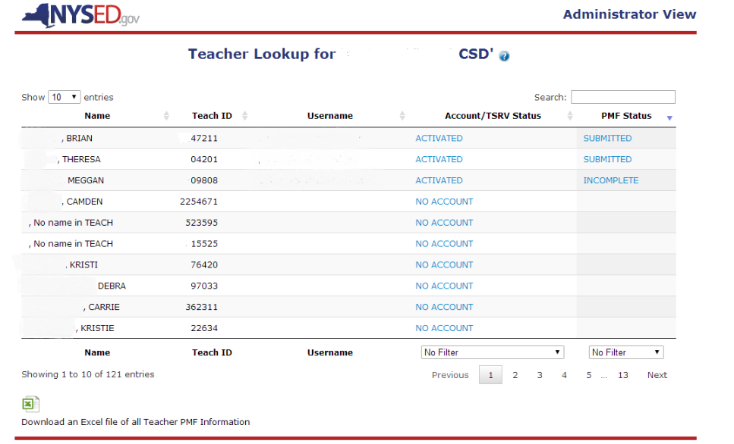
Administrator Review –Control Panel
New York State Education Department | Office of Information and Reporting Services | 2014

Slide 17
Administrator Review

Slide 18
Administrator Review

Slide 19
Tips and Reminders
Teachers, whether new or existing TAA account holders, will not be able to access the ePMF application until their 2014-15 Staff Snapshot record has been uploaded to the data warehouse. Districts will want to coordinate communication to teaching staff with the submission of Staff Snapshot data.
A teacher may “Save” their ePMF form at any time and continue working in a future session. They may only “Submit” their data once. Subsequent to formally submitting their data, a teacher will be unable to re-enter the application to edit data regardless of the date. Only delegated district staff may edit data for a teacher who has submitted the ePMF form.
Only the District Superintendent/Charter School Leader is authorized by default to edit ePMF data. The Superintendent/School Leader must choose to entitle additional district/school staff to also be able to edit teacher data. These roles are managed within the SEDDAS application in the same manner as other entitlements.
New York State Education Department | Office of Information and Reporting Services | 2014

Slide 20
Tips and Reminders
A district may submit Staff Snapshot data based on requirements for 2013-14 template for purposes of generating PINS for TAA account creation and for providing access to the ePMF form. It is highly recommended that districts become familiar with and begin planning for meeting the 2014-15 data requirements as soon as possible. More information about and support for the 2014-15 transition will become available well in advance of the requirement.
NYSED will make the ePMF application available from October 1, 2014 – January 31, 2015. This window presents districts with the opportunity to impose and manage local time lines within. While the collection represents a moment in time (October 1, 2014), the submission process may span months. This span requires knowledge of data as it existed on October 1, 2014 in cases where submission occurs subsequent to this date. Access to attendance registers and other records, as of BEDS Day, may facilitate accuracy.
Documentation and guidance designed specifically to support teachers is available. A list of resources is on the following page.
New York State Education Department | Office of Information and Reporting Services | 2014

Slide 21
Resources
Collection of Personnel Master File (PMF) Data http://www.p12.nysed.gov/irs/beds/2014/PMF/home.html
Administration Manual, Educational Personnel Data Form & ePMF User Guide for Teachers
Administration Manual, Educational Personnel Data Form for Non-Teaching Staff;
Personal Identification Numbers (PINS) & Creating a TAA Account
TAA Account Information and Teacher-Student Roster Verification Report http://www.p12.nysed.gov/irs/teacher/
SEDDAS - SED Delegated Account System http://www.p12.nysed.gov/seddas/seddashome.html
New York State Education Department | Office of Information and Reporting Services | 2014

