Slide 1
NYS Education Department Vendor Meeting
Date: January 18, 2017
Time: 2:00 PM – 3:30 PM EST
Phone: 1-866-394-2346
Pass code: 425-758-6404#
Webinar: https://moric.webex.com/join/SIRS-DW

Slide 2
Agenda
Welcome and Introductions
Vendor Feedback
SMS Updates/Reminders 2016-17
P-Tech
Career Path Codes
CDOS
Seal of Biliteracy
Student Attendance/BOCES
Homeless Students
Immigrant Update
Assessment Measure Codes Changes
Students in Foster Care and Students with a Parent in the Armed Forces Program Service Codes
LEP/ELL Update
Staff Student Course
Course Instructor Assignment
Student Class Entry Exit
HR Financial/Staff Vendors
Staff Evaluation
Staff Attendance
2016-17 Staff Snapshot
Staff Tenure
Food Service
Free and Reduced Price Lunch eligibility Type in 2017-18
Additional Resources
Questions

Slide 3
Vendor Feedback
New York State Education Department
Information and Reporting Services

Slide 4
Vendor Product Categories

Slide 5
Primary method for finding new information/reporting requirements from NYSED

Slide 6
Usefulness of the NYSED Vendor Website

Slide 7
Separate Meeting Preference- for vendor types (Staff, HR, Food Service, SMS, etc.)

Slide 8
Would Individualized Conference Calls- Vendors, NYSED, and SMS Cert Center be Helpful?

Slide 9
Utilization of SMS Certification Center for testing products and extracts

Slide 10
Additional Vendor Listserv Results
Question | Yes | No
Are you aware of the NYSED Vendor Listserv? | 100% | 0%
Are you on the NYSED Vendor Listserv to receive information? | 100% | 0%
Have you used the NYSED Vendor Listserv? | 71.4% | 28.6%
If you are on the Listserv, do you find it valuable as a source for information? | 85.7% | 14.3%
Would you prefer that NYSED use the Listserv more often? | 78.5% | 21.4%

Slide 11
Utilization of SMS Certification Center for NYSED Reporting Information

Slide 12
Additional Feedback
Areas for Improvement:
Vendor Template Excel worksheet – track changes.
NYSED should plan changes ahead of time and have fewer changes.
Provide materials sooner for review prior to the meetings.
Split meetings (HR & Student).
More timely delivery of SIRS Manual with complete definitions of upcoming changes.
Make all vendor documents searchable on the nysed.gov site.

Slide 13
Additional Feedback
Areas for Improvement:
Individual calls would be helpful so that each vendor is able to describe how their software handles the specifics of State reporting, including the new requirements.
More emails would be very helpful specific to the type of vendors with reminders of things such as new fields, when files are due etc.
Provide more guidance about when the changes must be in place.
Consolidate updates to minimize the number of change events.

Slide 14
What NYSED has done in response
Revamped the Vendor Webpage (consolidated pages).
Scheduled one-on-one phone calls with vendors that requested them.
Vendor Template Excel now has “Change History” tab.
Updates are sent out via SISVENDS Listserv.
SIRS manual updated more frequently as needed-communication via Listserv.
Questions can be answered if sent into datasupport@nysed.gov .

Slide 15
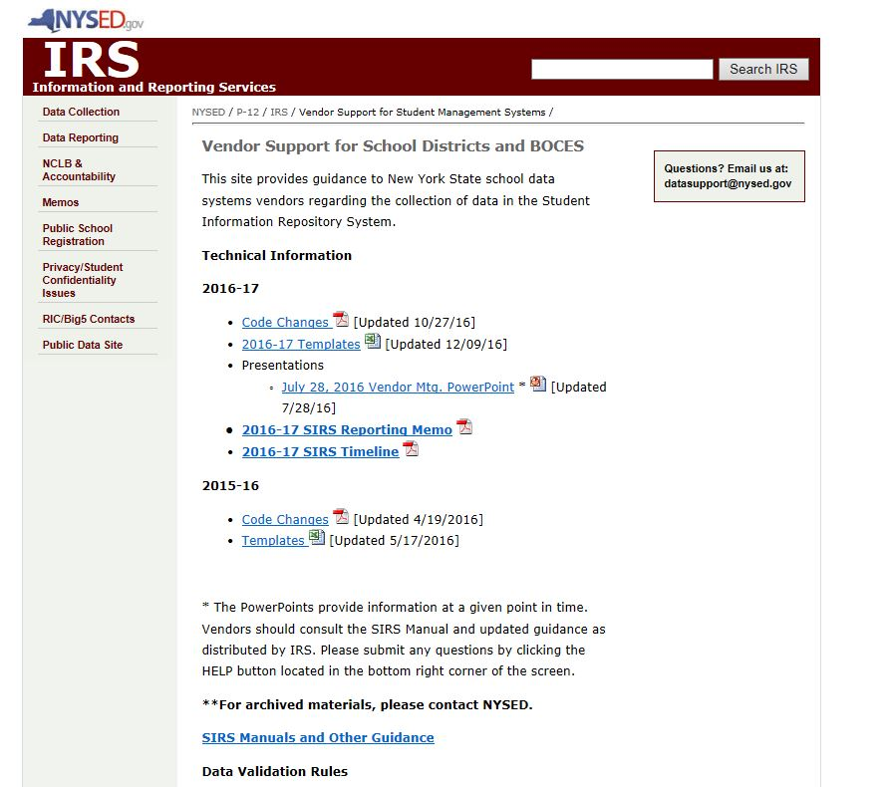
http://www.p12.nysed.gov/irs/vendors/home.html

Slide 16
SMS
Reminders and Updates for 2016-2017

Slide 17
SMS- P-Tech Programs
P-Tech Programs are programs in which students earn a Regents diploma, get workplace experience, and receive an Associate’s degree or credits towards one over six years of high school. Students in these programs qualify for ELL, disability, and FRPL services throughout the entire six years of the program.
Students enrolled in a NYS P-Tech Program must be reported with Program Service Code 4026.
Students enrolled in a NYC P-Tech Grades 9-14 Early College and Career High School program must be reported with Program Service Code 4027.

Slide 18
SMS- P-Tech Programs
Report program beginning date and end dates.
Report the current year in the program in the Program Duration in Program Facts (1-6).
Students reported as Grade 12 in the 4th, 5th, 6th year of the program.
See SIRS manual for information related to P-Tech Reason for Ending Enrollment Codes.

Slide 19
SMS- 2016-17 Career Path Codes
Code | Description | Definition: Student passes one Regents exam or an examination from the list of Department-approved alternatives in each of the following: English, Math, Science, and Social Studies PLUS:
ARTS | Arts | passes one Department-approved pathway assessment in the Arts
CTE | Career and Technical Education | passes one Department-approved Technical pathway assessment
HUM | Humanities | passes one additional Regents examination in Social Studies
HUMALT | Humanities Alternative | passes an examination from the list of Department-approved alternative exams in English or Social Studies
LOTE | Languages Other Than English | passes one Department-approved pathway assessment in Biliteracy
STEMMATH | Math | passes one additional Regents exam or Department-approved alternative in Math
STEMSCIENCE | Science | passes one additional Regents exam or Department-approved alternative in Science
CDOS | Career Development and Occupational Studies | meets the requirements of the CDOS Commencement Credential
NONE | No Pathway | Student ends enrollment with a credential but does not fulfill the requirement of the other pathways
NOTE: If a student used more than one pathway, report the pathway with which the student associates most closely.

Slide 20
SMS- CDOS 2016-17
CDOS Stand Alone: Beginning in 2015-16, general-education students may be reported with a Career Development and Occupational Studies (CDOS) commencement credential as a stand-alone credential. Previously, only students with disabilities were allowed to do so.
CDOS 4+1: Beginning in 2015-16, general-education students and students with disabilities may use CDOS as a Career Pathway. To do so, they must pass one Regents exam or an examination from the list of Department-approved alternatives in each of the following: English, Math, Science, and Social Studies AND meet the requirements of the CDOS commencement credential.

Slide 21
SMS- 2016-17 CDOS Update (cont.):
CDOS Program Service Code: Beginning in 2016-17, a new Program Service Code, 8271 (Student Working Toward a CDOS Credential), was added to identify general-education students and students with disabilities who are working toward earning a CDOS. This code was introduced to track students who earn a CDOS credential and an additional diploma or credential (as they will be reporting the additional diploma or credential as their Credential Type).
Students who receive a CDOS credential will end the 8271 program service with new ending Program Service Code 700 (Received a CDOS credential); students who are no longer working toward a CDOS and have not received the credential will end the 8271 program service with new ending Program Service Code 701 (Left program without receiving CDOS).

Slide 22
SMS - Seal of Biliteracy
New Program Service Code 8312 (Received Seal of Biliteracy) is collected to identify students who have received a New York State Seal of Biliteracy (NYSSB), which is an award given by a school or district in recognition of students who have studied and attained proficiency in foreign language courses.
This code can only be reported once the student has completed all requirements for a Regents diploma, even if the criteria for receiving the NYSSB were met in a prior year.

Slide 23
SMS- Student Attendance/BOCES
Report Student Attendance by BOCES program-
CTE
Alternative Education
Special Education
Report each program type as a unique BOCES program location (BOVL).
In order to report student attendance records, BOCES must report instructional enrollment records (0055) for students for each BOCES program type/location (BOVL) where attendance is taken. If students are enrolled in multiple programs, BOCES must report multiple enrollment records.
Submit day calendar for each BOCES program type/location (BOVL) where attendance is being reported.
The expectation is for BOCES to begin reporting data this school year. It will be required for 2017-18.

Slide 24
SMS- Homeless Students
Effective December 10, 2016, under the Every Student Succeeds Act (ESSA), students awaiting foster care placement are no longer considered homeless. Students awaiting foster care placement prior to December 10, 2016 should be considered homeless.
SIRS guidance issued on or after December 10, 2016 will exclude the reference to awaiting foster care placement for homeless students.

Slide 25
SMS- 2016-17 Immigrant Reminder
The immigrant definition was revised to align with that of the federal government:
Immigrant children and youth are defined as individuals who:
are aged 3 through 21;
were not born in any State; and
have not been attending one or more schools in any one or more States for more than 3 full academic years. The months need not be consecutive.
"State" means the 50 states, the District of Columbia, and the Commonwealth of Puerto Rico. Children born to U.S. citizens abroad (including those born on military bases), the U.S. Virgin Islands, Guam, or any other U.S. territory that is not D.C. or Puerto Rico are considered immigrants.

Slide 26
SMS- 2016-17 Immigrant Update
IMMIGRANT INDICATOR (Field 49) and YEARS IN UNITED STATES SCHOOLS (Field 39) in the Student Lite template are for local use only in 2016-17.
A new Program Service Code, 8282 (Immigrant Children and Youth Status), are used to identify children and youth who fit the federal definition of immigrant on the previous slide.
Students reported with Program Service Code 8282 must also be reported with Country of Origin, Date of Entry into United States, and Program Service Code 5731 (Title III: Language Instruction Immigrant LEP Students) and/or 5742 (Title III – Part B, subpart 4: Emergency Immigration Education Program), if applicable (that is, receiving those services).

Slide 27
SMS - Assessment Measure Codes
2016-17 Discontinued Codes
The following Assessment Measure Codes are not be used in 2016-17: 01040, 06040, and 08040 – Regents Comprehensive Exams in English for January, June, and August; 01204 and 06204 Regents Exams in Integrated Algebra for January and June; 01205, 06205, and 08205 – Regents Exams in Geometry for January, June, and August; and 06206 – Regents Algebra 2/Trigonometry for June.
The following Assessment Measure Codes are new in 2016-17: 01306 and 08306 – Regents Common Core Examination in Algebra II for January and August, respectively.
A complete list of changes is available in the “Code Changes for 2016-17” document at: http://www.p12.nysed.gov/irs/vendors/home.html and the SIRS Manual at: http://www.p12.nysed.gov/irs/sirs/home.html.

Slide 28
SMS- 2016-17 Students in Foster Care & Students with a Parent in the Armed Forces
In accordance with the proposed Every Student Succeeds Act (ESSA), data on students in foster care and students with a parent on active duty in the Armed Forces must be identified. ESSA was amended to include students with a parent serving full time in the National Guard.
New Program Service Code 8292 (Student with a Parent on Active Duty in the Armed Forces) was introduced to identify students with a parent on active duty in the Armed Forces.
The Department is currently determining the best method for identifying students in foster care.
Beginning in 2016-17, children in foster care must be reported with Program Service Code 8300 –Child in Foster Care for federal reporting purposes. Students reported with an 8300 must be reported with the date the child was placed in foster care (entry date) and date the child is no longer in foster care (exit date), if applicable. Definition of foster care is in the SIRS Manual.

Slide 29
SMS- 2016-17 LEP/ELL
Code descriptions that included the term “Limited English Proficient” or acronym “LEP” were revised to use the term “English Language Learner” and the acronym “ELL.” These codes include Program Service Code 0231 – LEP Eligible, which were changed to 0231 – ELL Eligible.
A complete list of changes is available in the “Code Changes for 2016-17” document at: http://www.p12.nysed.gov/irs/vendors/home.html and the SIRS Manual at: http://www.p12.nysed.gov/irs/sirs/home.html.

Slide 30
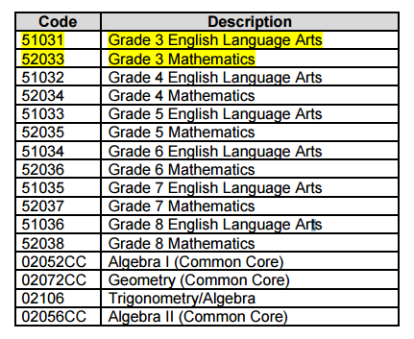
SMS- Staff Student Course
2016-2017 State Course Codes to be reported in Staff Student Course
Reduction in courses required in SSC for 2016-17. Allowable Courses. Only report records with assessment dates, not 6/30/2017. Although, there was the addition of grade 3 ELA and Math for CBT purposes.

Slide 31
SMS-Course Instructor Assignment
Report all teachers of record responsible for the course in all courses.
Instructor Start and End Dates.
Start Date- First day of the school year, or first date of the school year that the staff member was assigned to this "location" in this assignment, whichever comes last. In most cases, this would be the first day of class. This cannot be a future date.
Primary Instructor Indicator (Y, N);
Primary Special Education Indicator (Y, N).
A template is available at: http://www.p12.nysed.gov/irs/vendors/home.html .
Districts should be able to report data by March 1, 2017.

Slide 32
SMS-Student Class Entry Exit
Class Entry and Exit Dates - Multiple rows for reporting of entry/exit dates- multiple student transactions.
DUAL/CONCURRENT ENROLLMENT, Field 26 - Code that indicates if the student is enrolled in a course that is eligible for both postsecondary and high school credit, regardless of whether or not the student actually earns college credit after the course. Y=Yes, N=No. This may take the form where all students within a course are being instructed in the school through an approved institution of higher education or a situation where students may attend a college course for dual credit at an institution of higher education. Advanced Placement (AP) courses on their own are not considered dual/concurrent enrollment. College instructors cannot be reported as the Teacher of Record. A district, BOCES, or charter school must report a staff person as the Teacher of Record for the course.
A dual or concurrent enrollment course is defined as a course offered by a partnership between at least one institution of higher education and at least one school district, BOCES or charter school through which a secondary school student who has not graduated from high school is able to enroll in one or more postsecondary courses and may be able to earn postsecondary credit that is transferable to the institutions of higher education in the partnership and applicable toward completion of a degree.
Districts should be able to report data by March 1, 2017.

Slide 33
HR/Financial Staff
Reminders and Updates for 2016-2017

Slide 34
HR/Financial Staff- Staff Evaluation – Fall 2016-17
All Districts/BOCES will be using the 3012-d evaluation plan.
3012-c is no longer available.
Separate webinar later in the school year for Staff Evaluation vendors.

Slide 35
HR/Financial Staff- 2016-17 Staff Attendance Reminders
Staff Attendance reported for Teachers only.
Report staff as absent only if they were absent for the full day.
Different charges for an entire day may be reported as “Other” (e.g., 4 hours sick and 3 hours personal).
Attendance codes exist for “STUDENT” and “STAFF.” Please see Staff Attendance Code Type in the Staff Attendance template and the definition of this field in the SIRS Manual.
Please export Staff Attendance Codes, as is done for Student Attendance Codes, to ensure completion of this process.
Districts should be able to report data by March 1, 2017.

Slide 36
HR/Financial Staff- 2016-17 Staff Attendance
Reminders: Teachers Only
Staff Attendance Codes to be made available to districts, BOCES, and charter schools:
Codes & Descriptions
B Bereavement Leave
J Jury Duty
M Maternity/Paternity Leave
O Other
P Personal Leave
S Sick Leave

Slide 37
HR/Financial Staff- Staff Snapshot
Field 56 Itinerant Staff – The Itinerant flag allows an LEA to report a staff person responsible for students in this LEA but employed by another LEA district, BOCES, or charter school. There are a limited number of Staff Snapshot fields required. These fields found on the Staff Snapshot template include: (District Code, Location Code, Status/Active Indicator, Itinerant Status, Staff ID, Birth Date, Staff First and Last Name, Snapshot Date, Position Title, email – Fields 1, 2, 8, 14, 40, 41, 50, 56, 65, 66, 76).
Number of Years Employed in This District and Total Years Employed (including nonpub.) – Auto increment for returning staff. Combine all years of professional educational experience, including other public school districts, nonpublic schools, BOCES, and college or university experience within NYS.

Slide 38
Staff Snapshot - Itinerant Staff Scenarios

Slide 39
Staff Tenure
This template includes each staff member’s current tenure status as a teacher and/or principal, effective date of the tenure status.
Use Staff Snapshot as a filter “TEACHER” field #8 aligned with teacher tenure areas and “PRINCIPAL” field #105 aligned with ADT code. These are the only staff to be reported.

Slide 40
Food Service- Expanded Reporting Requirements for Free and Reduced Price Lunch (FRPL)
Beginning in the 2017-18 school year, FRPL records must indicate eligibility type (see eligibility types on the next slide).
Vendors should be able to report multiple eligibility types per student.
New Program Service Codes will be developed.
At the local level this information must already be captured, as it is reported in aggregate to the Office of Child Nutrition.

Slide 41
Food Service- FRPL Eligibility Types
SNAP (Supplemental Nutrition Assistance Program) recipients-identified via DCMP* and Medicaid –eligible identified in the Child Nutrition Management System
SNAP or TANF (Temporary Assistance for Needy Families) named on an eligibility letter for free school meals /milk from NYSED/NYS Office for Temporary and Disability Assistance (OTDA)
Reside in a household of a student who has been deemed free eligible based on the DCMP* or the receipt of an eligibility letter for free school meals/milk
Documented as:
homeless-identified by the Homeless Liaison
foster-certified directly by State/local foster agency
migrant-identified by Migrant Outreach Education Program Coordinator
Documented as participating in a program authorized by the Runaway and Homeless Youth Act

Slide 42
Food Service- FRPL Eligibility Types
Approved application for National School Lunch Program (NSLP) for free/reduced lunch
FDPIR-Food Distribution Program on Indian Reservations
*DCMP-federally mandated Direct Certification Match Process

Slide 43
SMS Certification Center

Slide 44
Additional Resources
2016-17 Templates and Collection Requirements
http://www.p12.nysed.gov/irs/vendors/home.html
SIRS Guidance
http://www.p12.nysed.gov/irs/sirs/
Google Calendar
http://www.p12.nysed.gov/irs/calendar-irs.html
Latest News/Memos
http://www.p12.nysed.gov/irs/news.html
http://www.p12.nysed.gov/irs/memos/
APPR Guidance
https://www.engageny.org/tle-library
Comprehensive State Course Catalog
http://www.p12.nysed.gov/irs/courseCatalog/home.html
School Management System (SMS) Certification Center
http://sms-certcntr.lhric.org/index.php

Slide 45
Questions?
General Questions: datasupport@nysed.gov
Staff Evaluation Questions: educatoreval@nysed.gov
Most up-to-date information:
Vendor Landing Page http://www.p12.nysed.gov/irs/vendors/home.html
44

