Slide 1
Smart Schools Bond Act
Completing the Smart Schools Investment Plan

Slide 2
Smart Schools Bond Act
Completing the Smart Schools Investment Plan
The Smart Schools Investment Plan, or SSIP, Application is available through the SED Business Portal, similar to your recently submitted Educational Technology Plan.
If You Do Not See “Smart Schools Bond Act Investment Plan Application” under “My Applications” you will need to have your School Superintendent provide access.
Once you have been entitled, the application will show up here. When you click on it, you will enter the form.
Please check the Smart Schools Bond Act website often for updated information and guidance.

Slide 3
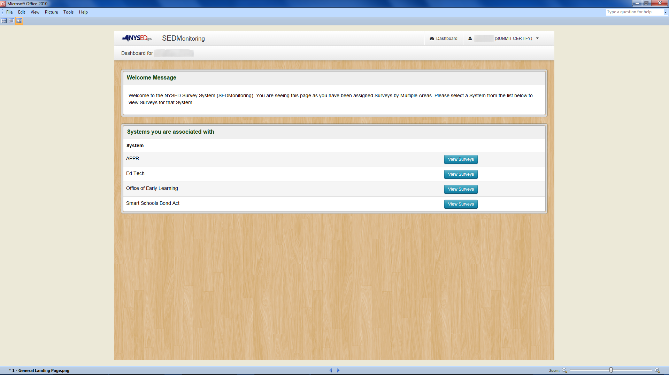
Click on Smart Schools Bond Act “View Surveys”
Notes:
Click On Smart Schools Bond Act “View Surveys” Button.

Slide 4
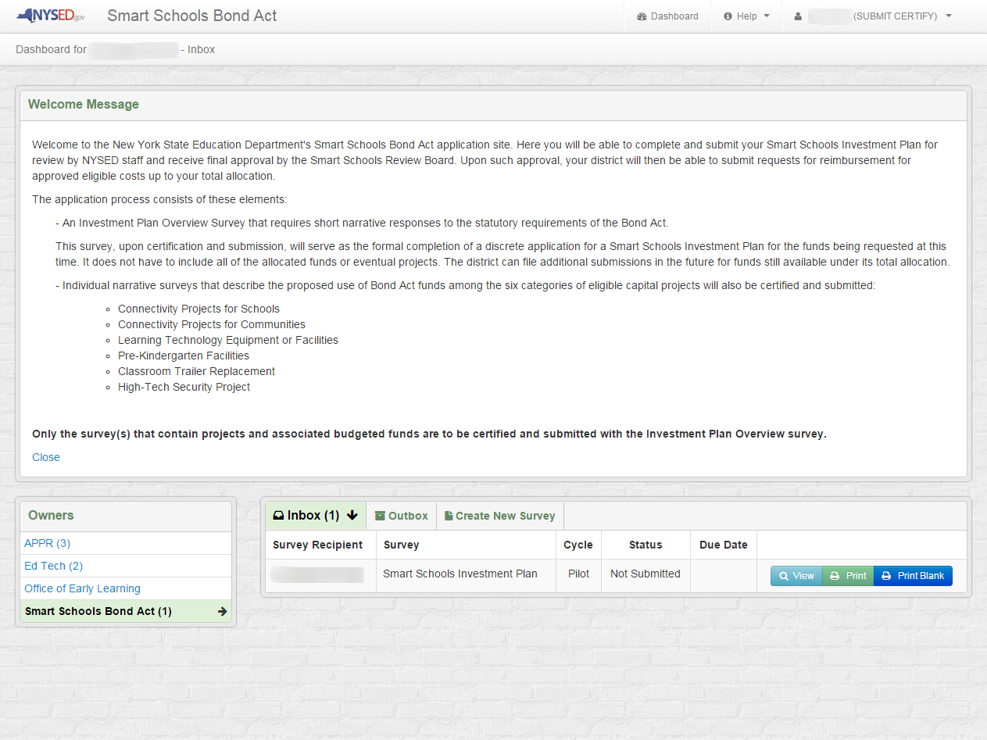
The Inbox is where you see the status of your individual or multiple projects.
After reading the Welcome Message, click on the “View” button to enter the application.
Notes:
After Reading The Welcome Message, Please Click On The “View” Button To Start The SSIP Application.

Slide 5
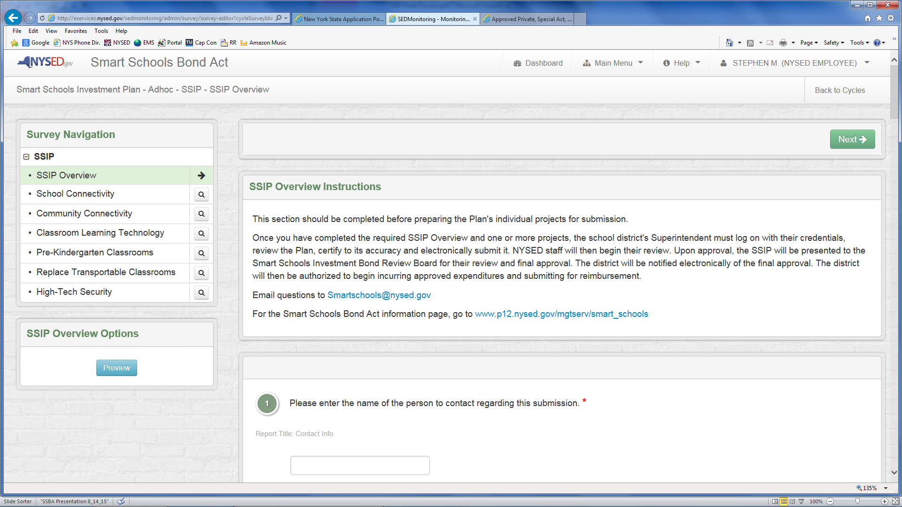
The SSIP Overview Section - 1
The first page of the Overview asks for basic contact information. All of the Overview questions, except those relating to possible consortia, must be answered or you will not be able to submit. Do not submit the Overview until you have completed all of the project areas. Note on the left that you can navigate directly between all of the project pages, as needed. Only make entries or save the category sections you are budgeting for in this submission.
Notes:
After Reading The Welcome Message, Please Click On The “View” Button To Start The SSIP Application.

Slide 6
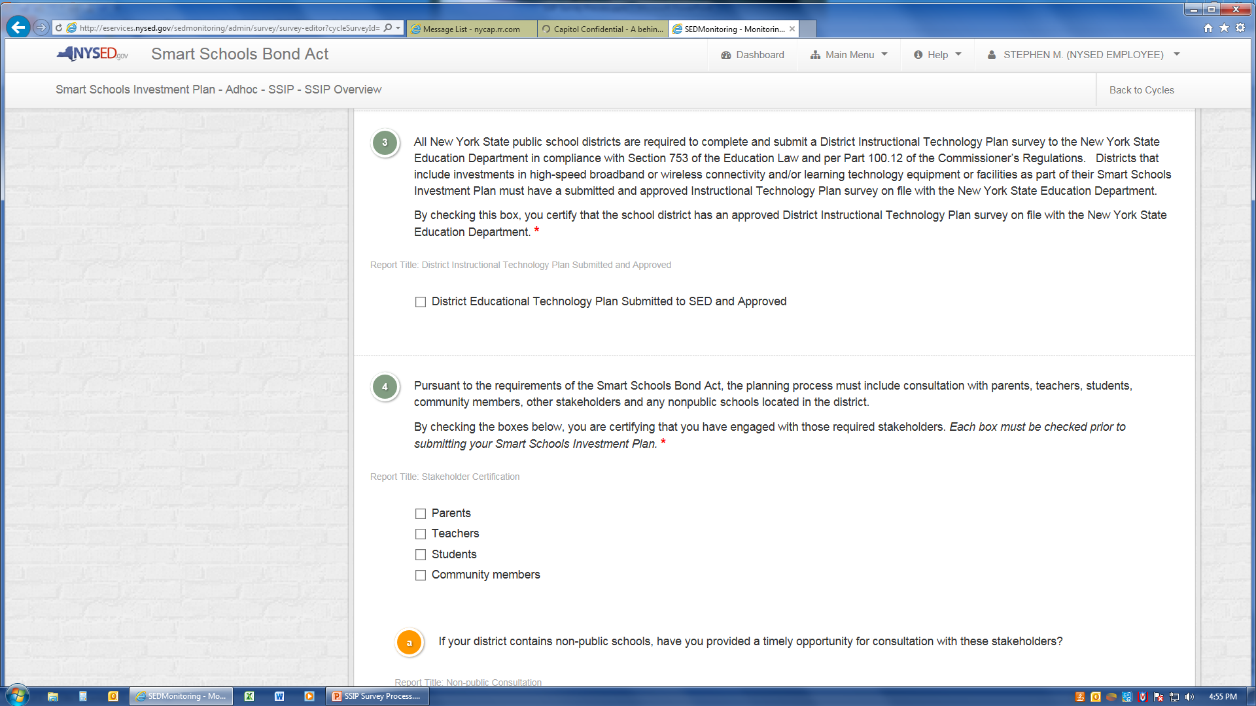
The SSIP Overview Section - 2
The SSIP Overview requires you to certify that your district has an SED-approved District Educational Technology Plan, that there has been a planning process that includes all stakeholders, including non-public schools, and that specific public notification steps have been completed, including the required 30-day comment period.
Notes:
After Reading The Welcome Message, Please Click On The “View” Button To Start The SSIP Application.

Slide 7
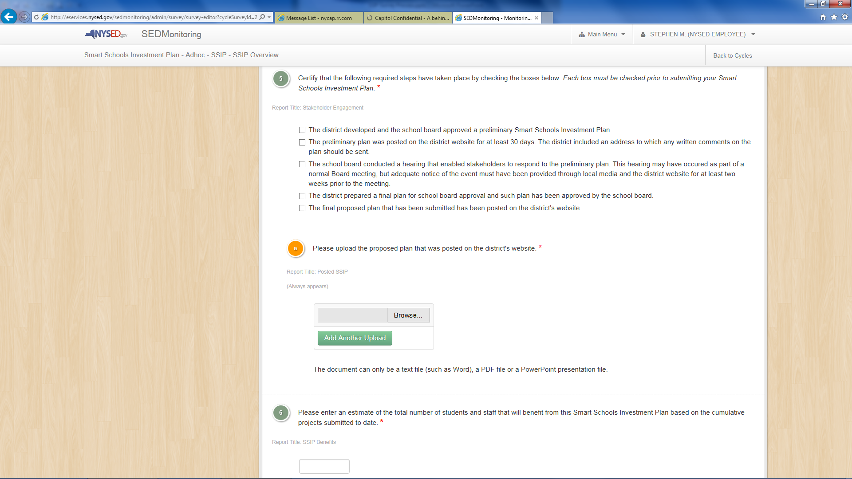
The SSIP Overview Section - 3
You must also upload the Smart Schools Bond Act Plan documents that you presented to your school board and/or public as part of your process. These can be a PowerPoint presentation or Word document(s). Multiple files can be uploaded at once. You must also provide an estimate of the number of students and staff who will benefit, understanding that this will be a rough estimate.
Notes:
After Reading The Welcome Message, Please Click On The “View” Button To Start The SSIP Application.

Slide 8
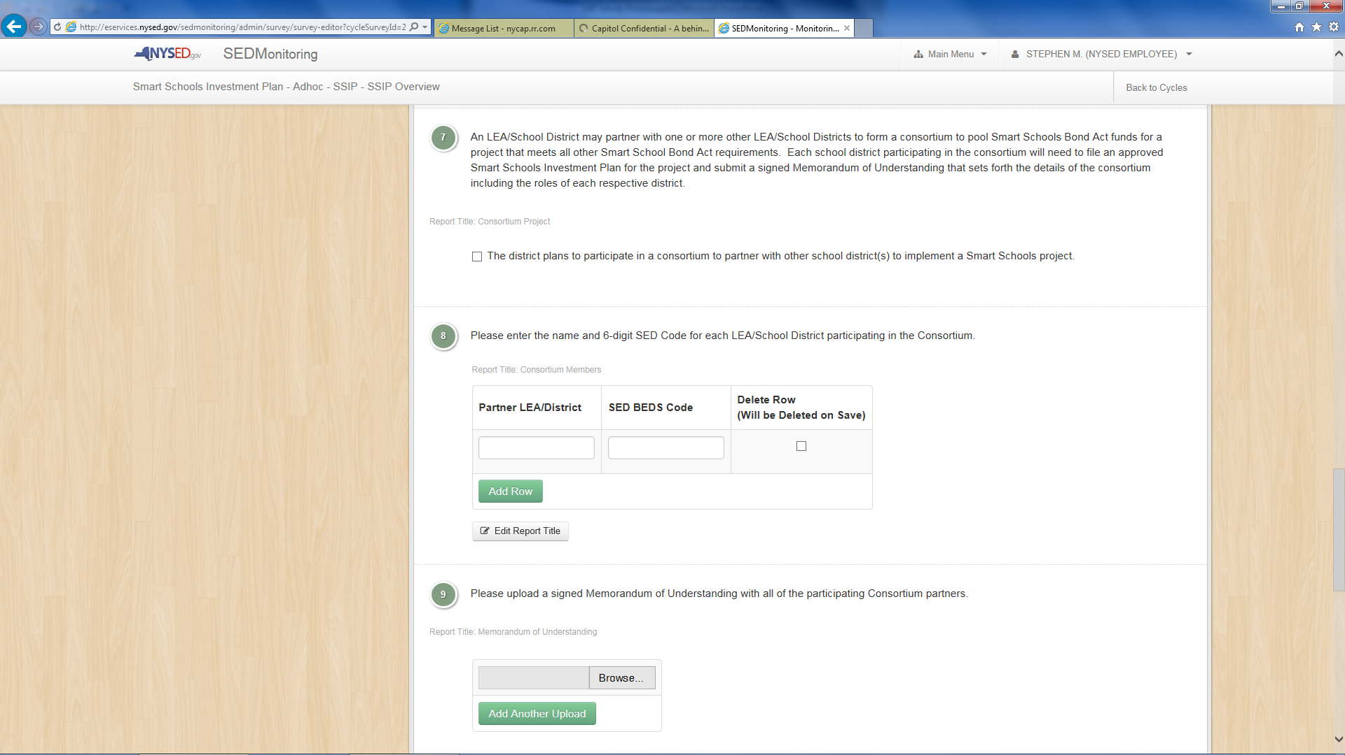
The SSIP Overview Section - 4
The Smart Schools Bond Act allows for establishing a consortium to combine resources to best leverage the districts’ funds to increase their technological capacity to provide improved learning and opportunity for students. This section of the SSIP collects the relevant data and upload a copy of the Memorandum of Understanding (MOU)setting out each district’s responsibilities.
Notes:
After Reading The Welcome Message, Please Click On The “View” Button To Start The SSIP Application.

Slide 9
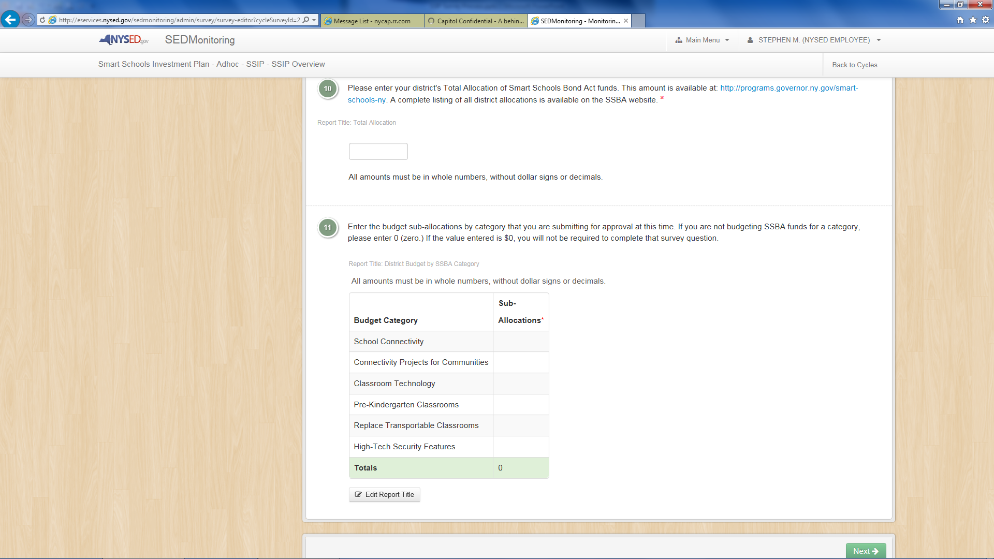
The SSIP Overview Section - 5
Finally, the SSIP Overview requires a Summary Budget of all of the sub-allocations included in this submission. You must include a number under each Budget Category to enable the automatic Totals function at the bottom. Please enter a zero for any Category you are not including in this plan submission.
Notes:
After Reading The Welcome Message, Please Click On The “View” Button To Start The SSIP Application.

Slide 10
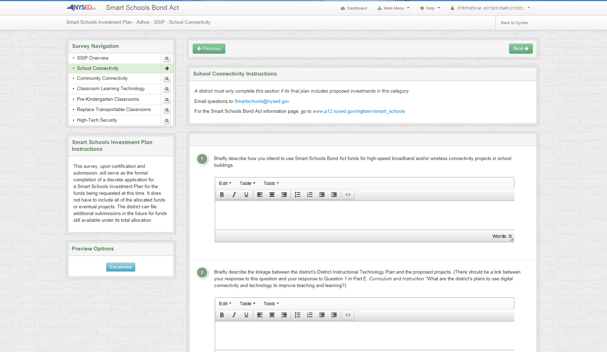
School Connectivity Projects - 1
We will go through this first project category page-by-page to demonstrate the process. The others will be similar.
These projects should develop long-term capacity to deliver high quality educational tools to the classroom utilizing the Internet.
The first two questions ask for your overall plan and coherence with your recently submitted and approved District Instructional Technology Plan.
Notes:
After Reading The Welcome Message, Please Click On The “View” Button To Start The SSIP Application.

Slide 11
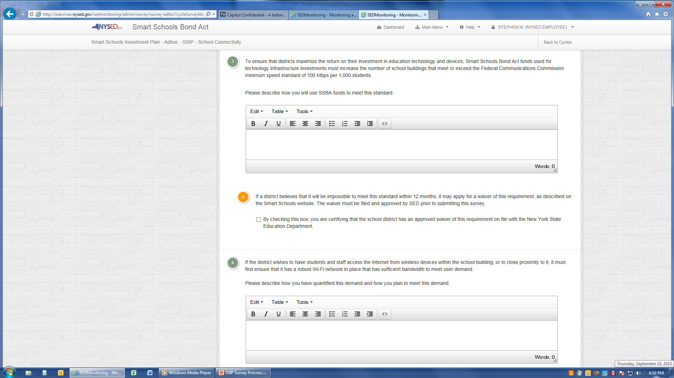
School Connectivity Projects - 2
This section addresses the requirement that Smart Schools Bond Act projects increase the speed and capacity of your technology infrastructure. There will be a waiver process for districts with practical conditions that restrict their ability to meet the Federal speed standard.
Notes:
After Reading The Welcome Message, Please Click On The “View” Button To Start The SSIP Application.

Slide 12
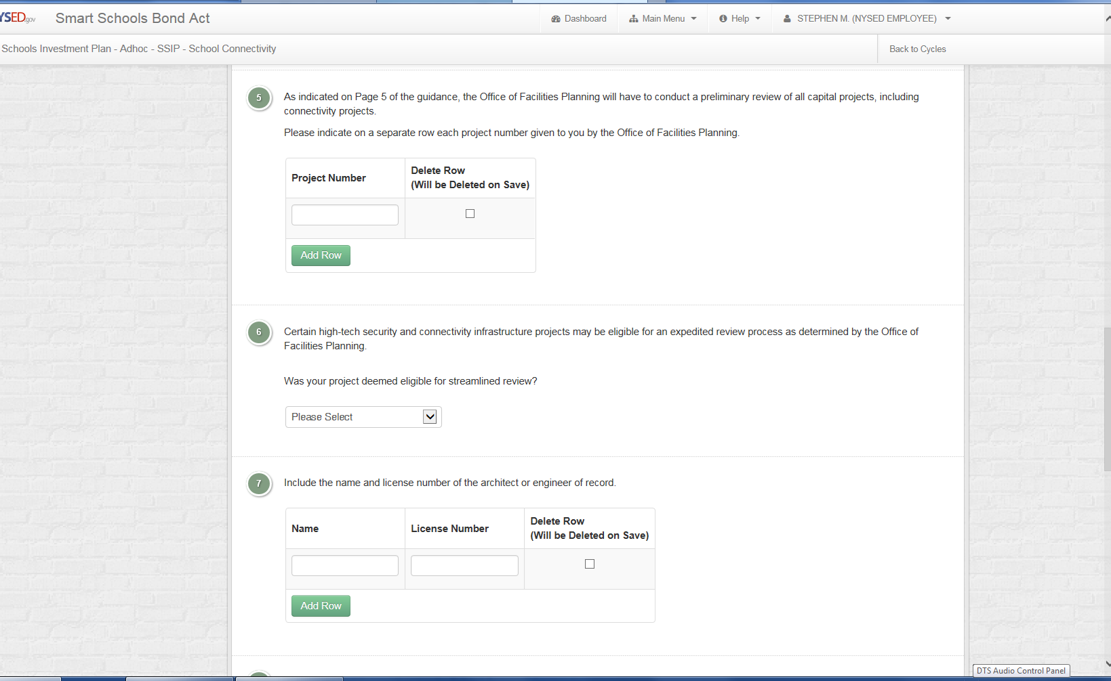
School Connectivity Projects - 3
The SED Office of Facilities Planning must review capital projects in school buildings , decide whether they are eligible for streamlined or full review, and issue a project number. Projects eligible for expedited review will generally not involve construction and will only need preliminary approval, with a licensed architect or engineer reviewing the plans for code compliance.
Notes:
After Reading The Welcome Message, Please Click On The “View” Button To Start The SSIP Application.

Slide 13
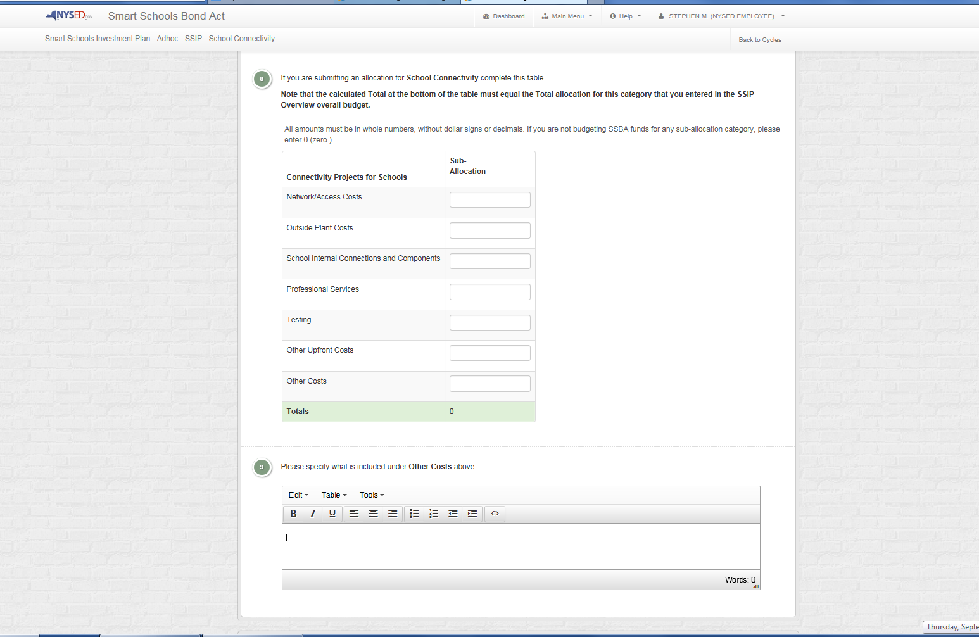
School Connectivity Projects - 4
The budget sub-allocations for each project category must total the same as shown in the SSIP Overview budget. Specific allowable and non-allowable expenditures under each line item are detailed in the guidance on the SSBA website. Once you have completed the budget, click Next.
Notes:
After Reading The Welcome Message, Please Click On The “View” Button To Start The SSIP Application.

Slide 14
Specific Questions or Certifications for Other Project Types
Community Connectivity Projects
Physical location(s) of installations
Office of Facilities review not required
Specific educational benefits
Public (Municipality) ownership
Other project partners
Classroom Learning Technology Projects
Approved Educational Technology Plan
Compatibility of devices with platform
Specific instructional goals
Meeting identified student needs
Communication with stakeholders
Regional partnerships
Professional development plan
Consultation with teacher prep programs
Non-public school loan requirements
Long-term maintenance and inventory plan
Pre-kindergarten Projects
Three-year projection of space needs
Specific space physical requirements
Sources of operational funds to support new space
Office of Facilities review and project #
Note: No streamlined review available
Other project partners
The actual survey question format is identical to that described under the previous School Connectivity slides. Remember each project category budget sub-allocations must total the same as shown in the SSIP Overview budget. Specific allowable and non-allowable expenditures under each project area and line item are detailed in the guidance on the SSBA website.
*Only make entries or save the category sections you are budgeting for in this submission.
Notes:
After Reading The Welcome Message, Please Click On The “View” Button To Start The SSIP Application.

Slide 15
Specific Questions or Certifications for Other Project Types
High-Tech Security Projects
Physical location(s) of installations
Office of Facilities review and project #
Streamlined review available
List licensed architect or engineer
Transportable Classrooms Projects
Physical location(s) of installations
# of classrooms and square footage
Office of Facilities review and project #
Note: No streamlined review available
Other project funding sources/amounts
The actual survey question format is identical to that described under the previous School Connectivity slides. Remember each project category budget sub-allocations must total the same as shown in the SSIP Overview budget. Specific allowable and non-allowable expenditures under each project area and line item are detailed in the guidance on the SSBA website.
Notes:
After Reading The Welcome Message, Please Click On The “View” Button To Start The SSIP Application.

Slide 16
Smart Schools Bond Act
Submitting the Smart Schools Investment Plan
Once you have completed the SSIP Overview and all of the category sub-allocation pages, your Superintendent will submit the Plan under their own Portal account.
They should click on the “Save & Submit” button at the bottom of any page of the application. This will submit the entire SSIP.
On the Superintendent’s Certification page, they will attest to the accuracy of the information being submitted and that all of the SSBA Assurances have been met.
Click on the “Submit” button.
The Superintendent will receive an e-mail confirmation of the submission receipt.

Slide 17
Smart Schools Bond Act
Submitting the Smart Schools Investment Plan
Next Steps
SED Program Offices will review specific categories for accuracy and that program goals are addressed and aligned with other plans.
After these reviews are complete, the SSIP will be forwarded for review and approval by the Smart Schools Bond Act Review Board.
The Superintendent will receive a final approval e-mail.
The District will then commence work on the project and submit for reimbursement.

Slide 18
Smart Schools Bond Act
Completing the Smart Schools Investment Plan
QUESTIONS?
Smart Schools Bond Act Website: http://www.p12.nysed.gov/mgtserv/smart_schools/
Smart Schools Bond Act Email Box: smartschools@nysed.gov
SED Office of Educational Management Services
(518) 474-6541

Slide 19
The Smart Schools Investment Plan (SSIP) District Process
District Posts Preliminary Plan 30 Days
District Prepares Final Plan
Final Plan Board Approval
District Submits Final Plan
District Consults w/Stakeholders and Prepares Preliminary Plan
Preliminary Plan Board Approval
Public Notice and Hearing
[START]

