Slide 1

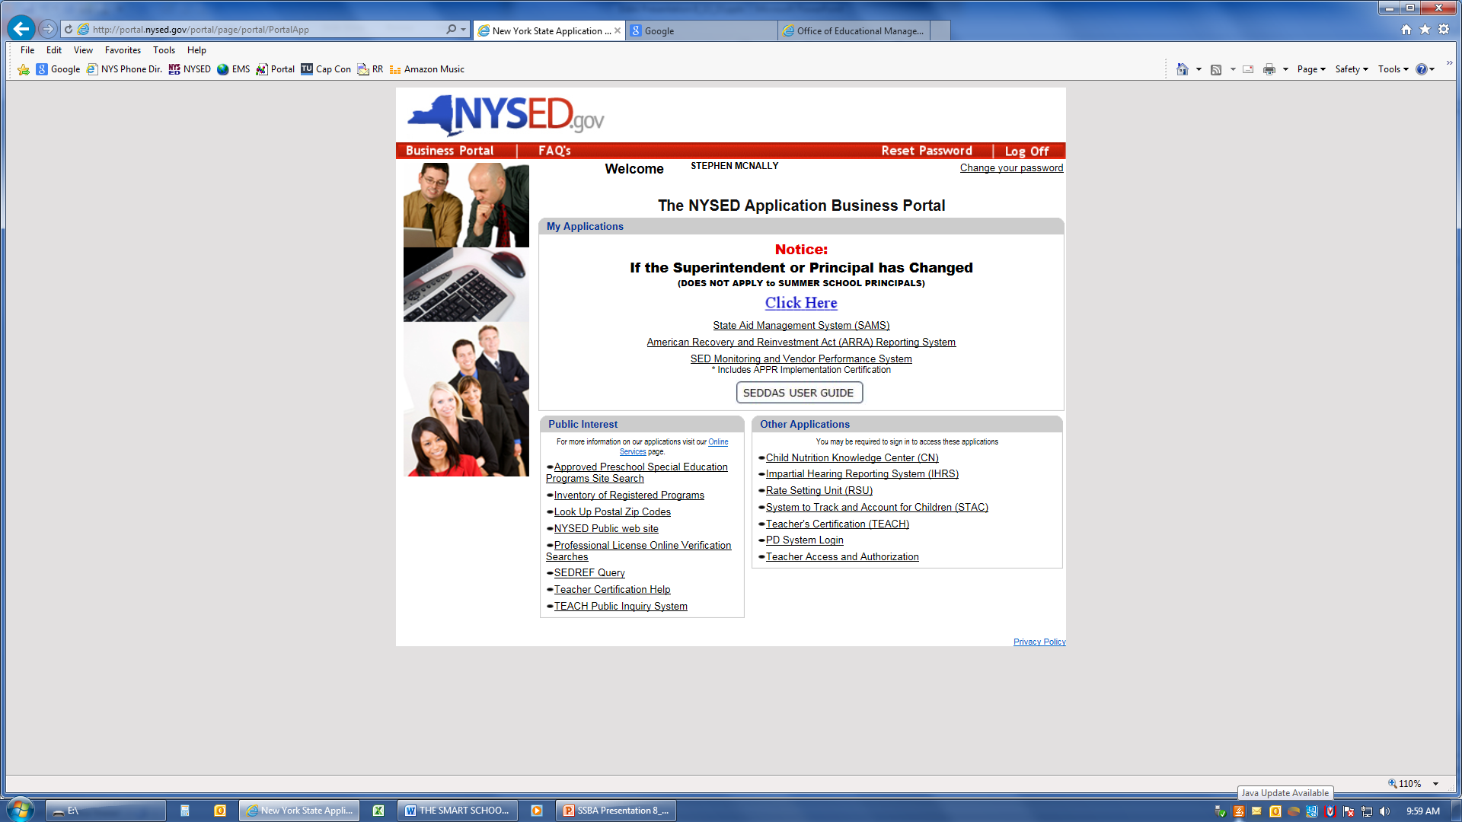
Smart Schools Bond Act
Completing the Smart Schools Investment Plan
Notes:
The Smart Schools Investment Plan, Or SSIP, Application Will Be Available Through The SED Business Portal, Similar To Your Recently Submitted Educational Technology Plan. If You Do Not See SED Monitoring And Vendor Performance System Under “My Applications” You Will Need To Have Your School Superintendent Provide Access To The Application In The Usual Way. The Next Several Slides Will Quickly Review The Steps Needed To Gain Access To The SSIP Application. Like Other SED Business Applications, We Will Use The Delegated Account System (SEDDAS) That Allows Districts To Control Access To SED Applications. Your Superintendent And Business Office Will Already Be Familiar With This System From Other SED Applications.

Slide 2
A Quick Guide
Entitling Users to SED Monitoring System
Smart Schools Bond Act
User Roles that exist in the State Education Department Delegated Account System (SEDDAS):
Role | Permissions
Delegated Administrator (DA) | Create a user account Update a user account Disable a user account Reactivate a user account Reset user passwords
Entitlement Administrator (EA) | Entitle users to applications
Delegated/Entitlement Administrator (DA/EA) | Create a user account Update a user account Disable a user account Reactivate a user account Reset user passwords Entitle users to applications
Super Delegated Administrator (SDA) – (available only to Public School Superintendents) | Create a user account Update a user account Disable a user account Reactivate a user account Reset user passwords Entitle users to applications Create other DA, EA, and DA/EA accounts
Notes:
This Slide Lists The User Roles That Are Able To Entitle Or Allow Users To View Or Complete The Application, As Appropriate.

Slide 3
Notes:
You may wish to give View Only permission to staff that should not be making changes to the application.

Slide 4
How a district EA or DA/EA can entitle another district user for SED Monitoring & Vendor Performance System

Slide 6
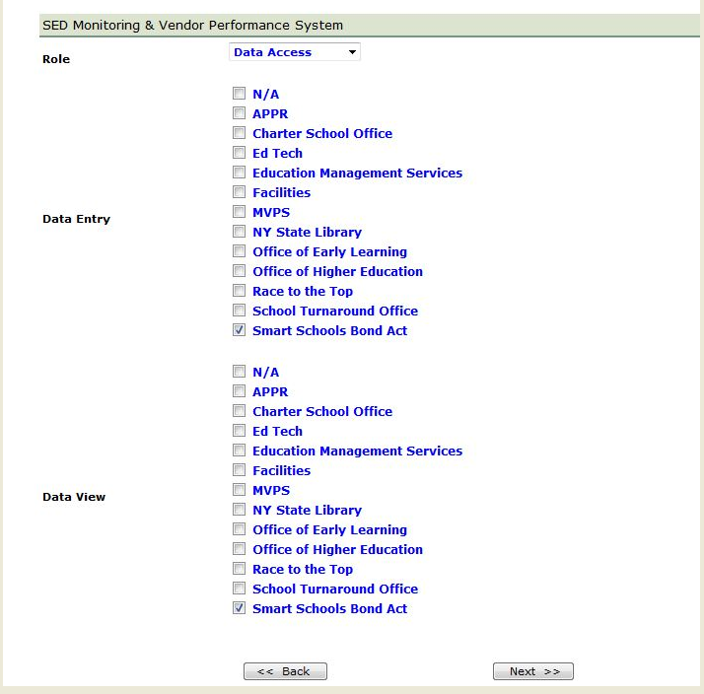

Slide 7
Smart Schools Bond Act
Completing the Smart Schools Investment Plan
Notes:
Once You Have Been Given Data Entry Rights To The Application, It Will Show Up Under “My Applications”. When You Click On It, You Will Enter The System.

Slide 8
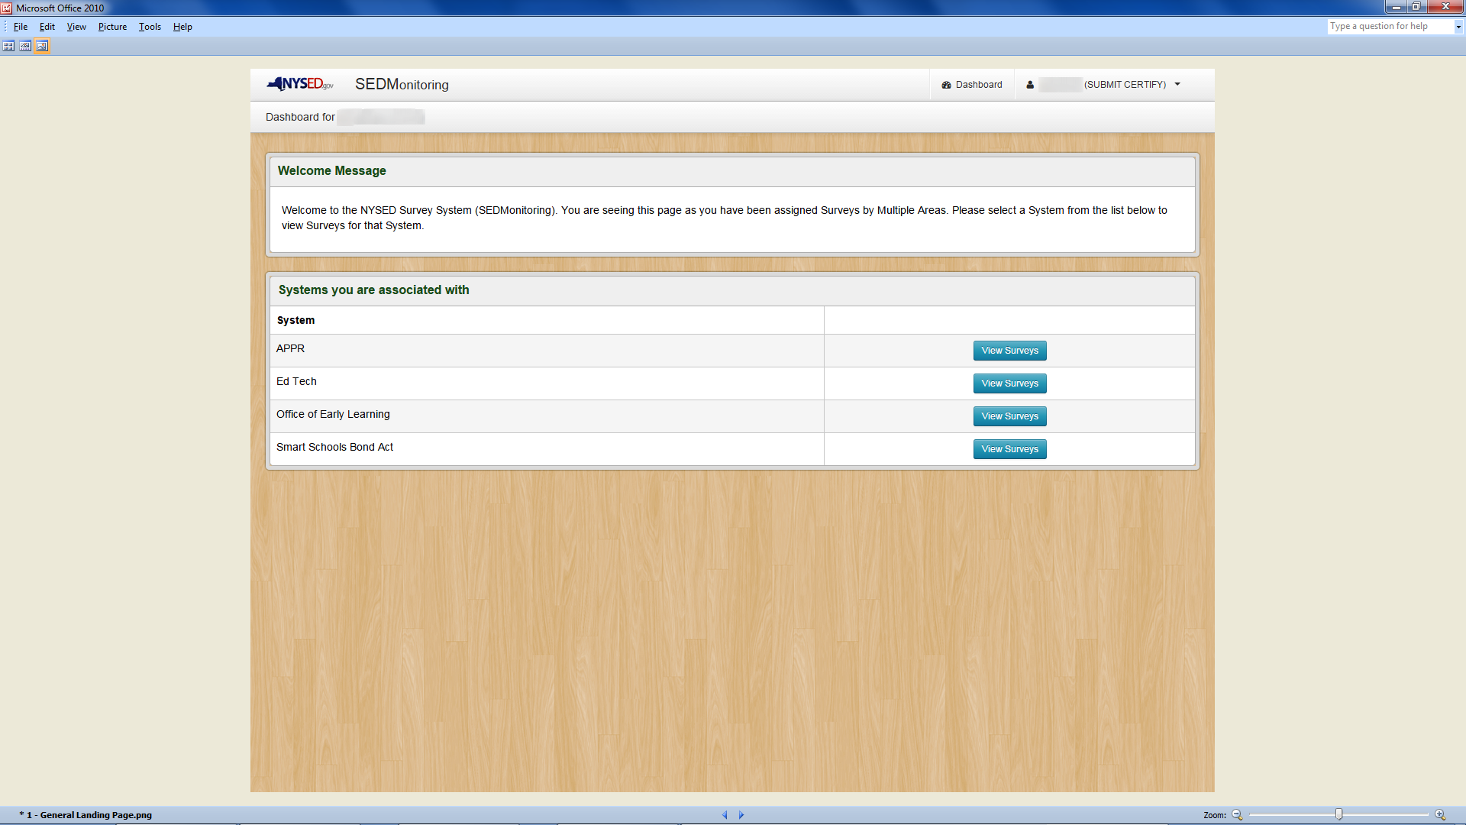
Notes:
Click On Smart Schools Bond Act “View Surveys” Button.

Slide 9
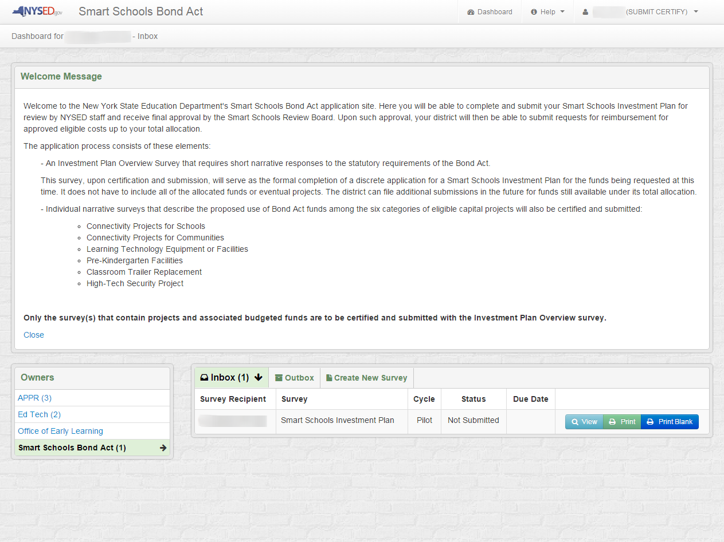
Notes:
After Reading The Welcome Message, Please Click On The “View” Button To Start The SSIP Application.

Slide 10
Smart Schools Bond Act
Completing the Smart Schools Investment Plan
QUESTIONS?
Smart Schools Bond Act Website: http://www.p12.nysed.gov/mgtserv/smart_schools/
Smart Schools Bond Act Email Box: smartschools@nysed.gov
SED Office of Educational Management Services
(518) 474-6541

