Slide 1
New York State Nonpublic School Safety Equipment Grant (NPSE)
Lori Genito, Supervisor of Education Programs
New York State Education Department
September 2019

Slide 2
Overview
Year 6 NYS Nonpublic Schools Safety Equipment Grant (NPSE) Overview of program
Completing the Reimbursement Form
Finding your Funds
Items to Remember
Submitting your Reimbursement Form
Contacting the SORIS Office

Slide 3
Program Years for NPSE
Each Program year begins on April 1 and ends on March 31
Year 1
  Enrollment Data – 2012-2013
  Program Year – 2013-2014
  School Year – 2014-2015
Year 2
  Enrollment Data - 2013-2014
  Program Year – 2014-2015
  School Year – 2015-2016
Year 3
  Enrollment Data – 2014-2015
  Program Year – 2015-2016
  School Year – 2016-2017
Year 4
  Enrollment Data – 2015-2016
  Program Year - 2016—2017
  School Year – 2017-2018
Year 5
  Enrollment Data – 2016-2017
  Program Year – 2017-2018
  School year – 2018-2019
Year 6 - Due Date March 31, 2020
  Enrollment Data – 2017- 2018
  Program Year – 2018-2019
  School Year – 2019-2020

Slide 4
Timeline
Funds are available to schools with expenditures that have occurred on or after April 1, 2013
Applications should be submitted to the Department by March 31, 2020
Notes:
Approved expenditures can date back to April 1, 2013.
PLEASE NOTE for any health related approved items this is only for years 4 -6 funds from years 1-3 will not be used for the health related items and this is clearly outlined on the application
You do NOT have to wait for the deadline to submit your application – once you are ready – send it in. You will receive your funds faster this way.

Slide 5
Methodology
School projects funded according to the following methodology:
The Year 6 Allocation amounts were determined by a per pupil allocation using the official pre-kindergarten through grade 12 enrollment submitted as part of the BEDS data collection from the 2017-18 school year for all eligible schools.
The Per-Pupil Amount for Year 6 has been calculated by dividing the total State enrollment in eligible Religious and Independent schools into the appropriation amount to obtain a per pupil amount, which is then multiplied by your school’s reported enrollment to arrive at your school’s allocation.
Notes:
Enrollment that was submitted from the BEDS collection divided into the amount of funds gave us a per pupil amount that was multiplied by each schools enrollment to determine each allocation.
NYSED posted the Year 6 Allocation (plus any remaining Funds from Yeas 1- 5) on the nonpublic school/SORIS website.

Slide 6
Carryover and Approved, Unreimbursed Expenditures
Remaining Funds from Year 1-5 will Carryover: Any funds from Years 1-5 that were not claimed by a school were treated as carryover funds and added to the school’s Year 6 Allocation to yield a Total Available Funds amount.
Approved, Unreimbursed Expenditures: A school may use the Year 6 Allocations for Approved, Unreimbursed eligible expenditures from Year 1, Year 2, Year 3, Year 4, and Year 5.
Notes:
In program years 1-5 of the grant, many schools had projects whose costs were above their allocations for that year. For example, a school may have had a $2,000 allocation and completed a $12,000 door replacement project, leaving $10,000 in approved, but unreimbursed, costs for the school. If this is the circumstance of your school, you will see the APPROVED, UNREIMBURSED EXPENDITURES in Column H, next to TOTAL AVAILABLE FUNDS Column
In a later slide we will show you the allocation spreadsheet for each of these titles.
Schools reimbursed for approved expenses, up to the amount of their Total Available Funds (Year 6 Allocation + Remaining Funds, if any, from years 1-5 Allocations).

Slide 7
Completing the Reimbursement Form

Slide 8
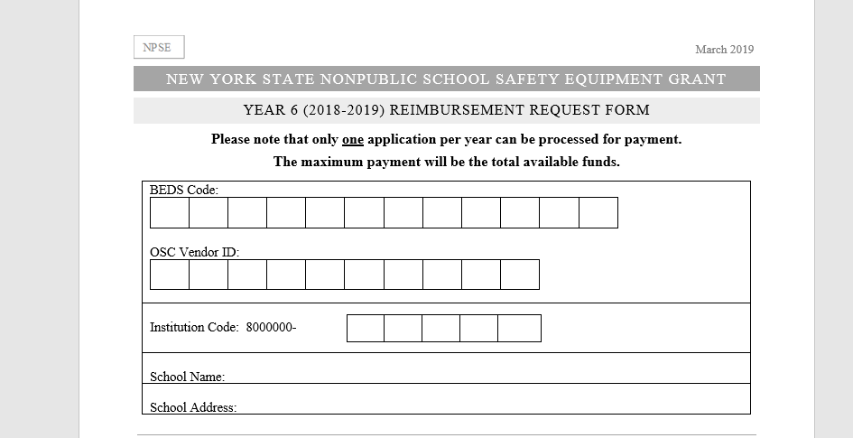
Notes:
Please include all of the information that is requested.
BEDS, OSC Vendor ID, School information,
And the Available Funding information – which can be found on the Allocation Spreadsheet
If you do not have a VENDOR ID, in a later slide we will give you the instructions on how to obtain one.

Slide 9
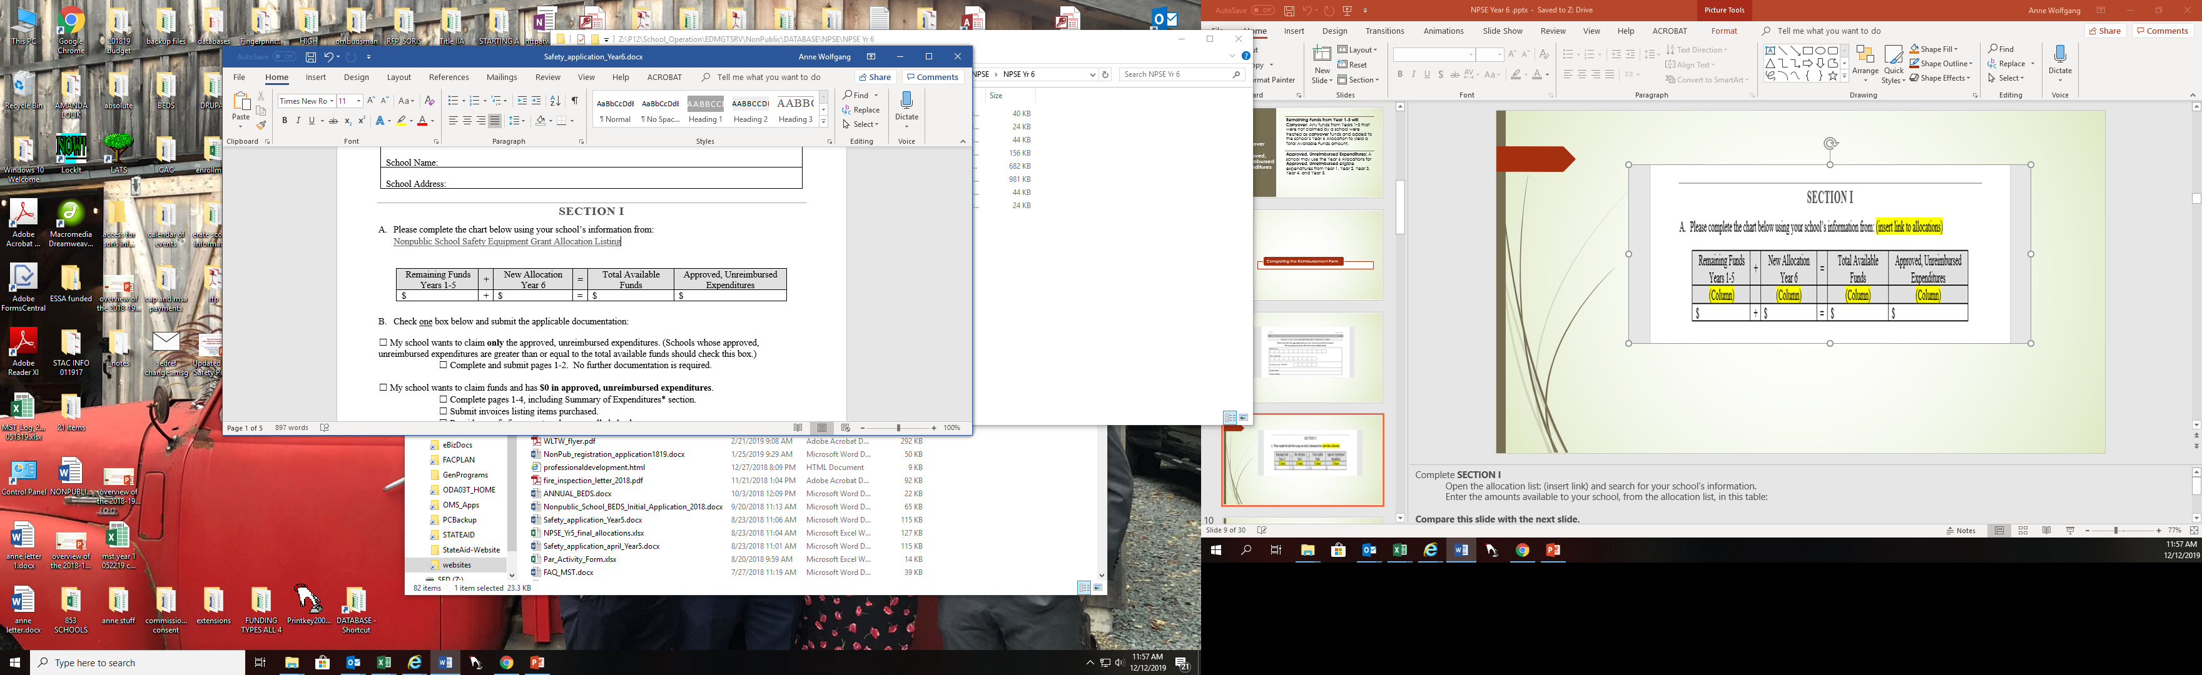
Notes:
Complete SECTION I
Open the allocation list: (insert link) and search for your school’s information.
Enter the amounts available to your school, from the allocation list, in this table:
Compare this slide with the next slide.
You will find these values listed on the Allocation spreadsheet
The Year 4 and Year 5 allocations are separated due to the newer language in the legislation concerning the HEALTH and safety
The Health only relates to years 4 and 5

Slide 10
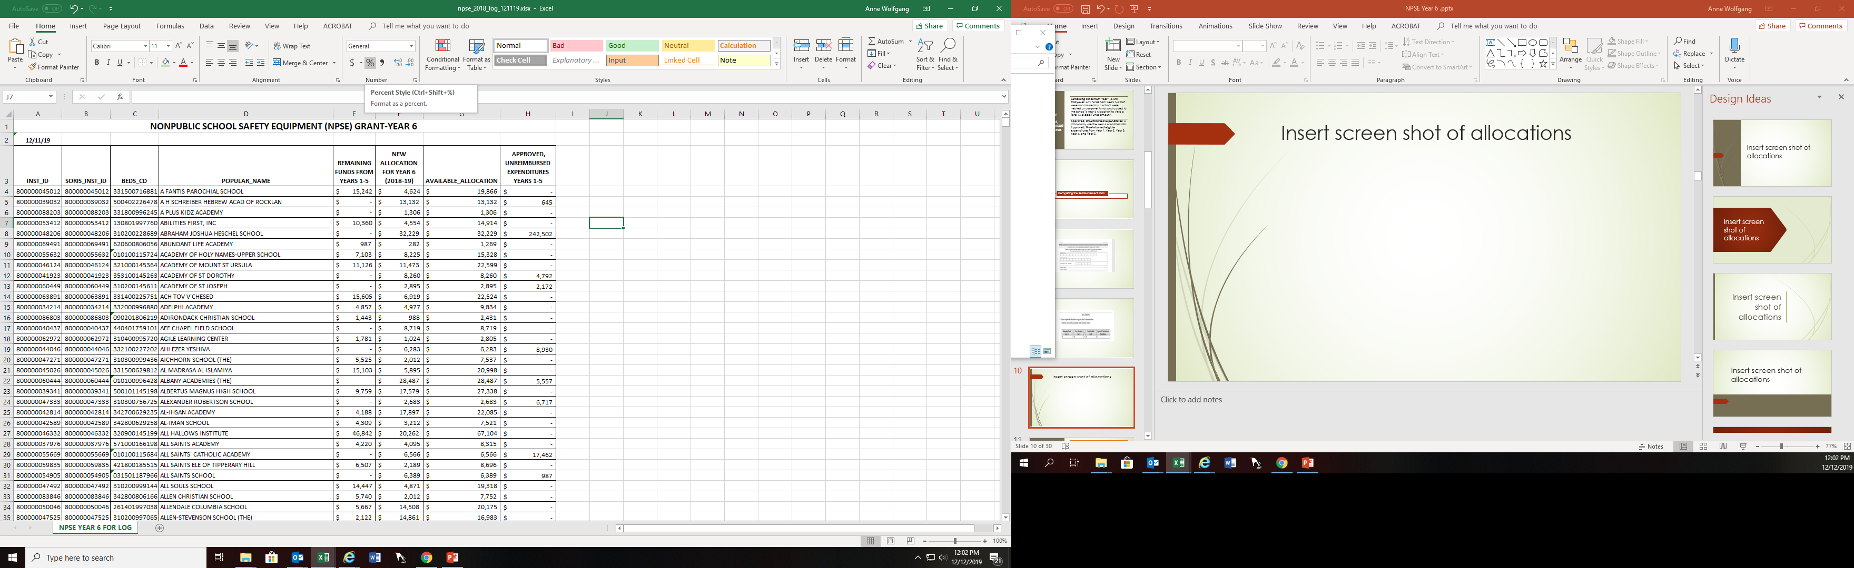

Slide 11
Claim Options
When completing the reimbursement form there are 3 options:
Use Total Available Funds to only pay Approved, Unreimbursed eligible expenditures from Years 1-4
Complete and submit pages 1-2 and no further documentation is required
Complete pages 1-4
Complete Summary of Expenditures Section
Submit invoices listing items purchased
Provide proof of Purchase such as cancelled checks showing the checks are cashed by vendor
Use school’s Total Available Funds to reimburse for school’s approved unreimbursed and additional available funds
Complete pages 1-4
Complete Summary of Expenditures Section
Submit invoices listing items purchased
Provide proof of Purchase such as cancelled checks showing the checks are cashed by vendor
Use Total Available Funds to reimburse for eligible expenditures – school has $0 in approved and unreimbursed
Notes:
Please note:
*Summary of Expenditures:
Section II Expenditures can be used for all funding years
Section III can be used for years 4 and 5 allocations only.

Slide 12
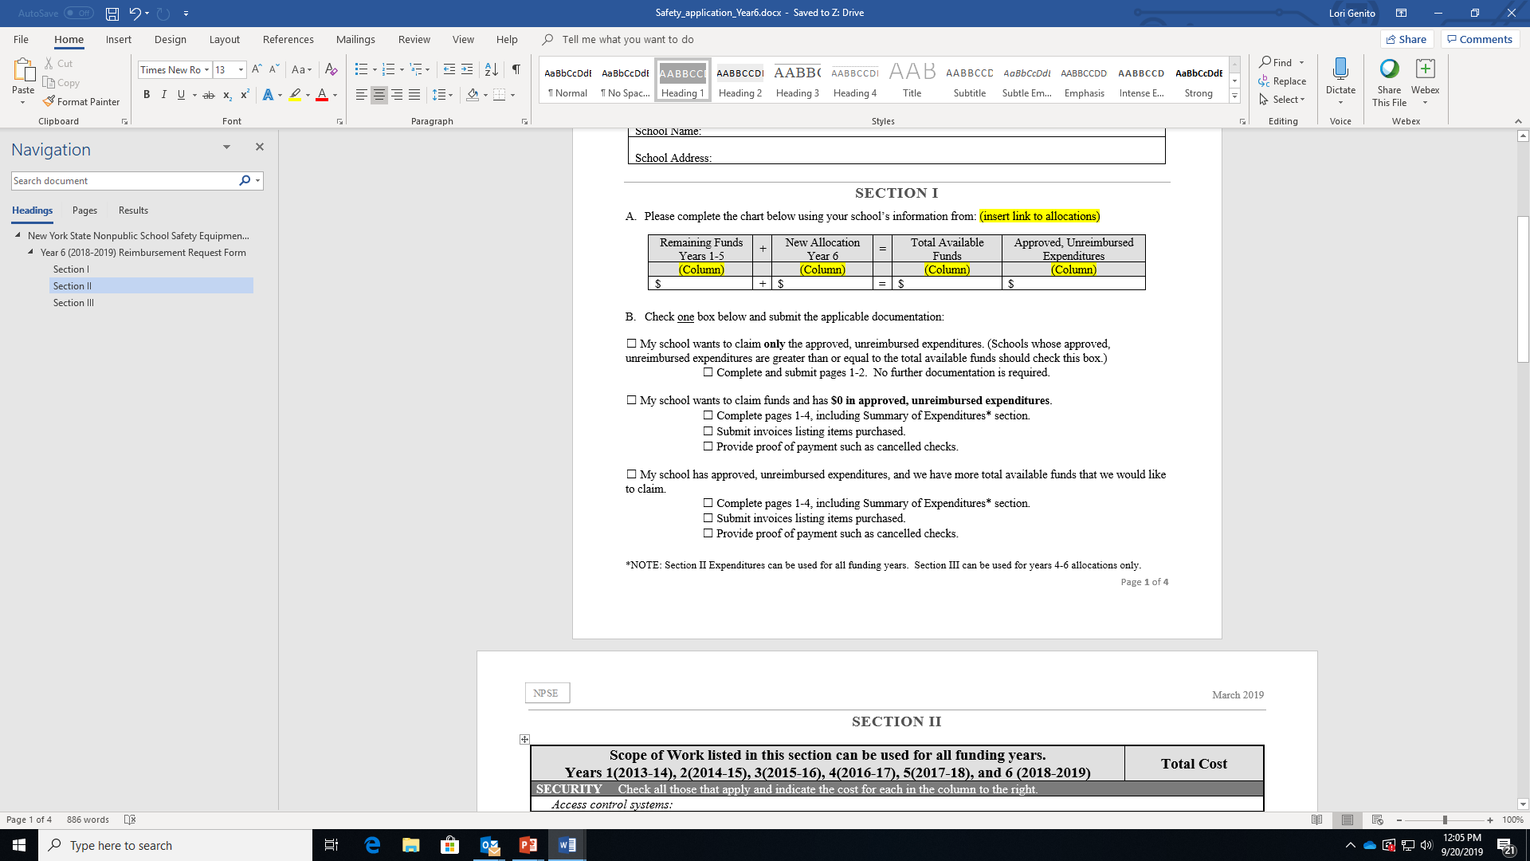
Notes:
What do these claim option mean?
My school wants to claim only the approved, unreimbursed expenditures. (Schools whose approved, unreimbursed expenditures are greater than or equal to the total available funds should check this box.)
☐ Complete and submit pages 1-2. No further documentation is required.
☐ My school wants to claim funds and has $0 in approved, unreimbursed expenditures.
☐ Complete pages 1-4, including Summary of Expenditures* section.
☐ Submit invoices listing items purchased.
☐ Provide proof of payment such as cancelled checks.
☐ My school has approved, unreimbursed expenditures, and we have more total available funds that we would like to claim.
☐ Complete pages 1-4, including Summary of Expenditures* section.
☐ Submit invoices listing items purchased.
☐ Provide proof of payment such as cancelled checks.

Slide 13
In order to determine if the claimed expenditures are eligible for reimbursement, schools must submit detailed invoices and proofs of payment.
Invoices
Please ensure that invoices are detailed. They should include the vendor name and address, date of work performed, school and address where work was performed, description of work completed, costs of work, etc. If the invoices do not describe the work completed, then please provide additional information from the vendor. The Department needs to be able to match the amounts on the invoices to the amounts listed in Sections II and III of the reimbursement form.
If the SED reviewer is not clear, they will contact your school. However, the review process will be easier and faster if all information is included with the application.
If an eligible scope of work (e.g., internal security cameras) is found on multiple invoices, it would be helpful for the school to include that information with the application. (see example on next slide)
Notes:
Invoices and proof of payment – what does this look like:
Invoices MUST be detailed
Must be able to match amounts on the invoice with the amounts on sections II and III

Slide 14
Scope of Work listed in this section can be used for all funding years. Years 1(2013-14), 2(2014-15), 3(2015-16), 4(2016-17), 5(2017-18), and 6 (2018-2019) | Total Cost
SECURITY Check all those that apply and indicate the cost for each in the column to the right.
Access control systems:
☐ Interface with the building management system
☒ Internal security cameras | $698
☐ Remote electronic door unlatching systems
☐ Screens and other devices for monitoring cameras remotely
☐ Radios/Walkie-Talkies
☒ Security fences | $200
☐ Sidelight frame replacement or removal
☐ Other* - please specify: *Items listed in Other category will be pending SED approval
SECTION II SUBTOTAL (enter on page 3) | $898
Example: Internal Security Cameras - $698
Invoice #123 Company A $300
Invoice #456 Company B $100
Invoice #789 Company C $298
Notes:
For Example

Slide 15
Acceptable Proofs of Payment | Unacceptable Proofs of Payment
Cancelled checks (front and back, showing the check has been cashed by the vendor) | An image or stub of an issued check (e.g., from accounting software) without evidence the check was cashed
Detailed bank or credit card account statements | A screen shot of a single line without showing the bank account details
Notes:
Proofs of Payment

Slide 16
Projects eligible for reimbursement
Years 1-6 ( April 1 2013 – March 31, 2020
Projects eligible for reimbursement for Years 1-6 include the purchase and installation of:
External lighting to illuminate primary entry doors;
Internal and External School Building Security Cameras
Access control systems;
Bollards and steel safety guards;
Acceptable door hardening items;
Security fences;
Walkie-talkies and radios
Notes:
Because the funds have changed to now include Health and Safety, - projects that are now eligible were not eligible in years 1-3 ( April 1 2013 – March 31, 2016). THEREFORE, we needed to separate projects that are eligible for ALL years (safety) and projects that are only eligible for year 4 -6 (health and safety)
The detailed list is in the application and will be seen in a later slide
Project expenditures made on or after April 1, 2013 and submitted by March 31, 2020.
Access control systems. These may include:
o An intercom to speak to visitors;
o Remote electronic door unlatching system;
o External cameras;
o Interface with the building management system and
o Central lockdown buttons, etc.
Door replacement;
o Door hardware replacement;
o Door frame replacement;
o Sidelight removal;
o Sidelight frame replacement;
o Change size of door or window vision panels to limit opening size;
o Change door or sidelight glass materials;
o Bars, grills or other protective measures over existing glass to prevent access;
**Please not other items have been approved, however the list is too long to add to the application. Add to the application and if we can – we will approve, if we can’t we will notify you.

Slide 17
Projects eligible for reimbursement for
Year 4, 5 and 6 ONLY (April 1, 2016 – March 31, 2020)
Projects eligible for reimbursement for Year 4, 5 and 6 ONLY include the purchase and installation of:
Environmental /Health
  Automatic External Defibrillator (AED);
  Carbon Monoxide Detectors;
  Eyewash Stations;
  Lead Testing in School Drinking Water;
  Radon Testing;
  Contracted Security Personnel and/or School Employee Personnel;
  School security and safety assessments to assist school officials in identifying potential vulnerabilities, as well as strengths relating to security and safety for students, staff and visitors;
  Training to assist Religious and Independent schools in their efforts to create/maintain a safe learning environment free of crime and violence; and
  Asbestos Testing
Fire Prevention
  Smoke Detectors;
  Annual Inspection of Fire Extinguishers;
  Purchase of Fire Extinguishers
Notes:
These project expenditures must have been made on or after April 1, 2016 – March 31, 2020
Because the language changed in the legislation to include Health and Safety we were able to expand the list of eligible items.
**Please not other items have been approved, however the list is too long to add to the application. Add to the application and if we can – we will approve, if we can’t we will notify you.
A few of these items include: D-20 and other fire safety trainings

Slide 18
Projects ineligible for reimbursement
Projects ineligible for reimbursement include, but not limited to:
The installation of bullet resistive glass in perimeter windows other than entrances;
Systems to scan visitor ID (such as drivers licenses) and compare those results with law enforcement databases are considered an operation expense; and
Construction expenses

Slide 19
Schools with SORIS Codes
This guidance only pertains to nonpublic schools who have multiple BEDS codes that are connected by a common SORIS code. If your school has more than one site which has received an allocation for this grant, and your sites are connected by a SORIS code, you may complete the reimbursement request forms as follows. Information about SORIS codes can be found at: http://www.p12.nysed.gov/nonpub/running/#beds
For Year 6, your schools must submit complete, separate application for each BEDS code.

Slide 20
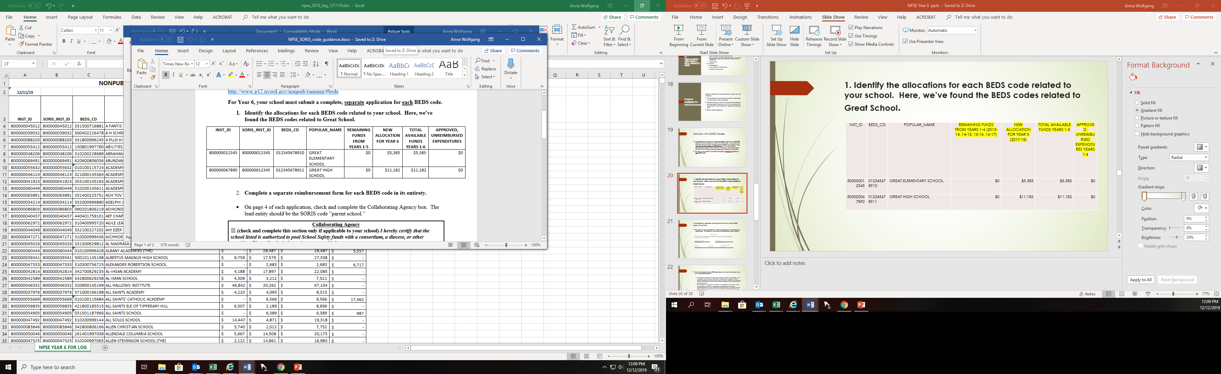
1. Identify the allocations for each BEDS code related to your school. Here, we’ve found the BEDS codes related to Great School.

Slide 21
2. Complete a separate reimbursement form for each BEDS code in its entirety.
On page 4 of each application, check and complete the Collaborating Agency box. The lead entity should be the SORIS code “parent school.”

Slide 22
The funds allocated to one BEDS code does not have to have been used at the associated address.
  For example, complete the application for GREAT ELEMENTARY SCHOOL, which has $5,385 in total available funds: GREAT SCHOOL spent $6,000 on internal security cameras at the elementary AND high schools. However, they are going to claim reimbursement for the internal security cameras using the elementary school BEDS code.
  Now complete the application for GREAT HIGH SCHOOL, which has $11,182 in total available funds: GREAT SCHOOL spent $20,000 on school security contracted personnel at the elementary AND high schools. However, they are going to claim reimbursement for the internal security cameras using the high school BEDS code.
Submit the related applications, with required documentation, in one package.

Slide 23
NPSE Collaborating Agency Information for Schools not Connected by a SORIS Code

Slide 24
NPSE Collaborating Agency Information
Collaborating Agency
(Check and complete this section only if applicable to your school) I hereby certify that the school listed is authorized to pool School Safety funds with a consortium, a diocese, provider. Please list the information requested below
____________________________________ ___________________________________
Name of Lead Entity BEDS CODE
____________________________ ______________________ _______________________
Contact Name Contact Phone # Contact E-mail
Notes:
This section is OPTIONAL
Your school would use this section of the form only if your school and others were working together to get a reduced price on products
For example:
You and other schools were going to replace all of the door locks and you find out that the vendor will give you a better deal if you purchase a higher number of locks.
SO, because you can get a better deal on the locks, your school and the others would collaborate and go in on the same contract with the same vendor.
Whoever is the lead on the contract would need to be identified on each school’s of the reimbursement forms and a copy of the contract/invoice would need to be submitted with each reimbursement form. That way if we have any questions we know who the lead is.
We are not sure this will work for everyone, and again this is optional but we wanted to give you the option to receive better pricing.

Slide 25
Notes:
This section MUST be completed
It is to certify that what you have reported is in accordance to regulations and guidelines and ethical

Slide 26
Items to remember
Complete the application in its entirety
Please submit an organized, clearly labeled application package
Provide the invoices with items purchased and proof of payment that demonstrates payment has been completed
Only one(1) application per year can be approved and paid
Approved but Unreimbursed Expenditures will be paid first
Applications are reviewed in order they are received
Submit Applications as they are Completed – Do Not Wait

Slide 27
Finding Your NPSE Funds
http://www.p12.nysed.gov/nonpub/schoolsafety/home.html
Notes:
Through this link, you will see the Guidance, Instructions and allocations.

Slide 28
Office of the State Comptroller (OSC)
Vendor ID Numbers
Does your school have a Vendor ID? Check here: http://www.p12.nysed.gov/nonpub/documents/osc-vendor-ids.pdf
Does your school need to obtain one? More information can be found here: http://www.p12.nysed.gov/nonpub/mandatedservices/osc.html
Notes:
If your school is not listed, and you have not previously submitted a request, you must complete both the NYSED Substitute W-9 form and the Payee Information form (which can be found at the second link), and return it by mail with an original signature (photocopies are not accepted) to the Office of Grants Management.
Schools that have submitted Substitute W-9s that are not included on the list were most likely sent letters requesting additional information and are still pending. If you are one of these schools, please respond to the Department’s request for additional information at your earliest possible convenience.

Slide 29
Please submit reimbursement form and all required documents to:
New York State Education Department
State Office of Religious and Independent Schools
89 Washington Avenue, Room 1078 EBA,
Albany, New York 12234

Slide 30
Contacts for the SORIS Team
Office E-Mail – SORIS@NYSED.gov
Office Phone Number –
518-473-8202
Staff:
Lori Genito
Nicole Henderson
Amanda Lolik
Christine Mozone
Sabrina Petruska-Wilmot
Elizabeth Taylor
Anne Wolfgang

