Slide 1
Smart Schools
Investment Plan
Public Presentation 12/15/15

Slide 2
Purpose:
To improve educational technology & infrastructure to enhance learning & to provide opportunities for students throughout NYS.

Slide 3
Four Focus Areas:
Construct, enhance, & modernize educational facilities
Install high-speed broadband connectivity

Slide 4
Four Focus Areas:
Install high-tech security features
Acquire learning technology equipment or facilities

Slide 5
Application Process
District Tech Plan
NYSED Tech Plan Survey (last Summer)
Smart Schools Investment Plan (Now)

Slide 6
Allocation
$1,065,000

Slide 7
Planning
Year 1 | Year 2 | Year 3 | Year 4
$481,445 | $250,000 | $200,000 | $103,845

Slide 8
Planning - Year 1
School Connectivity | Classroom Technology | High-Tech Security Features | Total
$181,445 | $250,000 | $30,000 | $461,445

Slide 9
Planning - Year 2
School Connectivity | Classroom Technology | High-Tech Security Features | Total
 | $250,000 | $50,000 | $300,000

Slide 10
Planning - Year 3
School Connectivity | Classroom Technology | High-Tech Security Features | Total
 | $200,000 |  | $200,000

Slide 11
Planning - Year 4
School Connectivity | Classroom Technology | High-Tech Security Features | Total
 | $103,585 |  | $103,585

Slide 12
CSD Allocations
School Connectivity | Classroom Technology | High-Tech Security Features | Total
$181,415 | $803,585 | $80,000 | $1,065,000

Slide 13
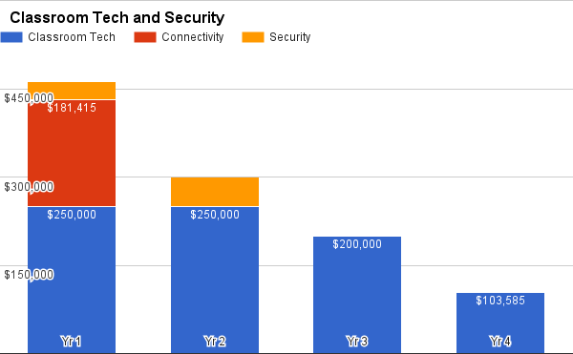
4 - Year Distribution

Slide 14
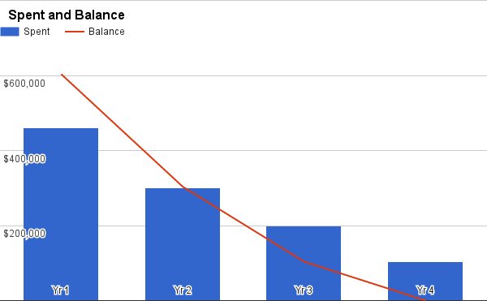
4 - Year Distribution

Slide 15
Several Caveats
Non-Public Schools:
King - $33,500
Ambleside - $2,000
Professional Development excluded
Like Excel Aid
All of the dollars shown here may be revised as we continue our planning.

Slide 16
What Happens Next...
The plan must be posted to the Web site for 30 days prior to submission.
Submit to SED; plans are reviewed quarterly.
Await corrections from SED, hopefully minimal!

Slide 17
Why This is Important!
Learning — Engaging and Empowering Learning Through Technology
Teaching — Teaching With Technology
Leadership — Creating a Culture and Conditions for Innovation and Change
Assessment — Measuring for Learning
Infrastructure — Enabling Access and Effective Use

Slide 18
Questions?

