Slide 1
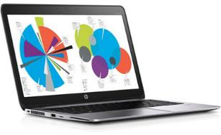
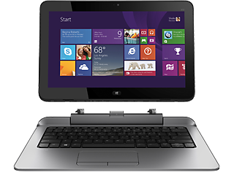
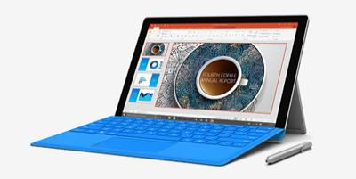
Smart Schools Bond Act
Notes:
This template can be used as a starter file to give updates for project milestones.
Sections
Right-click on a slide to add sections. Sections can help to organize your slides or facilitate collaboration between multiple authors.
Notes
Use the Notes section for delivery notes or to provide additional details for the audience. View these notes in Presentation View during your presentation.
Keep in mind the font size (important for accessibility, visibility, videotaping, and online production)
Coordinated colors
Pay particular attention to the graphs, charts, and text boxes.
Consider that attendees will print in black and white or grayscale. Run a test print to make sure your colors work when printed in pure black and white and grayscale.
Graphics, tables, and graphs
Keep it simple: If possible, use consistent, non-distracting styles and colors.
Label all graphs and tables.

Slide 2
What is the SMART Schools Bond?
SMART Schools Bond Act was approved in November, 2014
Could be used for:
School Connectivity - Connect school buildings to high speed broadband
Community Connectivity - Expand learning outside of the school day and building
Learning Technology (or Devices) - Acquire learning technology equipment or devices
Pre-Kindergarten Classrooms - Construct, enhance or modernize education facilities
Replacing Transportable Classrooms - Expand or construct permanent instructional space to replace transportable classroom units
High-Tech Security - Install high-tech security features in school buildings and on school campuses

Slide 3
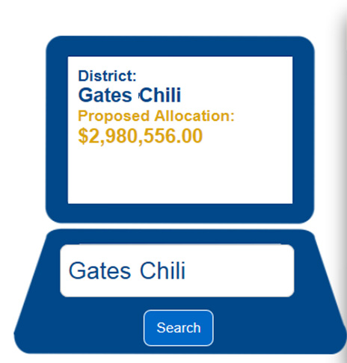
Gates Chili Allocation

Slide 4
Steps to Procuring SMART Bond Funding
Technology Plan Completed
Summer 2015
Ed Tech Survey Submitted
August 2015
SMART School Investment Plan submitted November 2015
Purchase devices/Receive reimbursement
Spring 2016-Spring 2020
Public comment and stakeholder feedback

Slide 5
Year | Purchases | Rationale | Approximate Cost
2015-2016 | Grade 5 – Device carts for each classroom | Self contained – singular group to work with | 14 carts @ 2000 = 28,000 300 @ 500 = 150,000
 | Device carts for Elementary Libraries | Can be teaching skills needed | 4 carts @ 2000 = 8,000 (30 *4) @ 500 = 60,000
 | Laptops for all teachers | Need to be mobile | 401 * 800 = 320,800
 | Device carts for MS/HS teachers that attend PD sessions (18) | More Devices in MS/HS | 18 carts @ 2000 = 36,000 (30*18) @ 500 = 270,000
 |  | Non-Public Students 739 * $250 | 184,750
 |  |  | 2015-2016 Total: $1,057,550
2016-2017 | Grade 4 and Grade 6 – Device carts for each classroom | Gr 6 still somewhat self contained – Gr 6 students will have had them in Gr 5 | 26 carts @ 2000 = 52,000 600 @ 500 = 300,000
 | Device carts for MS/HS teachers that attend PD sessions (18) | More Devices in MS/HS | 18 carts @ 2000 = 36,000 (30*18) @ 500 = 270,000
 |  |  | 2016-2017 Total: $658,000
2017-2018 | Grade 3 and Grade 7/8 – Device carts for classrooms | 20 MS teachers will already have carts from above | ~10 MS – 10 carts @ 2000 = 20,000 Gr 3 13 carts @ 2,000 = 20,000 600 @ 500 = 300,000
 | Device carts for HS teachers that attend PD sessions (8) | Third year – should have a good sense of how devices are being used | 8 carts @ 2000 = 16,000 (30*8) @ 500 = 120,000
 |  |  | 2017-2018 Total: $476,000
2018-2019 | Grade 1 and Grade 2 - Device carts | Might not need 1:1 – needs to be evaluated | 26 carts @ 2000 = 52,000 600 @ 500 = 300,000
 | Device carts for HS teachers that attend PD sessions (8) | Fourth year – evaluate need | 8 carts @ 2000 = 16,000 (30*8) @ 500 = 120,000
 |  |  | 2018-2019 Total: $488,000
2019-2020 | Students entering Grade 9 receive device to keep for 4 years | These students have had access since Grade 5 | 300@ 500 = 150,000
 | Kindergarten – Device carts for classrooms | 1:1 or stations? | 13 carts @ 2000 = 26,000 250 @ 500 = 125,000
 | NOTE: Since we have SMART Bond money for these 5 years, we should “bank” ~ $100,000 per year from technology budget for special purchases. |  | 2019-2020 Total: $301,000 GRAND TOTAL: $2,980,550

Slide 6
Year | Purchases | Rationale | Approximate Cost
2020-2021 | Replace Grade 5 Devices | Self contained – singular group to work with | 300 @ 500 = 150,000
 | Replace devices in Elementary Libraries | Can be teaching skills needed | (30 *4) @ 500 = 60,000
 | Grade 9 receives devices | Grade 9 students will keep the device for 4 years | 300 @ 500 = 150,000
 |  |  | 2020-2021 Total: $360,000
2020-2021 special purchase | *** Replacement Laptops for all teachers ***** | This is a big recurring replacement cost. Should utilize savings from previous years | 401 * 800 = 320,800 – from savings – not included in yearly budget
 |  |  | Special Purchase: $320,800
2021-2022 | Replace devices in Grade 4 and Grade 6 | Gr 6 still somewhat self contained – Gr 6 students will have had them in Gr 5 | 600 @ 500 = 300,000
 | Grade 9 receives devices |  | 300 @ 500 = 150,000
 |  |  | 2021-2022 Total: $450,000
2022-2023 | Replace devices in Grade 3 and Grade 7/8 |  | 600 @ 500 = 300,000
 | Grade 9 receives devices |  | 300 @ 500 = 150,000
 |  |  | 2022-2023 Total: $450,000
2023-2024 | Replace Grade 1 and Grade 2 devices | Might not need 1:1 – needs to be evaluated | 600 @ 500 = 300,000
 | Grade 9 receives devices |  | 300 @ 500 = 150,000
 |  |  | 2023-2024 Total: $450,000
2024-2025 | Students entering Grade 9 receive device | Will keep for four years | 300@ 500 = 150,000
 | Replace Kindergarten devices | 1:1 or stations? | 300 @ 500 = 150,000
 | May want to replace ½ teacher devices if possible…… |  | 2024-2025 Total: $300,000
NOTE: Current Technology Budget is $590,000. This purchase plan does not include upgrades to the servers, switches, wireless access points, SMART Board repairs, replacements of labs, staff or administrative devices, etc. Recommendation is that for the 5 years we are using the SMART Bond money, we “bank” some of the Technology Budget into our new reserve to be used as needed in the future.

Slide 7
While we wait for State Ed approval…..
We will take advantage of the time to
Offer Professional Development
Develop and communicate scope and sequence of technology skills
Develop and communicate policies and presentations regarding use of student email and Office 365
Notes:
What is the project about?
Define the goal of this project
Is it similar to projects in the past or is it a new effort?
Define the scope of this project
Is it an independent project or is it related to other projects?
* Note that this slide is not necessary for weekly status meetings

