Slide 1
Huntington UFSD Preliminary Smart Schools Investment Plan (SSIP)
May 9, 2016

Slide 2
WHAT IS THE SMART SCHOOLS BOND ACT?
Proposal by Gov. Cuomo to fund technology and expand Pre-K throughout the state
Voted on and passed in November 2014
Huntington UFSD can apply for $1,407,121.00

Slide 3
Purpose
Acquire learning equipment for facilities, i.e. Interactive Whiteboards, projection systems, devices
Infrastructure upgrades, i.e. wireless, servers, storage, point-point connections, community connectivity
Construct, enhance modernize facilities to accommodate Pre-K programs
Install high-tech security features in school buildings, video surveillance, door access controls

Slide 4
Requirement to attain funding
Submit three year district technology plan to the state
Form a committee of stake-holders to create/review a preliminary plan
Preliminary Smart Schools Investment Plan – Public Hearing
Post Preliminary SSIP on the school website for 30 days for days for community comments
Make adjustments to the plan if needed
Post the final SSIP on the district website
Submit the SSIP to NYSED for approval.

Slide 5
Huntington’s SSIP for Classroom Technology
Purchase Touchscreen Chromebooks for use in grades 3 through 5
Re-distribute Chromebooks from those grades to 2nd, 7th, and HHS
Touchscreen devices will be piloted for use with School4One, eliminating the purchase of math modules in those grades
Purchase tablets for use in grades K-1. Purchase 6 per classroom per year for use as a center in classrooms
Begin to replace our current Smartboards (approximately 265) with LED interactive whiteboards at the rate of 40 each year. LED boards require no projector/bulbs, have better resolution, do not require calibration, and allow multi-touch.

Slide 6
Interactive Whiteboards:
The Huntington Union Free School District continues to advance its efforts in crating a district-wide digital age learning culture along with the implementation of comprehensive technology integration designed to increase student achievement, promote excellence and achieve Cyber Citizenship.
The district has an inventory of 263 Smart projectors/Smart boards throughout its schools. There are 46 Smart Boards that exceed 5 years in age and another 78 that are between 4 and 5 years old. The LEP interactive white boards are a long term investment with a life expectancy of approximately 14 years.
Advantages of moving to LED interactive whiteboards
Longer life expectancy
No bulbs
No calibration issues
Multi-touch features allow multiple students to interact at one time.
Higher resolution
Touchscreen Chromebooks
The district has been pro-active in rolling out tablet devices and piloting them to see which is the most cost-effective tool to assist our students in gaining a 21st century education. Touchscreen Chromebooks are inexpensive and give students the opportunity to combine the best features of tablets with the best features of small computers. In particular, students will be able to demonstrate their understanding of math by drawing diagrams and pictures to enhance their thinking using the touchscreen, as well as using interactive games and calculators.
Tablets
Teachers in grades K and 1 will use tablets to reinforce learning that is taking place in their classrooms. Apps on tablets will be available for use as a center activity to support curriculum.
HUFSD completed infra-structure upgrades in 2014-15 so the district is close to meeting the minimum speed of 100 Mbps per 1,000 students required by the Federal Communications Commission. We are currently at 400 Mbps and we have approximately 4500 students.

Slide 7
technology devices will:
Enhance DI and Benefit SWD and ENL Students
Teachers will use software, videos and apps (Read 180, Math 180, Khan Academy, LearnZillion, YouTube, Google Apps for Education (GAFE) and others) and will assign lessons tailored to the needs of students
Expand student learning both inside and outside the classroom
The use of technology (GAFE) will allow collaboration and learning to take place regardless of time and place. Students can collaborate on digital projects, conference with leaders all over the world, and can access information on the world-wide-web.
Close gaps
Digital tools will be used to identify gaps in learning and teachers will use this data to inform instruction.
Teachers will use software, videos and apps to assist students who struggle with specific performance indicators.
Enhance communication with parents and other stakeholders
Teachers will continue to post information on eboards, google sites and the parent-portal portion of our student management system to keep parents, students and the community informed about progress and happening in the school community.

Slide 8
the Smart Schools Investment plan:
Facilitates technology-based regional partnerships/distance learning
Huntington has Virtual Advanced Placement classes currently and will expand these as interest and technology grows.
Our AHSEP program uses Odysseyware, another virtual learning platform
Virtual remedial courses have been created by our RTI Math and Reading professionals to alleviate the summer slide.
Our school participates in an assessment consortium, where teachers from participating districts create questions aligned to standards and are placed in an item bank, which is then able to be accessed by all parties.
Shows that the district is committed to providing professional development in integrating technology into the classroom.
Teachers hold collegial circles in which best practices are shared
Two staff-developers work part-time providing assistance to teachers both during the school day and after-school.
Huntington is committed to providing St. Patrick’s School with a portion of funds (see the budget projections)
Sustainability: Huntington is committed to using district funds to continue to upgrade infrastructure and to replacing older, obsolete devices. When previous projects are examined, it shows Huntington’s commitment to technology and providing a 21st Century learning experience for students.

Slide 9
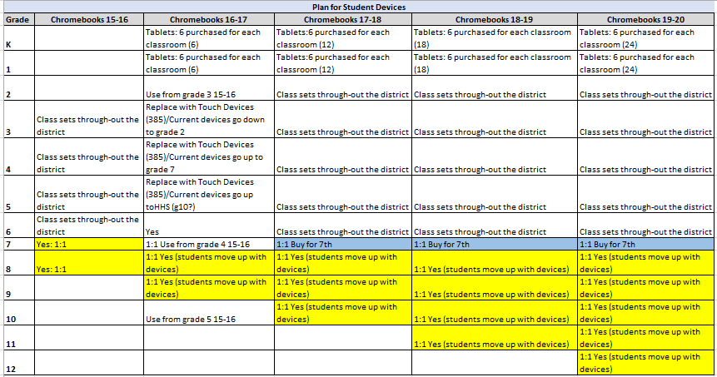

Slide 10
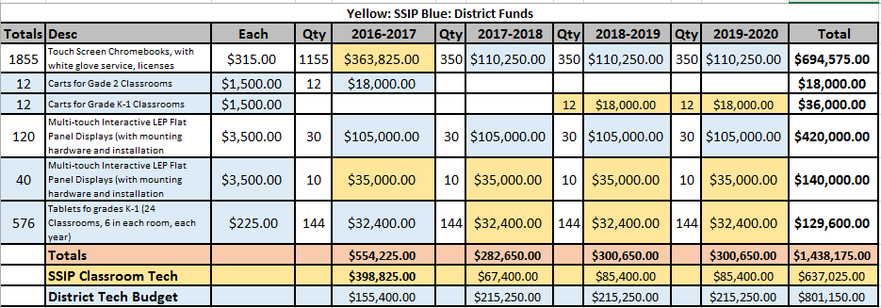
YELLOW: SSBA Funds will pay. Light Blue: General Fund
St. Patrick’s Allocation: $48, 396
St. Patrick’s will submit their classroom technology requests to the district by 5/16/2016 for inclusion in Phase 1.
St. Patrick’s request has been received: 211 Chromebooks, totaling $48,319

Slide 11
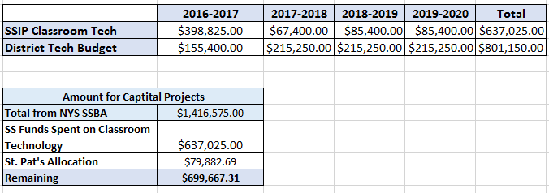
Summary of Proposed Expenditures

Slide 12
Future plans for Smart Schools Investment
Wireless Connectivity
Access Points
High Speed Broad Band
Security
Wiring upgrade at JA
Video broad cast system
Others as needed
Questions or Comments? Please contact Kathleen Acker or Marybeth Robinette
kacker@hufsd.edu 631-673-2111
mrobinette@hufsd.edu 631-673-2077

