Slide 1
Smart Schools Bond Act Investment Plan Submission Information and Review Process
Presentation to Regional Partners
Hosted By: Capital Region BOCES
October 27, 2015
http://www.p12.nysed.gov/mgtserv/smart_schools/

Slide 2
The Smart Schools Investment Plan (SSIP) District Process
District Posts Preliminary Plan 30 Days
District Prepares Final Plan
Final Plan Board Approval
District Submits Final Plan
District Consults w/Stakeholders and Prepares Preliminary Plan
Preliminary Plan Board Approval
Public Notice and Hearing
[START]

Slide 3
The Smart Schools Investment Plan (SSIP) Approval Process
SED Staff Review and Approve Plan
SSBA Review Board Review and Approve Plan
District Begins Project(s)
District Submits Reimbursement Request(s)
SED/State Reimburses District
District Submits Final Plan
[START]

Slide 4
Preliminary Steps to Prepare the SSIP
Submit to the SED Office of Educational Design and Technology the required annual 3-Year Educational Technology Survey that defines the near-term goals of the District. It must be approved by SED for districts that include educational technology purchases on their SSIP.
Should be used as a reference for completing the SSIP’s category-specific questions. Investments shown as financed with SSBA funds in the Educational Technology Survey should be included in the SSIP.
Conduct a planning process that includes all stakeholders, including non-public schools, and provide the required 30-day comment period.
Contact the SED Office of Facilities Planning for initial review of any capital projects or components. The Office will also determine whether certain minor projects can receive an expedited SSBA review. The Office must issue a project number for each building before submitting the SSIP
http://www.p12.nysed.gov/mgtserv/smart_schools/

Slide 5
Smart Schools Bond Act Investment Plan Office of Facilities Planning Process
http://www.p12.nysed.gov/mgtserv/smart_schools/

Slide 6
Office of Facilities Planning Review Process
OFP Issues
Project Number
OFP Determines Full Review
OFP Issues Project Number
District Submits
Letter of Intent (LOI)
OFP Reviews
OFP Determines Streamlined
District Submits SSIP
[START]

Slide 7
Smart Schools Bond Act Office of Facilities Planning Letter of Intent (LOI)
For capital projects using Smart School Bond Act funding
For determining the SSBA eligibility of the Capital Project
For determining if the Project can be streamlined to receive a Building Permit
For determining if the Capital Project requires a full review leading to a Building Permit
A Determination of Need will need to be performed before authorizing districts to apply for Prekindergarten Construction or Renovation or Replacement of Transportable Classroom Units projects in an SSIP

Slide 8
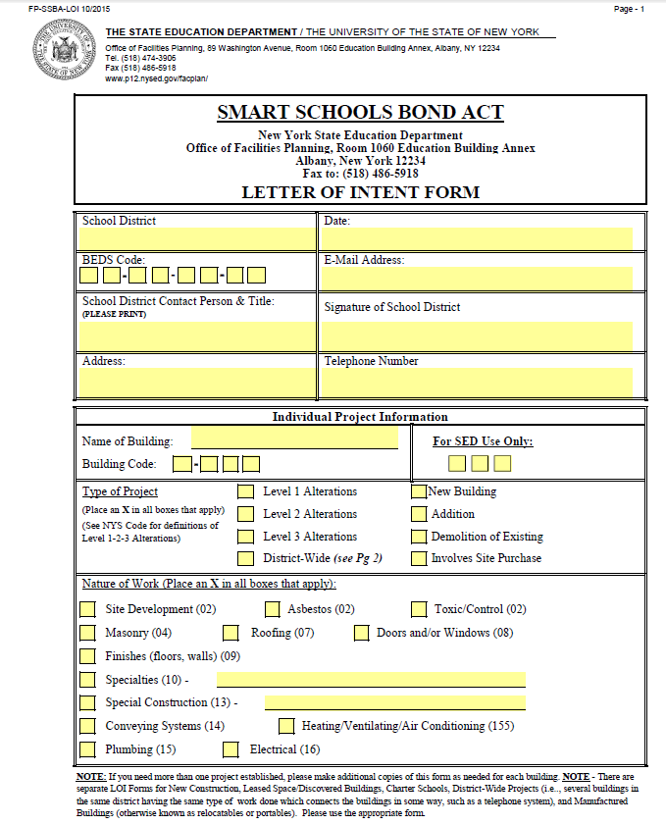
Office of Facilities Planning Letter of Intent

Slide 9
Letter of Intent Scope Information for Preliminary Review

Slide 10
Scope Details to determine if the Project can be Streamlined

Slide 11
Office of Facilities Planning Review Process

Slide 12
Office of Facilities Planning Review Process

Slide 13
Office of Facilities Planning Links and Contacts
Guidance:
http://p1232.nysed.gov/mgtserv/smart_schools/
Letter of Intent and Scope Detail:
http://www.p12.nysed.gov/facplan/SmartSchoolsBondAct.html
Review Process:
http://www.p12.nysed.gov/facplan/documents/ProcessforSSBAReview.pdf
Contact: 518-474-3906

Slide 14
Smart Schools Bond Act Investment Plan Online Investment Plan Process
http://www.p12.nysed.gov/mgtserv/smart_schools/

Slide 15
The Smart Schools Investment Plan, or SSIP, Application is available through the SED Business Portal.
Smart Schools Bond Act
Reviewing the Smart Schools Investment Plan
Once you have been entitled, the application will show up here. When you click on it, you will enter the SED Monitoring System.

Slide 16
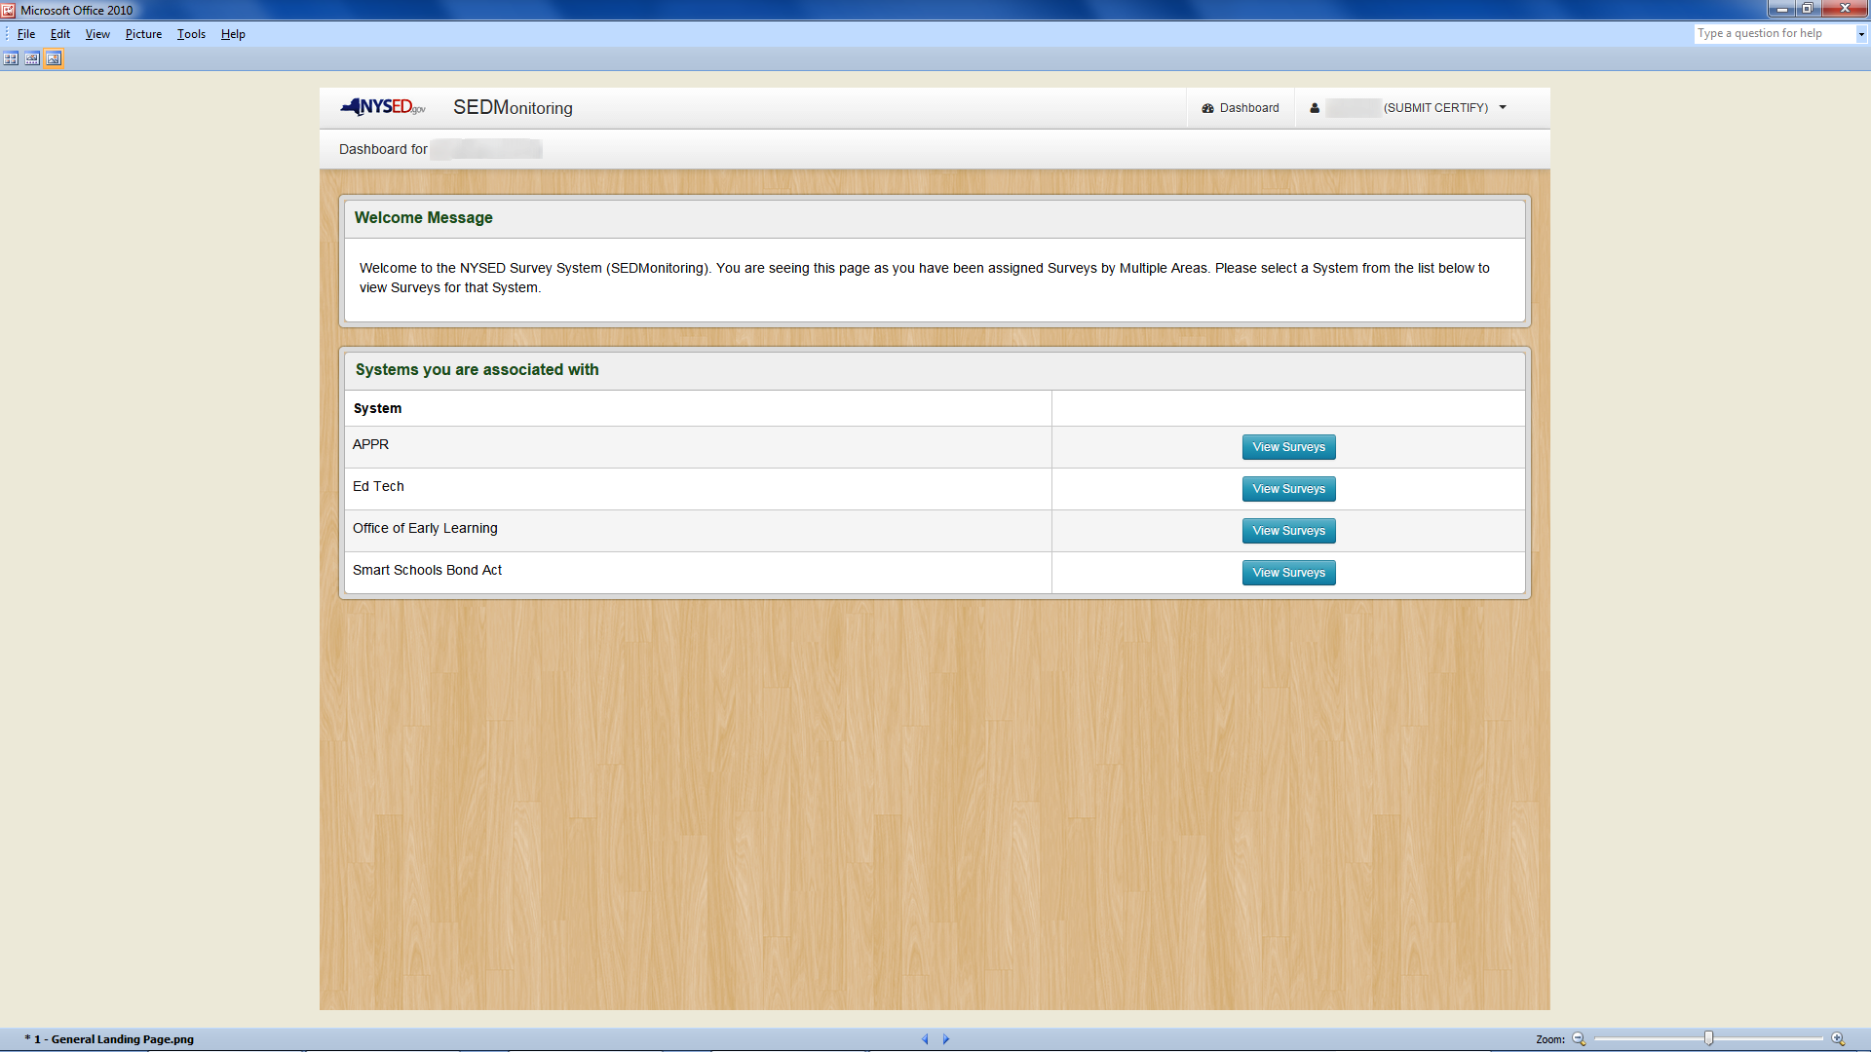
Click on Smart Schools Bond Act “View Surveys”
Notes:
Click On Smart Schools Bond Act “View Surveys” Button.

Slide 17
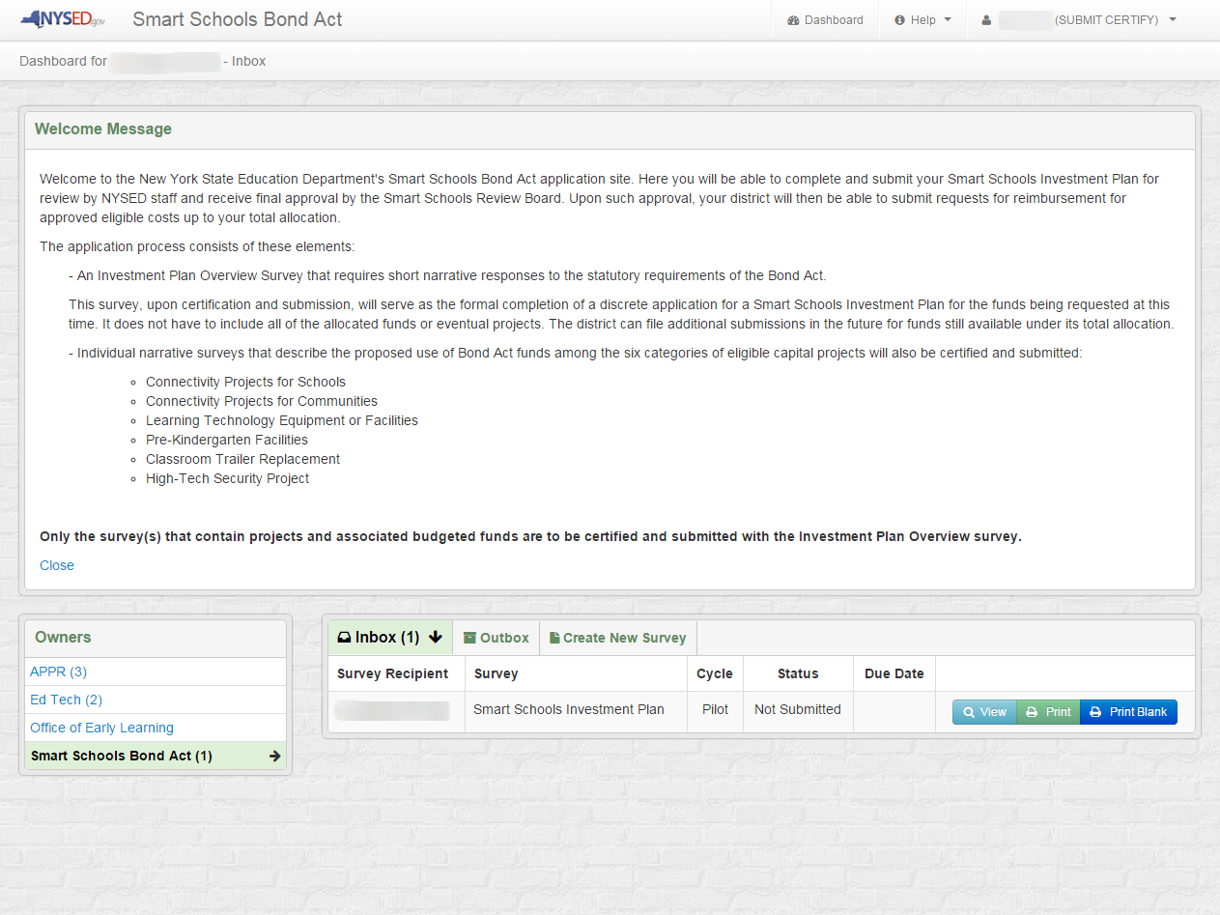
The Inbox is where you see the status of your individual or multiple projects.
Click on the “View” button to enter the application.
Notes:
After Reading The Welcome Message, Please Click On The “View” Button To Start The SSIP Application.

Slide 18
SSIP Overview
The application consists of two basic elements: an Investment Plan Overview and separate pages for each of the allowable project types:
School Connectivity - Connect school buildings to high speed broadband
Community Connectivity - Expand learning outside of the school day and building
Learning Technology (or Devices) - Acquire learning technology equipment or devices
Pre-Kindergarten Classrooms - Construct, enhance or modernize education facilities
Replacing Transportable Classrooms - Expand or construct permanent instructional space to replace transportable classroom units
High-Tech Security - Install high-tech security features in school buildings and on school campuses
Remember: Only project categories with budgeted funds should be submitted.
http://www.p12.nysed.gov/mgtserv/smart_schools/

Slide 19
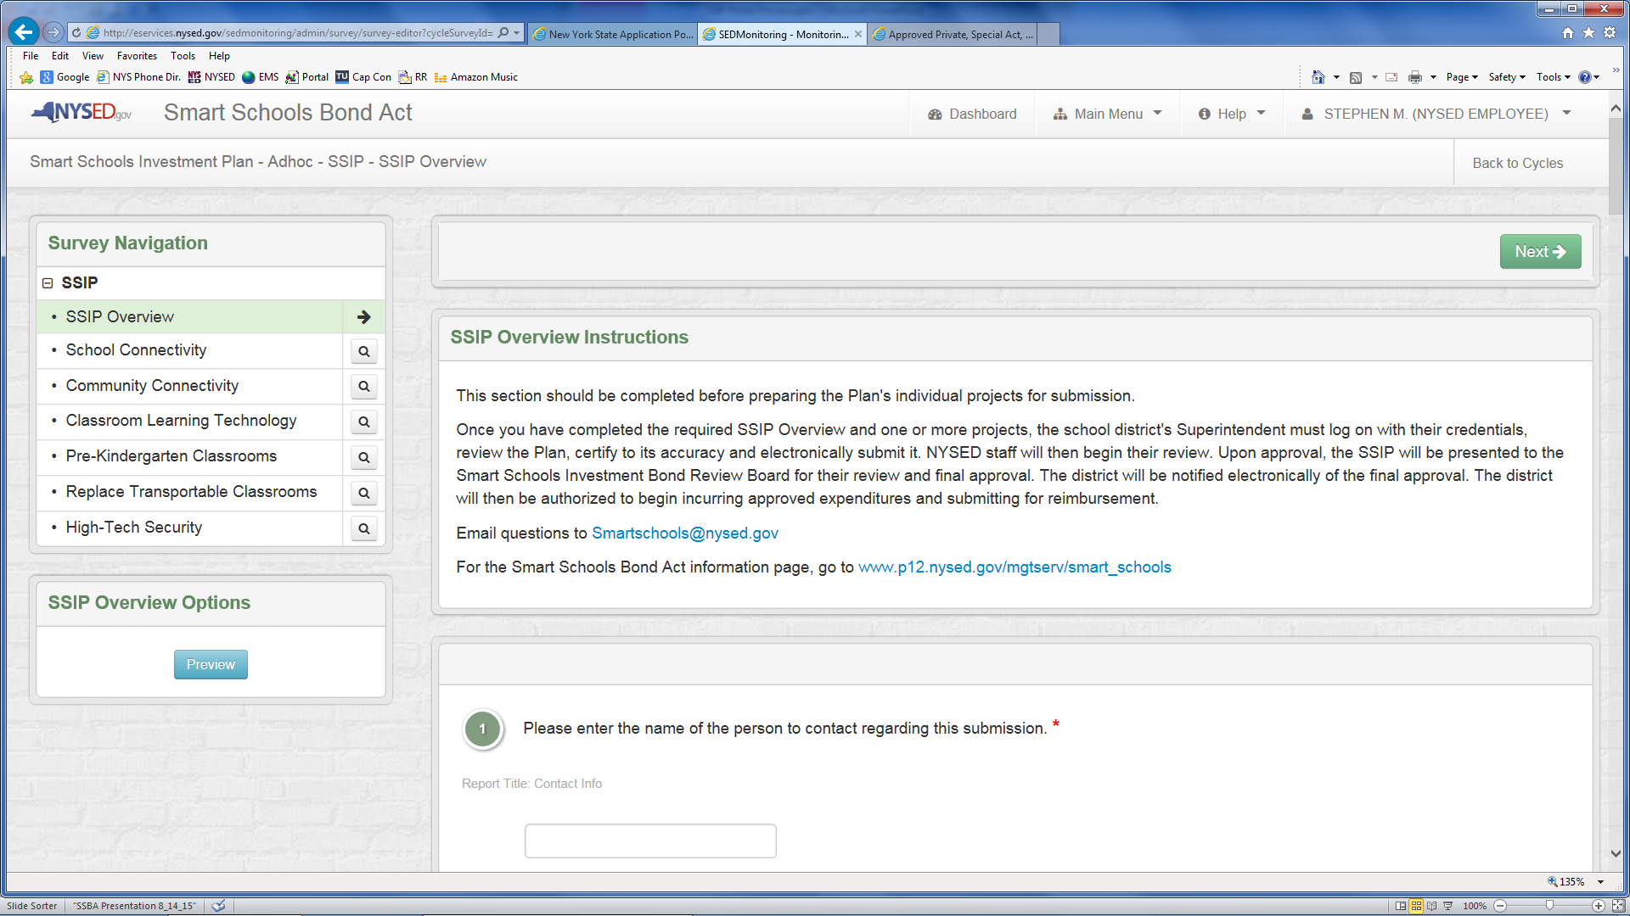
The first page of the Overview asks for basic contact information. All of the Overview questions, except those relating to possible consortia, must be answered or you will not be able to submit. Do not submit the Overview until you have completed all of the project areas. Note on the left that you can navigate directly between all of the project pages, as needed. Only make entries or save the category sections you are budgeting for in this submission.
Notes:
After Reading The Welcome Message, Please Click On The “View” Button To Start The SSIP Application.

Slide 20
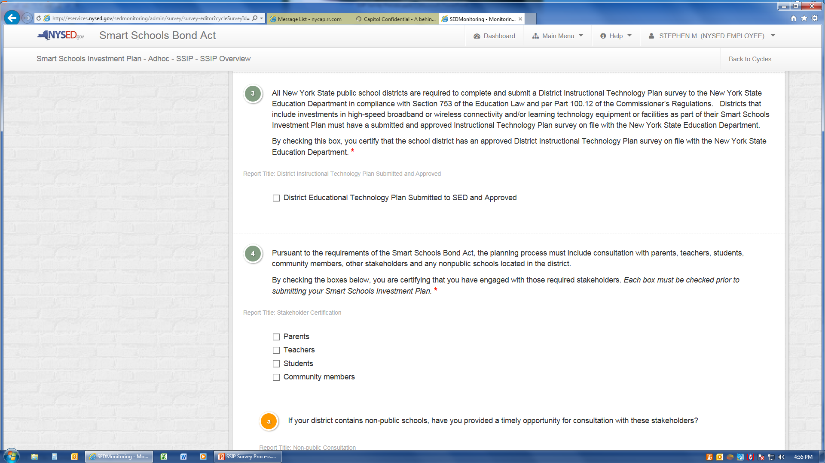
The SSIP Overview requires the district to certify that it has an SED-approved District Educational Technology Plan, that there has been a planning process that includes all stakeholders, including non-public schools, and that specific public notification steps have been completed, including the required 30-day comment period.
Notes:
After Reading The Welcome Message, Please Click On The “View” Button To Start The SSIP Application.

Slide 21
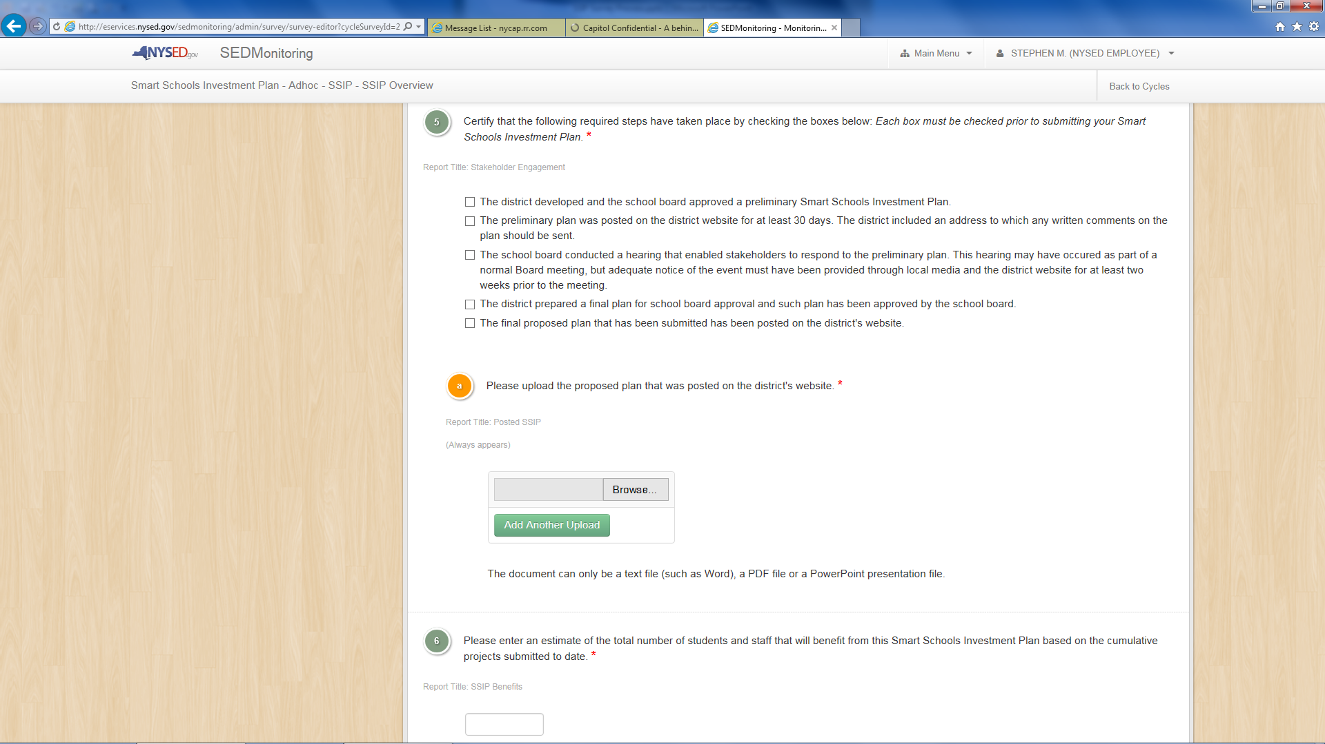
The Smart Schools Bond Act Plan documents will be uploaded here. Do not include the approved Ed Tech Survey.
Districts must also upload the Smart Schools Bond Act Plan documents that were presented to the school board and/or public. These can be a PowerPoint presentation or Word document. Multiple files can be uploaded at once.
Notes:
After Reading The Welcome Message, Please Click On The “View” Button To Start The SSIP Application.

Slide 22
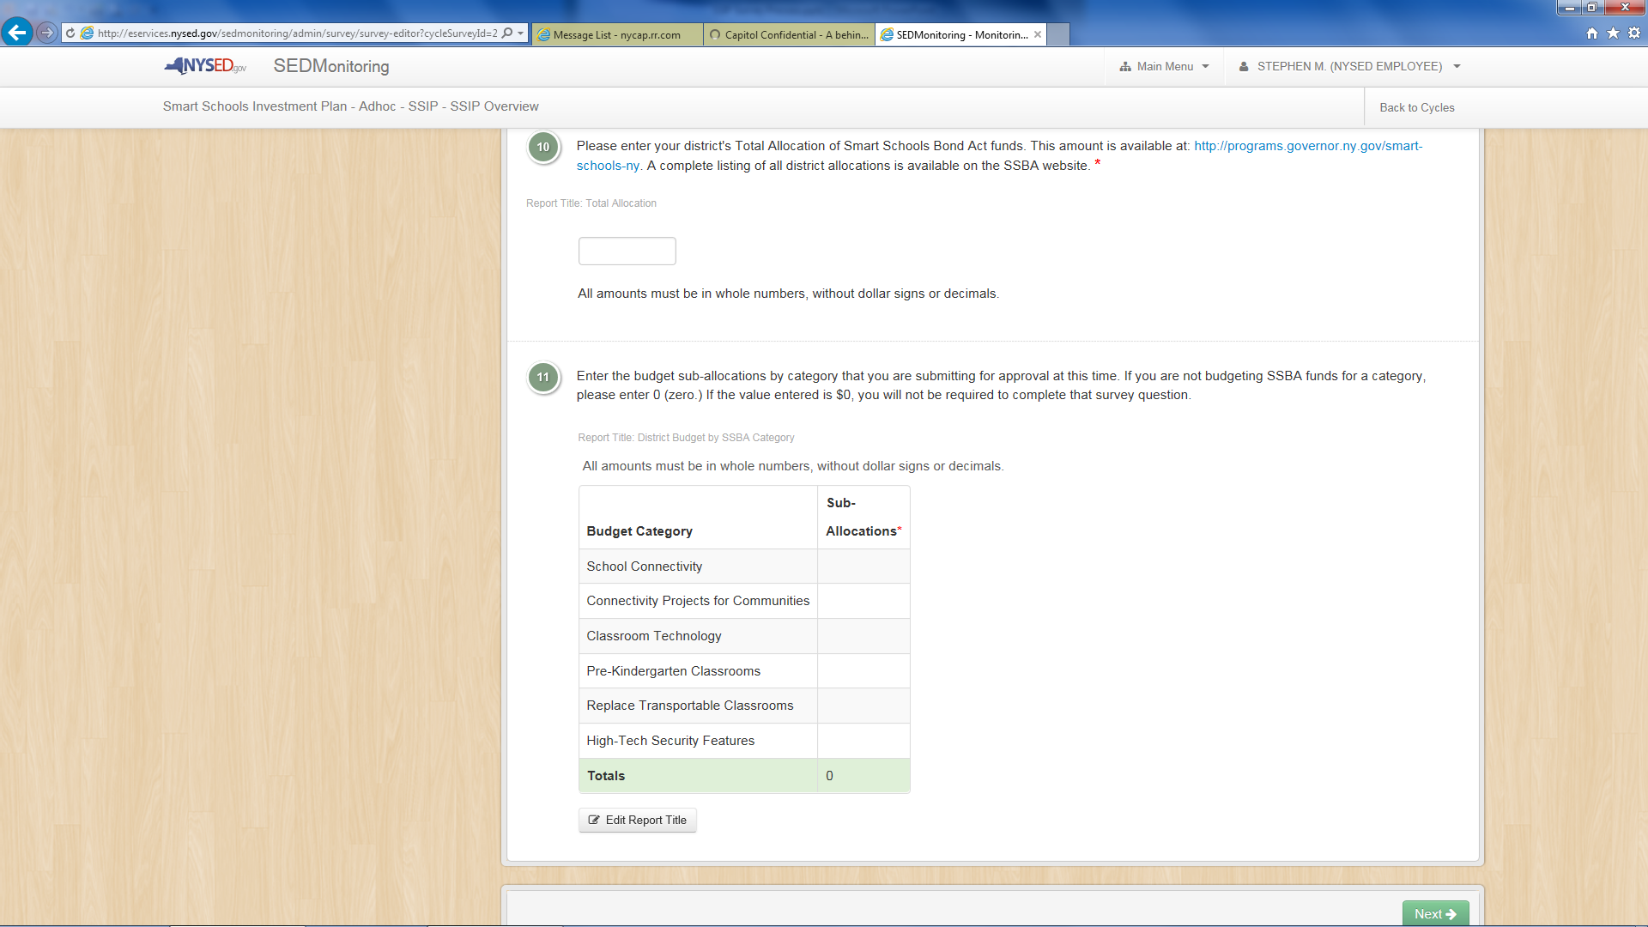
Finally, the SSIP Overview requires a Summary Budget of all of the sub-allocations included in this submission. A number must be entered in each Budget Category to enable the automatic Totals function at the bottom. A zero must be entered for any Category that is not included in the plan submission.
Notes:
After Reading The Welcome Message, Please Click On The “View” Button To Start The SSIP Application.

Slide 23
Smart Schools Bond Act Investment Plan Frequently Asked Questions
http://www.p12.nysed.gov/mgtserv/smart_schools/

Slide 24
Smart Schools Investment Plan
FURTHER QUESTIONS?
Smart Schools Bond Act Website: http://www.p12.nysed.gov/mgtserv/smart_schools/
Smart Schools Bond Act Email Box: smartschools@nysed.gov
SED Office of Educational Management Services
(518) 474-5928

