Slide 1

Smart Schools Bond Act Update
2016 Education Summit & Expo
June 13, 2016
Presenter: Stephen McNally
NYSED Office of Educational Management Services
http://www.p12.nysed.gov/mgtserv/smart_schools/

Slide 2
Smart Schools Bond Act Update
52 districts have approved Smart Schools Investment Plans
>150 districts have submitted and are in various stages of review
Significant effort occurring in SED to identify and verify planned expenditures, which requires consultation and resubmissions
The goal is to anticipate outside questions before Board review and to expedite final approvals
The SSIP has been revised with several structured tables to ease the calculation of connectivity speeds, the classroom technology nonpublic loan obligation and to capture greater expenditure detail required for State capital bonding for reimbursement
http://www.p12.nysed.gov/mgtserv/smart_schools/

Slide 3
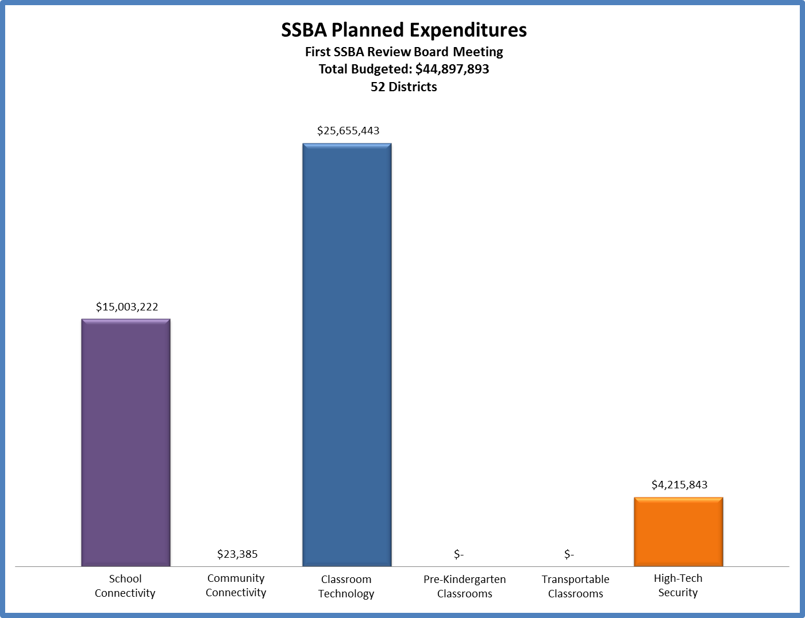
Allocation of Funds in 52 Approved Plans
http://www.p12.nysed.gov/mgtserv/smart_schools/

Slide 4
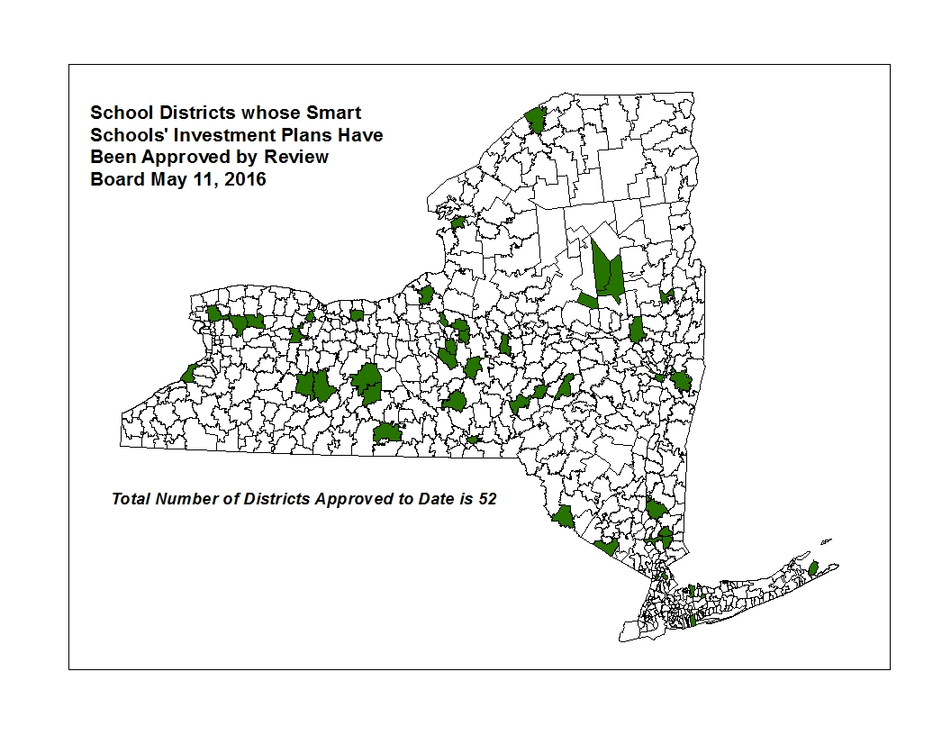
Geographic Distribution of 52 Approved Plans
http://www.p12.nysed.gov/mgtserv/smart_schools/

Slide 5
Allocation of Funds in Submitted Plans Pending Review
http://www.p12.nysed.gov/mgtserv/smart_schools/

Slide 6
The Smart Schools Investment Plan (SSIP) Approval Process
SED Staff Review and Approve Plan
SSBA Review Board Review and Approve Plan
District Begins Project(s)
District Submits Reimbursement Request(s)
SED/State Reimburses District
District Submits Final Plan
[START]

Slide 7
Preliminary Steps to Prepare the SSIP
Submit to the SED Office of Educational Design and Technology the required annual 3-Year Educational Technology Survey that defines the near-term goals of the District. It must be approved by SED for districts that include educational technology purchases on their SSIP.
Conduct a planning process that includes all stakeholders, including non-public schools, and provide the required 30-day comment period.
Contact the SED Office of Facilities Planning for initial review of any capital projects or components. The Office will also determine whether certain minor projects can receive an expedited SSBA review. The Office must issue a project number for each building before submitting the SSIP
http://www.p12.nysed.gov/mgtserv/smart_schools/

Slide 8
Completing the Smart Schools Bond Act
Online Investment Plan (SSIP) Process
http://www.p12.nysed.gov/mgtserv/smart_schools/

Slide 9
SSIP Overview
The application consists of two basic elements: an Investment Plan Overview and separate pages for each of the allowable project types:
School Connectivity - Connect school buildings to high speed broadband
Community Connectivity - Expand learning outside of the school day and building
Learning Technology (or Devices) - Acquire learning technology equipment or devices
Pre-Kindergarten Classrooms - Construct, enhance or modernize education facilities
Replacing Transportable Classrooms - Expand or construct permanent instructional space to replace transportable classroom units
High-Tech Security - Install high-tech security features in school buildings and on school campuses
http://www.p12.nysed.gov/mgtserv/smart_schools/

Slide 10
Changes to the Smart Schools Investment Plan Application
Nonpublic Classroom Technology Requirement Table
School Connectivity and Classroom Technology Speed Calculator
Nonpublic Loan Calculator | 1. Classroom Technology Sub-allocation | 2. Public Enrollment (2014-15) | 3. Nonpublic Enrollment (2014-15) | 4. Sum of Public and Nonpublic Enrollment | 5. Total Per Pupil Sub-allocation | 6. Total Nonpublic Loan Amount
Calculated Nonpublic Loan Amount
Connectivity Speed Calculator | Number of Students | Multiply by 100 Kbps | Divide by 1000 to Convert to Required Speed in Mb | Current Speed in Mb | Expected Speed to be Attained Within 12 Months | Expected Date When Required Speed Will be Met
Calculated Speed
http://www.p12.nysed.gov/mgtserv/smart_schools/

Slide 11
New Expenditure Detail Table
Expenditure Detail Table
Allowable Expenditure Types in Drop-down Box
  Capital-Intensive Security Project: Construction materials/labor, Electrical and HVAC
  Electronic Security System: Cameras, DVRs, VoIP, Storage devices, Installation
  Entry Control System: Card readers, Intercoms, Visitor Sign In/Badging, Installation
  Approved Door Hardening Project: Door/Window replacement, Window security film
  Other: Project Incidentals, Architect Fees, Contingencies and Clerk of the Work Fees
Electronic Security and Entry Control Systems are no longer limited to Main Entrances for streamlined review (in cases that don’t involve other construction or installation of wiring
http://www.p12.nysed.gov/mgtserv/smart_schools/

Slide 12
Common Issues Requiring Revisions and Resubmissions
Documentation of public process and Board adoption not uploaded
Districts that haven’t contacted the Office of Facilities Planning and received an SSBA Project Number based on their SSBA Letter of Intent
  This includes any project under School Connectivity, PreK Classrooms, Replacement of Transportable Classrooms and all High-Tech Security Projects, even streamlined projects
Expenditure table doesn’t provide specific details, such as the specific items purchased, number of items or exact projected cost
The total of expenditures in each category doesn’t equal the budgeted amount in each category
Expenditures that include the cost of ineligible items, such as leased items, professional development, etc.
Incomplete or conflicting answers to required questions
http://www.p12.nysed.gov/mgtserv/smart_schools/

Slide 13
Smart Schools Bond Act Investment Plan
Office of Facilities Planning Process
http://www.p12.nysed.gov/mgtserv/smart_schools/

Slide 14
Smart Schools Bond Act
Office of Facilities Planning
Letter of Intent (LOI)
For capital projects using Smart School Bond Act funding
For determining the SSBA eligibility of the Capital Project
For determining if the Project can be streamlined to receive a Building Permit
For determining if the Capital Project requires a full review leading to a Building Permit
A Determination of Need will need to be performed before authorizing districts to apply for Prekindergarten Construction or Renovation or Replacement of Transportable Classroom Units projects in an SSIP

Slide 15
Office of Facilities Planning Issues
Talk to your Project Manager early and often…….
  For Streamlined Review – Provide sufficient information for us to agree!
  Proper LOI categories for various types of work
  Project numbers – SSBA Specific
  Identify projects as SSBA when permit applications submitted
  Work with your consultants for non-permit work
http://www.p12.nysed.gov/mgtserv/smart_schools/

Slide 16
Smart Schools Bond Act Investment Plan
Expenditure Reimbursement Process
http://www.p12.nysed.gov/mgtserv/smart_schools/

Slide 17
Expenditure Reimbursement Process
Accessed through the same SED Monitoring and Vendor Performance link as the SSIP on the NYSED Business Portal
SSIP Budget information will flow through to the reimbursement system
Districts will tell us specifically what they purchased
Purchases must be consistent with the items detailed in the SSIP
These details will facilitate the sale of the State capital bonds by helping us determine the PPU of the purchases
Keep invoices on file in the event of audit
http://www.p12.nysed.gov/mgtserv/smart_schools/

Slide 18
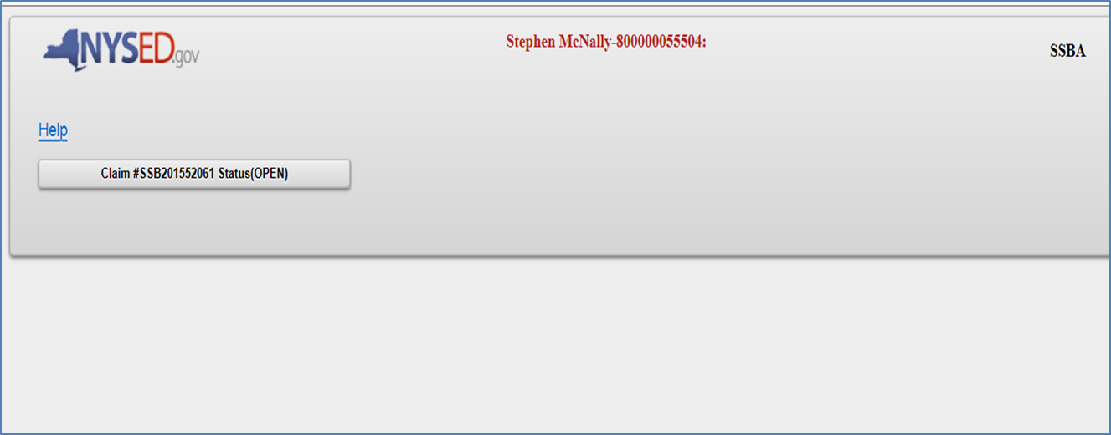
SSBA On-Line Reimbursement Claiming System
All of your district’s previous and current claims should be listed here. Please select the appropriate one.
http://www.p12.nysed.gov/mgtserv/smart_schools/

Slide 19
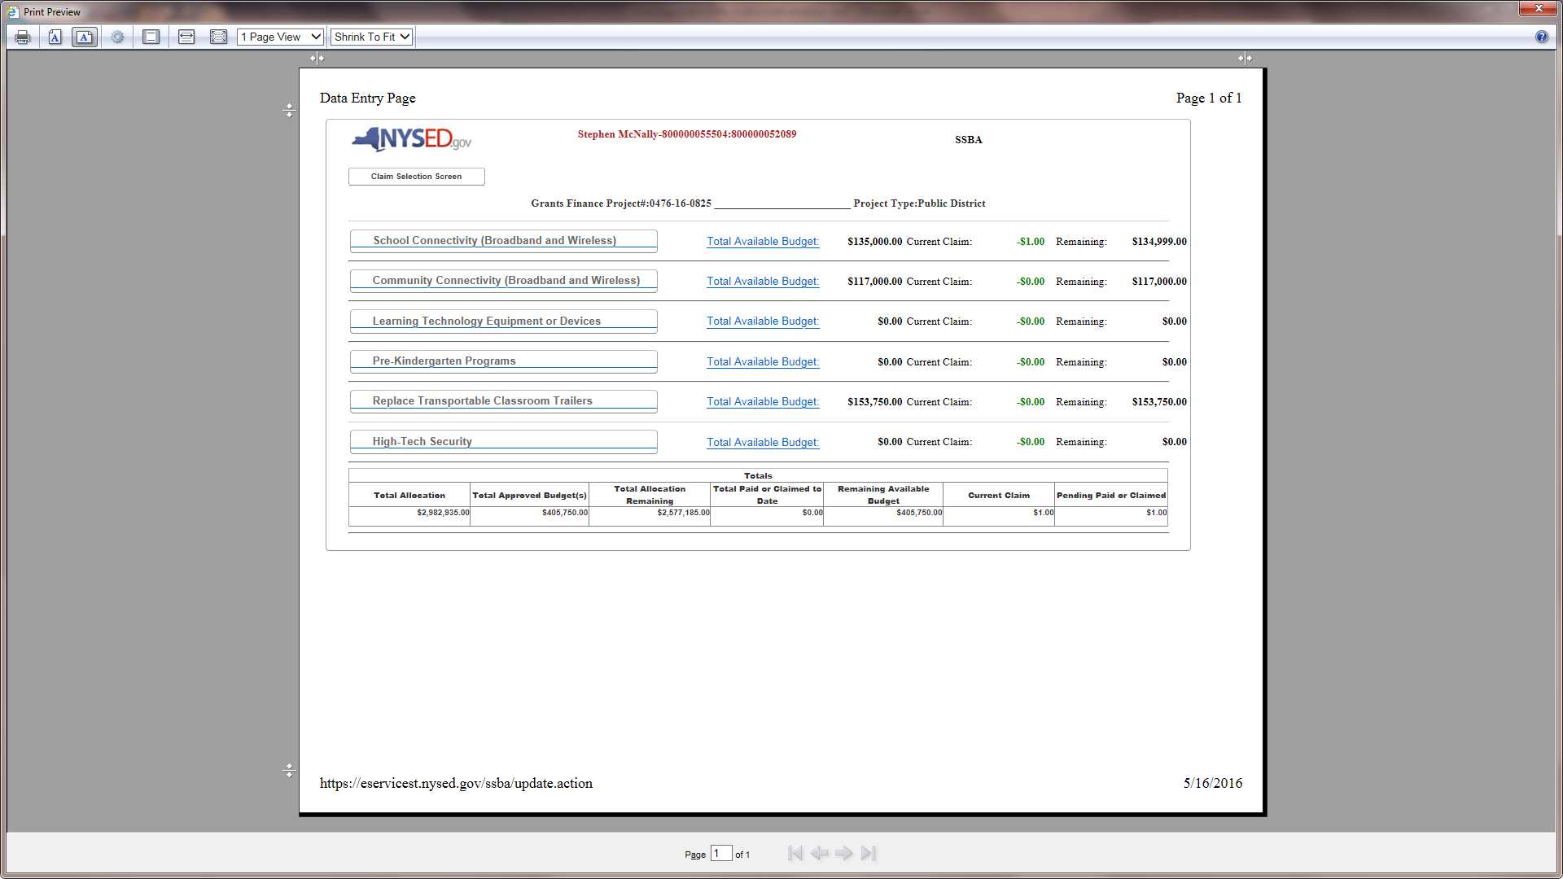
Expenditure Summary Page
District Summary of all Approved Budgets, Claims Paid or to Date and Remaining Allocation to Budget; along with the Current and Pending Claims.
http://www.p12.nysed.gov/mgtserv/smart_schools/

Slide 20
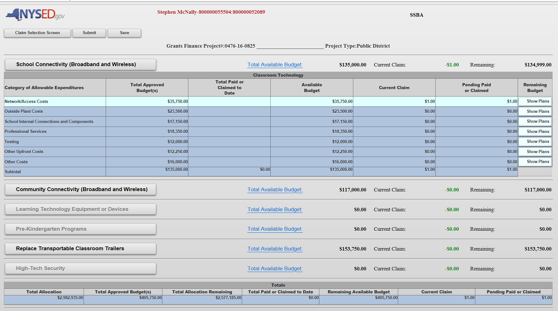
Category Detail Page
Select a Category to file a claim. It will expand to show the allowable expenditures from the SSIP that were allocated funds. It will also show expenditures paid to date, the current claim and any pending claims, along with the remaining approved budget to claim against.
http://www.p12.nysed.gov/mgtserv/smart_schools/

Slide 21
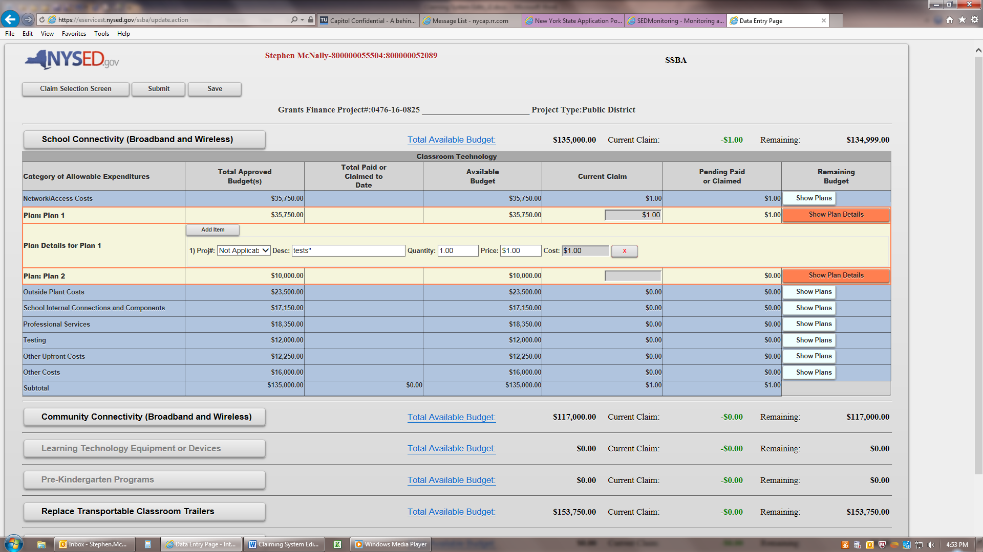
Category Detail Page
Select “Show Plan Details” and the row will expand to allow entry of the actual claim data by item. Click on “Add Item” and then enter a specific description, the quantity and the price per unit. The form will calculate the total cost for that item. Continue adding items.
http://www.p12.nysed.gov/mgtserv/smart_schools/

Slide 22
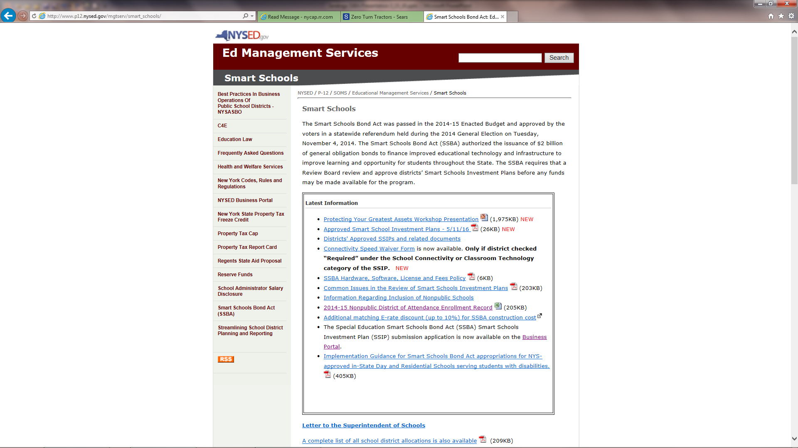
http://www.p12.nysed.gov/mgtserv/smart_schools/

Slide 23
QUESTIONS?
Smart Schools Bond Act Website: http://www.p12.nysed.gov/mgtserv/smart_schools/
Smart Schools Bond Act Email Box: smartschools@nysed.gov
SED Office of Educational Management Services
(518) 474-5928
SED Office of Facilities Planning
(518) 474-3906
http://p1232.nysed.gov/facplan/SmartSchoolsBondAct.html

