Slide 1

Preparing Students
to be
College and Career Ready
Bill Daggett
Founder and Chairman
November 4, 2016

Slide 2
The Nation’s Most Rapidly Improving Schools

Slide 3
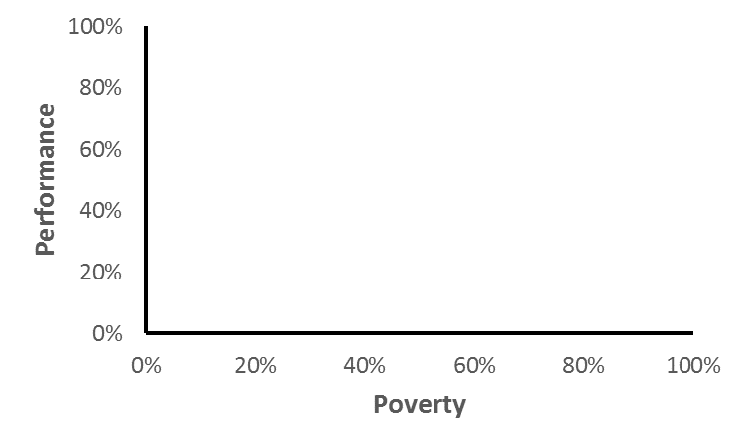
Nation’s Most Rapidly Improving Schools
Source: Publicly available performance and enrollment data

Slide 4
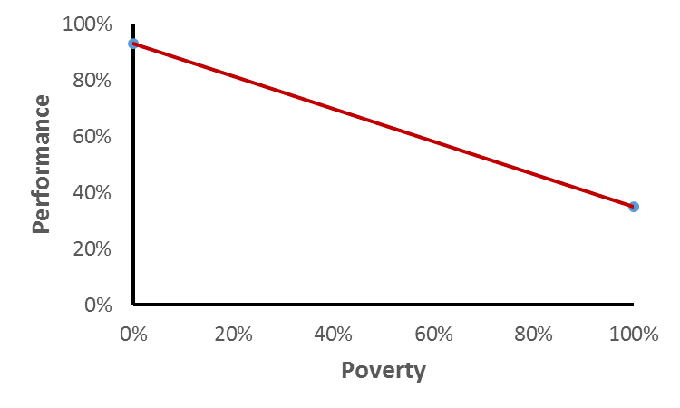
Nation’s Most Rapidly Improving Schools
Source: Publicly available performance and enrollment data

Slide 5
Nation’s Most Rapidly Improving Schools
Source: Publicly available performance and enrollment data

Slide 6
Nation’s Most Rapidly Improving Schools
Source: Publicly available performance and enrollment data

Slide 7
The Nation’s Most Rapidly Improving Schools
Good to Great
High Poverty – High Performing

Slide 8
The Nation’s Most Rapidly Improving Schools
Culture Trumps Strategy

Slide 9
The Nation’s Most Rapidly Improving Schools
Culture Trumps Strategy
College AND Career Ready

Slide 10
WHY

Slide 11
WHY - WHAT

Slide 12
WHY - WHAT - HOW

Slide 13

College and Career Ready
Technology

Slide 14

iPhone

Slide 15
Web 3.0

Slide 16

The Order of Things Have Changed
Uber- The world’s largest taxi company, owns no vehicles
Source: Better and Faster, Jeremy Gutsche

Slide 17
The Order of Things Have Changed
Uber- The world’s largest taxi company, owns no vehicles
Facebook- The world’s most popular media owner, creates no content
Source: Better and Faster, Jeremy Gutsche

Slide 18
The Order of Things Have Changed
Uber- The world’s largest taxi company, owns no vehicles
Facebook- The world’s most popular media owner, creates no content
Alibaba- The world’s most valuable retailer, has no merchandise
Source: Better and Faster, Jeremy Gutsche

Slide 19
The Order of Things Have Changed
Uber- The world’s largest taxi company, owns no vehicles
Facebook- The world’s most popular media owner, creates no content
Alibaba- The world’s most valuable retailer, has no merchandise
Airbnb- The world’s largest accommodation provider, owns no real estate
Source: Better and Faster, Jeremy Gutsche

Slide 20
College and Career Ready
Technology
Work

Slide 21
Job Shares by Skill Group
1980 - 2040
33.4%
10.2%
31.3%
25.1%
Source: NY Fed Calculations, U.S. Census Bureau

Slide 22
Lost Jobs

Slide 23
Lost Jobs
Telemarketers
99%
Source: McKinsey Quarterly 2016 Number 1

Slide 24
Lost Jobs
Telemarketers
99%
Secretarial / Administrative Assistants
Accountants / Auditors
94%
Source: McKinsey Quarterly 2016 Number 1

Slide 25
Lost Jobs
Telemarketers
99%
Accountants / Auditors
94%
Machinists
65%
Economists
Source: McKinsey Quarterly 2016 Number 1

Slide 26
Lost Jobs
Telemarketers
99%
Accountants / Auditors
94%
Machinists
65%
Economists
43%
Source: McKinsey Quarterly 2016 Number 1

Slide 27
U.S. Job Creation by Decades
32%
27%
20%
20%
7%
0%

Slide 28
Workplace
Technology
Large Bureaucratic
to
Smaller Entrepreneurial

Slide 29
College and Career Ready
Technology
Work
Higher Education

Slide 30
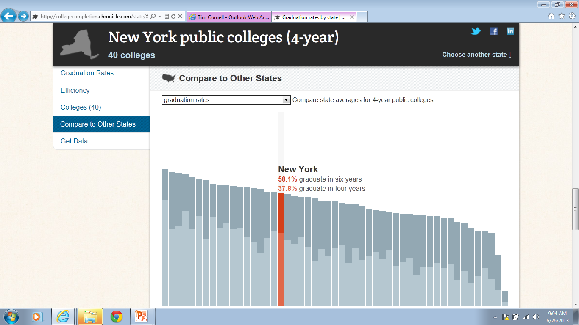
New York Four-Year
Public College
37.8%

Slide 31
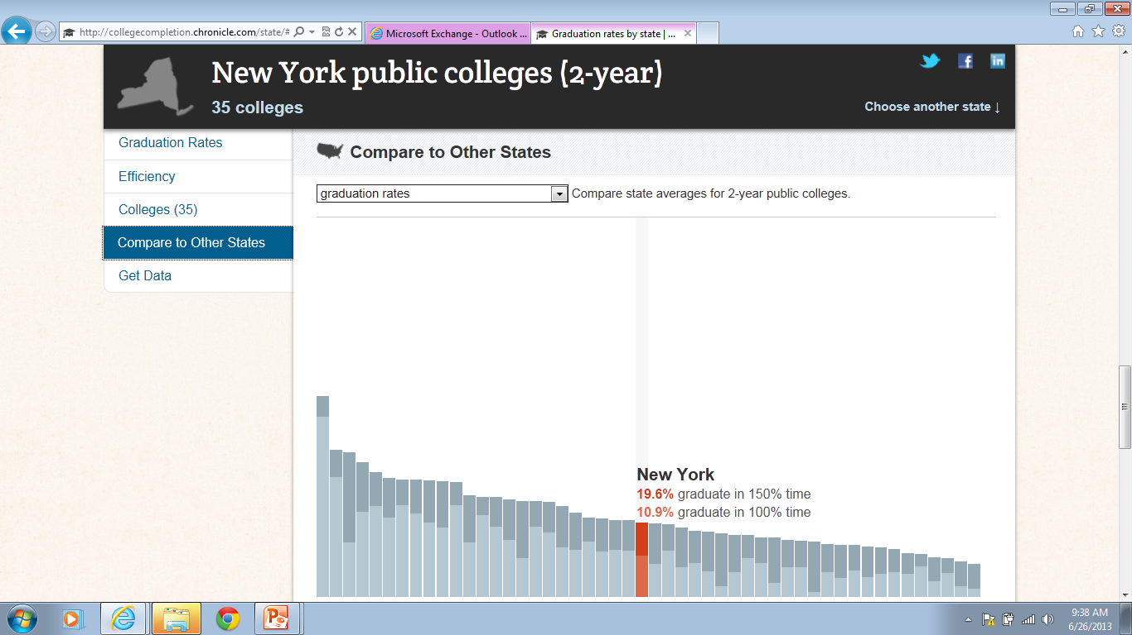
New York Two-Year
Public College
10.9%

Slide 32

College Dropout Rate 2015
First to Second Year
34.8%
Four-Year Colleges
44.5%
Two-Year Colleges
Source: http://www.air.org/sites/default/files/downloads/report/AIR-CALDER-
Understanding-the-College-Dropout-Population-Jan14.pdf

Slide 33
Average Graduation Rate 2015
1983 - 2015
36.6%
Four-Year Colleges in 5 years
29.1%
Two-Year Colleges in 3 years
Source: http://www.air.org/sites/default/files/downloads/report/AIR-CALDER-
Understanding-the-College-Dropout-Population-Jan14.pdf

Slide 34
2-Year College Graduates
OCCUPATION | STARTING | AVERAGE
Management Info Systems | $45,100 | $72,100
Electrical and Chemical Engineers | $45,100 | $69,800
Occ. Health and Safety | $50,300 | $68,200
Diagnostic Medical Specialist | $50,200 | $66,800
Computer Programmer | $42,300 | $65,300
Payscale.com

Slide 35
4-Year College Graduates
OCCUPATION | STARTING | AVERAGE
Human Development | $35,900 | $48,000
Athletic Trainer | $34,800 | $46,900
Social Worker | $33,000 | $46,600
Recreation and Leisure | $32,200 | $45,300
Child and Family Studies | $30,300 | $37,200
Payscale.com

Slide 36
4-Year College Graduates
OCCUPATION | STARTING | AVERAGE
Petroleum Engineer | $103,000 | $160,000
Actuarial Math | $58,700 | $120,000
Nuclear Engineer | $67,600 | $117,000
Chemical Engineer | $68,200 | $117,000
Aerospace Engineer | $62,800 | $109,000
Payscale.com

Slide 37
WHAT

Slide 38

Application Model
1. Knowledge in one discipline
2. Application within discipline
3. Application across disciplines
4. Application to real-world predictable
situations
5. Application to real-world unpredictable
situations

Slide 39
Knowledge Taxonomy
Remembering
Understanding
Applying
Analyzing
Evaluating
Creating

Slide 40
Rigor/Relevance Framework
6
C
D
5
4
Rigor
3
A
B
2
1
1
2
3
4
5
Relevance

Slide 41
Levels
6
C
D
5
4
Rigor
3
A
B
2
1
1
2
3
4
5
Relevance

Slide 42
College Ready (College Prep)
6
C
D
5
4
Rigor
3
A
B
2
1
1
2
3
4
5
Relevance

Slide 43
Job Ready (CTE)
6
C
D
5
4
Rigor
3
A
B
2
1
1
2
3
4
5
Relevance

Slide 44
Career Ready
6
C
D
5
4
Rigor
3
A
B
2
1
1
2
3
4
5
Relevance

Slide 45
Levels
6
C
D
5
4
Rigor
3
A
B
2
1
1
2
3
4
5
Relevance

Slide 46
A and C were Needed Pre-Internet
6
C
5
4
Rigor
3
A
2
1
1
2
3
4
5
Relevance

Slide 47
B and D are Required in the Internet Age
6
D
5
4
Rigor
3
B
2
1
1
2
3
4
5
Relevance

Slide 48
Regulated, Certified, Tenured and Contracted
6
C
D
5
4
Rigor
3
A
B
2
1
1
2
3
4
5
Relevance

Slide 49
Seven Interrelated Fundamental Shifts
1
7
2
6
3
5
4
From
A/C to B/D
Non-cognitive
Reading and Writing
Social Media
Data Analytics
Technology Tools
Innovation and Creativity

Slide 50
Seven Interrelated Fundamental Shifts
1
2
From
A/C to B/D
Reading and Writing

Slide 51
Reading Study Summary
Interquartile Ranges Shown (25% - 75%)
1600
1400
1200
Text Lexile Measure (L)
1000
800
600
High
School
Literature
College
Literature
High
School
Textbooks
College
Textbooks
Military
Personal
Use
Entry-Level
Occupations
SAT 1,
ACT,
AP*
Source: National Test Data, MetaMetrics

Slide 52
Reading Study Summary
Interquartile Ranges Shown (25% - 75%)
1600
1400
1200
Text Lexile Measure (L)
1000
800
600
High
School
Literature
College
Literature
High
School
Textbooks
College
Textbooks
Military
Personal
Use
Entry-Level
Occupations
SAT 1,
ACT,
AP*
Source: National Test Data, MetaMetrics

Slide 53
Seven Interrelated Fundamental Shifts
1
2
3
From
A/C to B/D
Reading and Writing
Data Analytics

Slide 54

Data analytics requires you to reduce, refine and manage information.

Slide 55

Data Analytics
Like a Microscope: Examine smaller details than we can quickly observe (your personal shopping habits).
AND
Like a Telescope: See things in large scale showing connections not recognized before (people who buy one product and then buy another).

Slide 56
Data analytics involves examining large data sets from multiple sources to find patterns, correlations and trends.

Slide 57

Data Analytics
Tables
Charts
Graphs

Slide 58
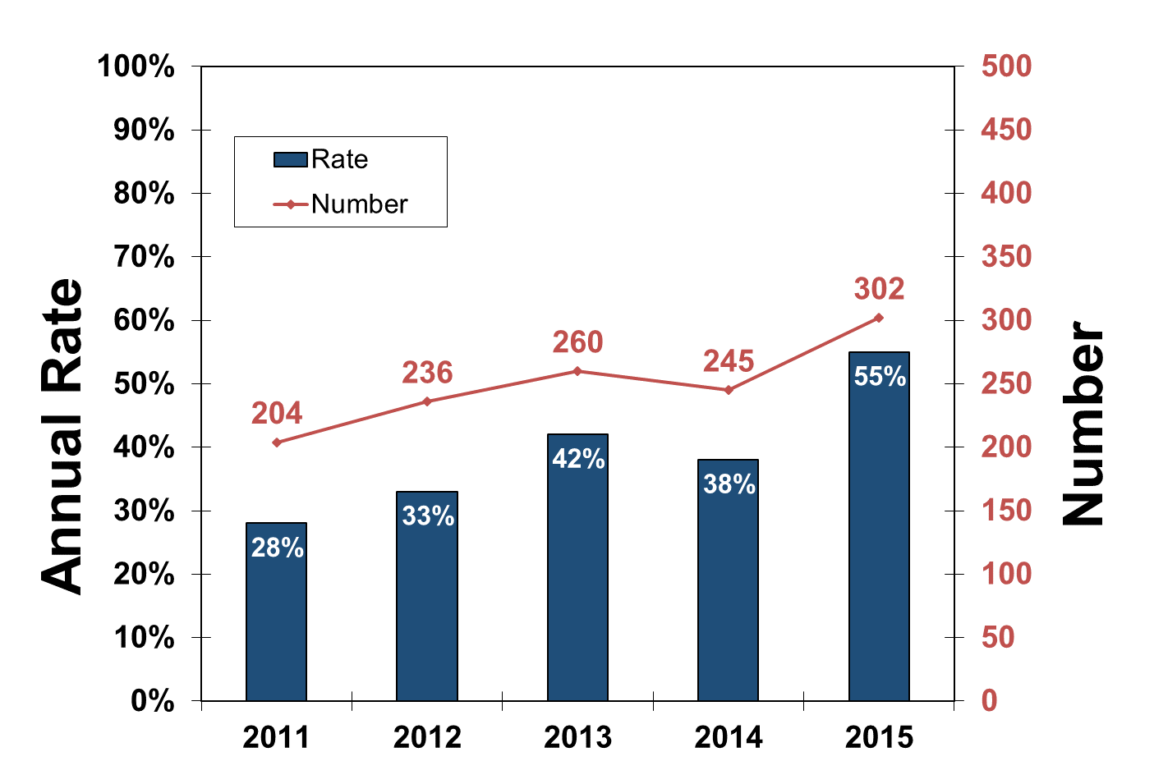
Clustered Column-Line on Secondary Axis

Slide 59
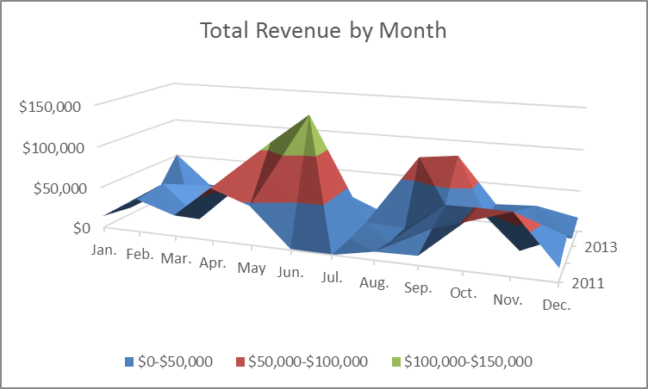
3-D Surface

Slide 60
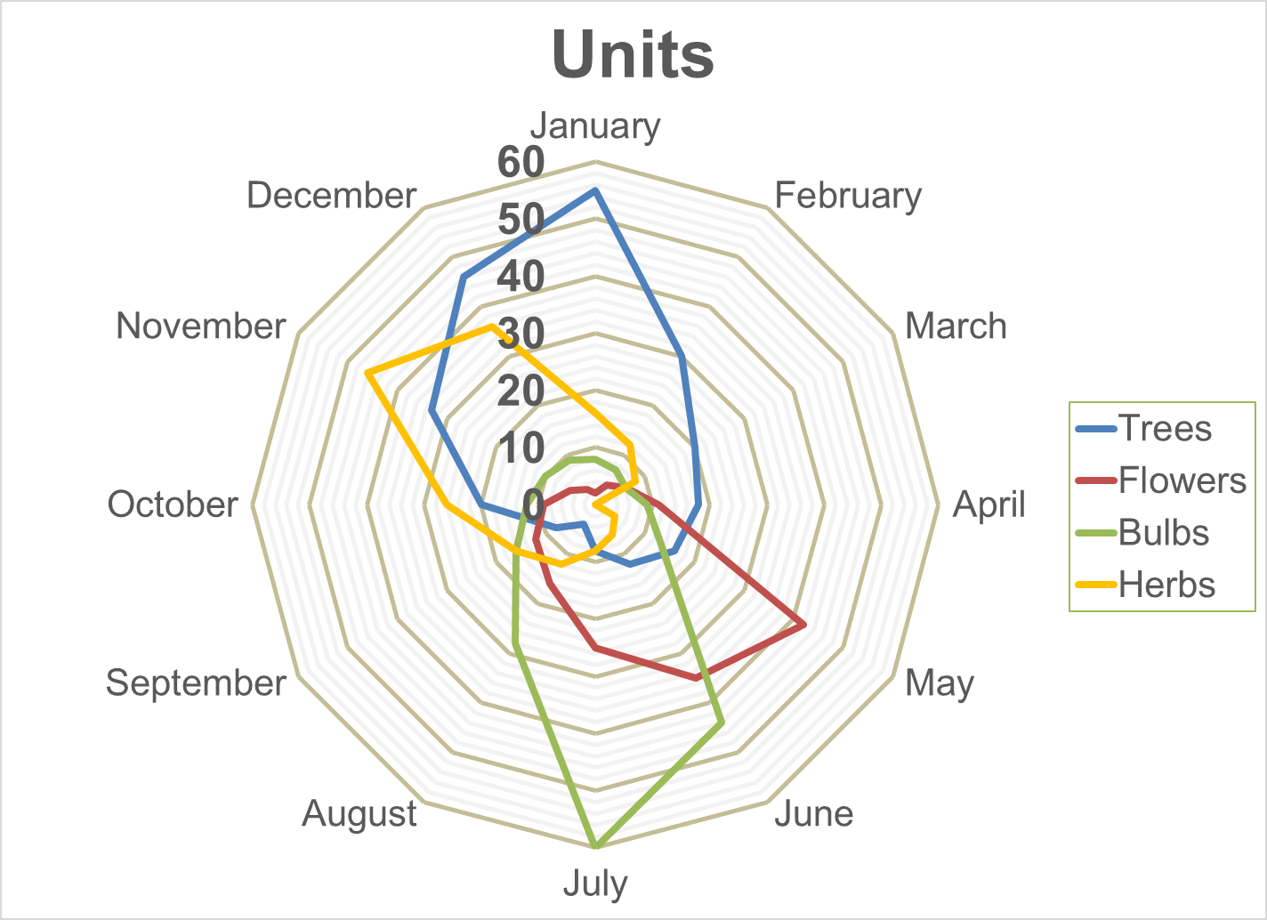
Radar

Slide 61
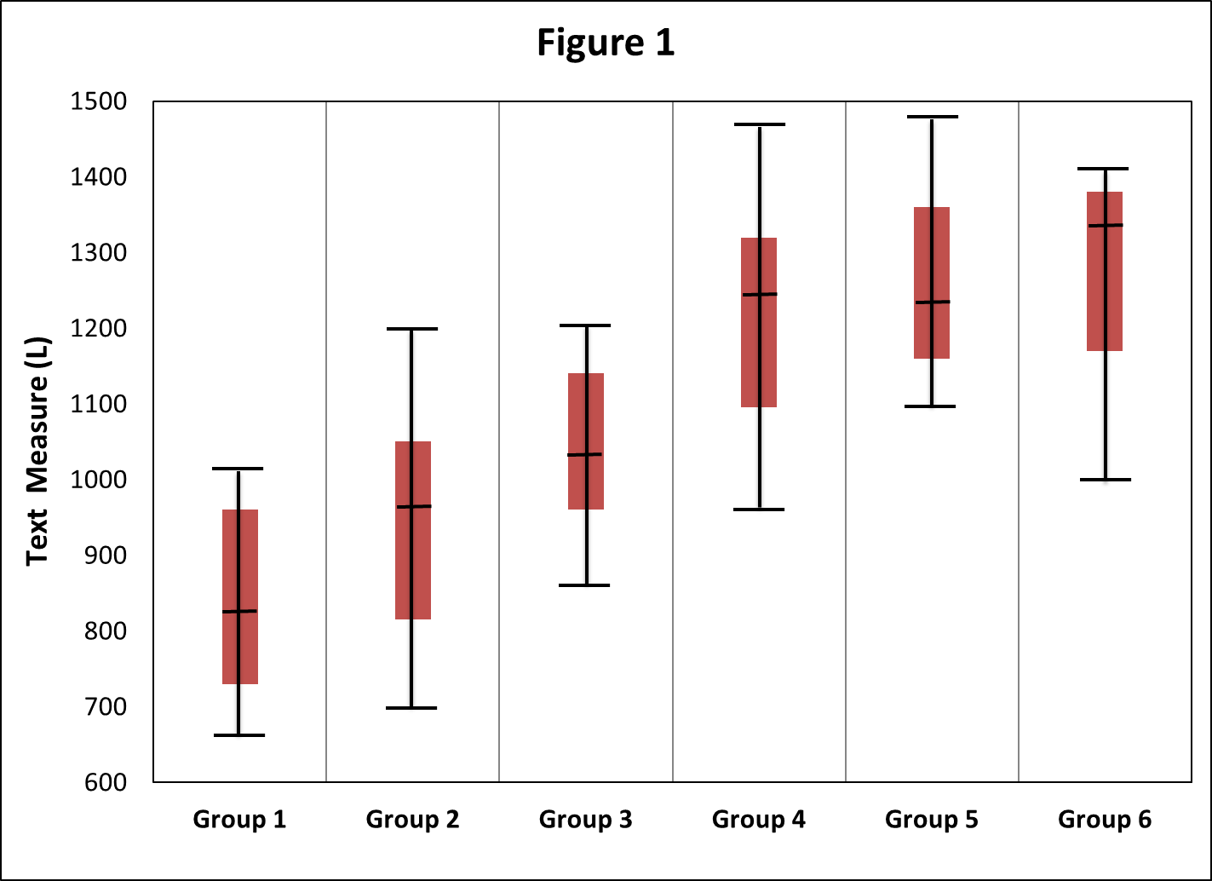
Box-and-Whisker Plot

Slide 62
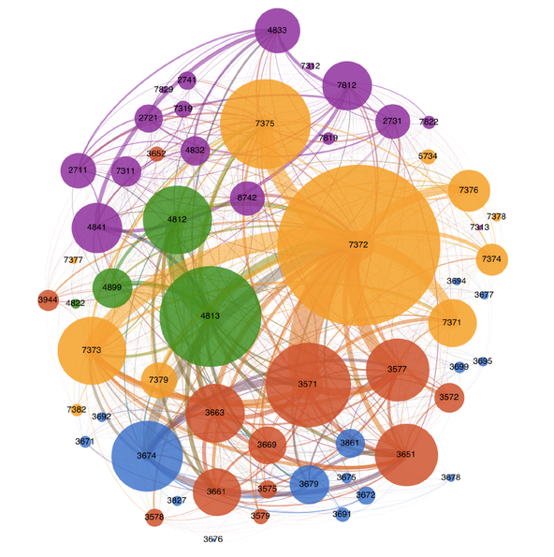
Big Data
A graphic visualization of the mobile industry.
Source: http://bits.blogs.nytimes.com/2014/09/20/making-big-data-think-bigger/?_r=0

Slide 63
Is that reading?

Slide 64
Is that statistics?

Slide 65
Is that logic?

Slide 66
Is that probability?

Slide 67
Is that measurement systems?

Slide 68
Is that writing?

Slide 69
DATA ANALYTICS IS INTERDISCIPLINARY
But that is not how we are organized, certified, tenured or contracted

Slide 70
Seven Interrelated Fundamental Shifts
1
7
2
6
3
5
4
From
A/C to B/D
Non-cognitive
Reading and Writing
Social Media
Data Analytics
Technology Tools
Innovation and Creativity

Slide 71
HOW

Slide 72
Organizational Changes
Looping

Slide 73
Organizational Changes
Looping
Department Chairs

Slide 74
Organizational Changes
Looping
Department Chairs
9th Grade Electives

Slide 75
Fundamental Shift in Instruction
Open Educational Resources

Slide 76

Open Educational Resources
Teachers Pay Teachers

Slide 77
Scope and Sequence

Slide 78
Fundamental Shift in Instruction
Open Educational Resources
Text to Digital

Slide 79
Fundamental Shift in Instruction
Open Educational Resources
Text to Digital
Virtual to Augmented Reality

Slide 80
Google Cardboard

Slide 81
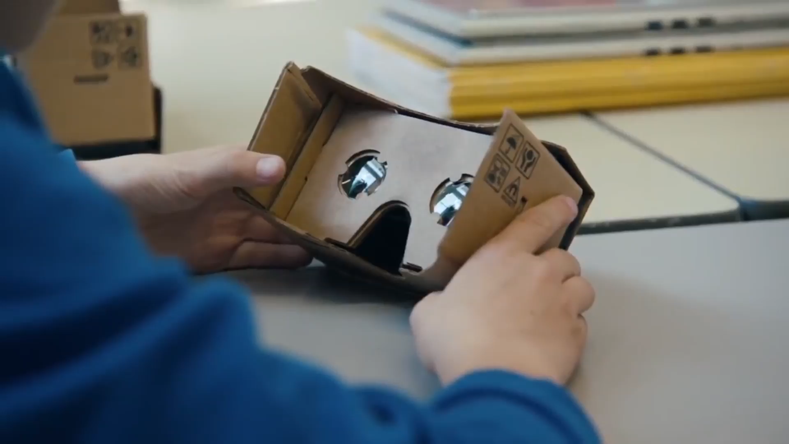

Slide 82


Slide 83

Augmented Reality
      www.xshopx.net

Slide 84
Fundamental Shift in Instruction
Open Educational Resources
Text to Digital
Virtual to Augmented Reality
Gamification

Slide 85

Gamification
Engaging

Slide 86
Gamification
Engaging
Personalized

Slide 87
Gamification
Engaging
Personalized
Built on Growth Model

Slide 88
Gamification
Engaging
Personalized
Built on Growth Model
Tied to Standards

Slide 89

Fundamental Shift in Instruction
Open Educational Resources
Online
Text to Digital
Virtual to Augmented Reality
Gamification

Slide 90
Florida, Michigan, Virginia and Alabama require one online course as a graduation requirement.
Idaho requires two.

Slide 91
Fundamental Shift in Instruction
Open Educational Resources
Online
Text to Digital
Data Driven
Virtual to Augmented Reality
Gamification

Slide 92
WHY - WHAT - HOW

Slide 93

by Dr. Bill Daggett
Highlights the six core values that underpin the vision at leading-edge schools, and the frameworks to fold them into your own district, school, and classrooms.
^{PURCHASE YOUR COPY TODAY}
^{Store.LeaderEd.com}
Save 30% through 12/31/16 with code MSW30

Slide 94


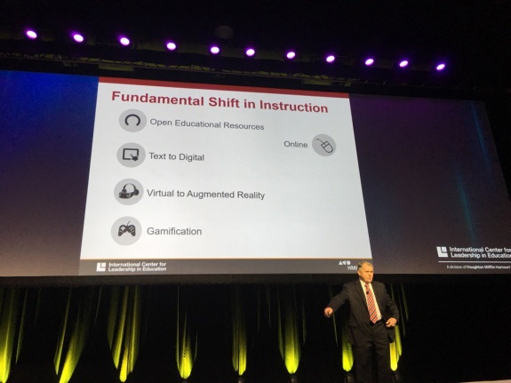

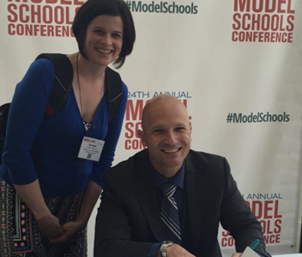

Register Today!
www.modelschoolsconference.com
#modelschools

Slide 95
Coaches
Network Resources

Slide 96
Coaches
Thought Leadership
Network Resources

Slide 97
Coaches
Thought Leadership
- Bill Daggett
- Ray McNulty
- Sue Szachowicz
- Sam Houston
Network Resources

Slide 98
Coaches
Thought Leadership
Model Lesson Plans
Network Resources

Slide 99
Coaches
Thought Leadership
Model Lesson Plans
- Resource bank
Network Resources

Slide 100
Coaches
Thought Leadership
Model Lesson Plans
- Resource bank
- Submit/Review
Network Resources

Slide 101
Coaches
Thought Leadership
Model Lesson Plans
- Resource bank
- Submit/Review
- Share
Network Resources

Slide 102
Coaches
Thought Leadership
Model Lesson Plans
Action Plans
Network Resources

Slide 103
Coaches
Thought Leadership
Model Lesson Plans
Action Plans
Webinars
Network Resources

Slide 104
Coaches
Thought Leadership
Model Lesson Plans
Action Plans
Webinar
Annual Meeting
Network Resources

Slide 105
Coaches
Thought Leadership
Model Lesson Plans
Action Plans
Webinar
Annual Meeting
Member Requested Services
Network Resources

Slide 106


Connect with me
NEW BLOG: What’s Relevant Right Now
http://blog.leadered.com/
Bill Daggett, Ed.D.
Notes:
I’ve launched a new blog, What’s Relevant Right Now. Subscribe through blog.leadered.com or use the QR code. I’m also on Linkedin.

Slide 107
Are we measuring what is most important or what is easiest to measure?
Notes:
What does the slide represent and what is the source??

Slide 108
Survey Tools for Measuring What Matters
We Teach
We Learn
Instructional Staff Survey
Student
Survey
We Lead
We Support
Whole Staff Survey
Parent/Community Survey

Slide 109

Teacher vs. Student Comparison
92%
58%
Teacher
Student
Students can apply what I am teaching to their everyday lives.
I can apply what I learn to my everyday life.

Slide 110
Teacher vs. Student Comparison
88%
45%
Teacher
Student
Students in my classroom engage in hands-on activities.
We do lots of hands-on activities in my classes.

Slide 111
Teacher vs. Student Comparison
84%
40%
Teacher
Student
I make learning exciting for my students.
My teachers make learning exciting.

Slide 112
Teacher vs. Student Comparison
95%
40%
Teacher
Student
I recognize students when they demonstrate positive behavior in school.
Good citizenship is rewarded in this school.

