Slide 1
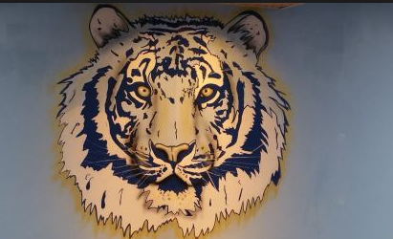
Hempstead High school
Tiger Pride
Promising Practices Conference November 2016
Strategic Practices for Transformation
Dr. Stephen Strachan, Principal
Dr. Fadhilika Atiba-Weza, Superintendent
James Clark, Associate Superintendent for Secondary Education
Transformation Team Members:
Carey Gray
Reina Jovin
Nickeisha Wilson
Felicia Prince
Sean O’Brien

Slide 2
Key Components: Tiger Spirit
Transformation Plan
Bell Schedule: Increased Use of Space and Time
Partnership: Building Capacity
Extended Instructional Time for 9th Grade

Slide 3
Transformation Plan
Dr. Stephen Strachan
Principal

Slide 4
SCHOOL CHANGE MODEL

Slide 5
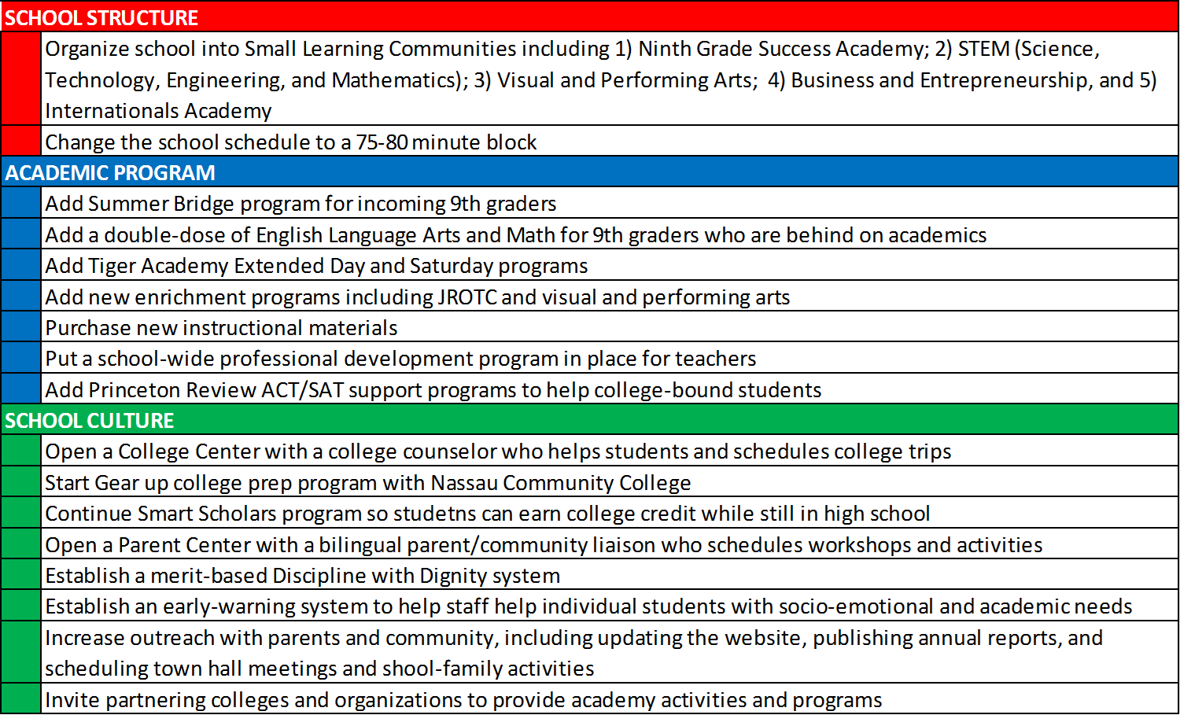
School Change Model

Slide 9
Partnerships
Professional Development & Instructional Practice
Reina Jovin
School Implementation Manager

Slide 10
External Partnerships and the Development of Professional Learning Communities
As the lead partner, Talent Development Secondary instructional facilitators work with coaches and teachers to analyze current curriculum, align classroom instruction, and refine pedagogical practices. Working with teams through the coaching cycle during embedded Professional Community Meeting times creates a culture of continuous professional Development

Slide 11
Small Learning Communities:
School Redesign
John Hopkins Talent Development Secondary
  Provide training and on-going support to implement the new school organization
  Ninth Grade Success Academy
  Career Academies and the International Academy
  Teacher Teams
  Extended Learning Time
  4x4 Block Schedule
  Early Warning Indicator & Intervention System
International Network of Public Schools
  leverage the home languages of their students to help improve their home-language skills and access more rigorous content.
  MALP framework for understanding the unique challenges SLIFE students face in formal education settings
  Strategies for adapting curriculum to make it more accessible to students with emergent literacy.
  Learn core strategies to enable students at different academic and English proficiency levels to access academically rigorous curriculum at a variety of entry points.

Slide 12
External Partnerships and the Development of Professional Learning Communities
Pearson Professional Development, Change of Practice (COP) Foundations CCLS Institutes in Math and ELA. Supporting teachers in implementing the instructional shifts required by CCLS.
REACH Educational Solutions, REACH School Leader Coaching Program (SCLP) and School-wide Effective
Practices for Using Data Program™ (SEPUDP)
In efforts to promote leadership capacity for school leaders

Slide 13
3 -Tiered Professional Development Plan
Administrators
REACH
School Leader Coaching and School Wide Effective Practices for using Data
Instructional
Coaches
Pearson
Change of Instructional Practice Institutes in ELA, Math and Leadership
Teachers

Slide 14
3- Tiered Professional Development Plan cont.
School Leaders
Distributive Leadership
Using Data to Drive School Change
Instructional Coaches
The Coaching Model for PLC’s
Development of Teacher Leaders
Teachers
Effective Pedagogy

Slide 15
Focus Area: College-Going Culture
Exposure and Access to College
Nassau Community College GEAR Up
Farmingdale College Smart Scholars Program
Stony Brook University STEM Academy
Syracuse University SUPA Program
Adelphi University STEP Program
The Princeton Review SAT/ACT Prep

Slide 16
Bell Schedule
Carey Gray, Assistant Principal &
Brian O’Brien, Guidance Counselor

Slide 17
Hempstead High School
Bell Schedule
PERIOD | BEGINNING | END | LENGTH
Block A 1 | 7:30 A.M. | 8:45 A.M. | 75 min
Advisory Block 2 | 8:50 A.M. | 9:05 A.M. | 15 min
Block B 3 | 9:10 A.M. | 10:25 A.M. | 75 min
Lunch A 4 | 10:25 A.M. | 11:05 A.M. | 40 min
Block C 5 | 10:30 A.M. | 11:45 A.M. | 75 min
Block D 6 | 11:10 A.M. | 12:25 P.M. | 75 min
Lunch B 7 | 11:45 A.M. | 12:25 P.M. | 40 min
Block E 8 | 11:50 A.M. | 1:05 P.M. | 75 min
Block F 9 | 12:30 P.M. | 1:45 P.M. | 75 min
Team Meetings 1 | 1:45 P.M. | 2:30 P.M. | 45 min
Lunch C 10 | 1:05 P.M. | 1:45 P.M. | 40 min
Block G 11 | 1:50 P.M. | 3:05 P.M. | 75 min

Slide 18
Student Schedule Types
Student Type | Student A | Student B | Student C
Time | Early (7:30-1:45) | Early (7:30-1:45) | Late (8:50-3:05)
Blocks (Period) | Block A (1) Advisory Block (2) Block B (3) Lunch A (4) Block D (6) Block F (9) | Block A (1) Advisory Block (2) Block B (3) Block C (5) Lunch B (7) Block F (9) | Advisory Block (2) Block B (3) Block C (5) Block E (8) Lunch C (10) Block G (11)

Slide 19
Freshman Schedule At A Glance
Freshman Academy
Semester 1 | Semester 2
Strategic Reading | English 9
Advisory | Advisory
Living Environment or U.S. History | Living Environment or U.S. History
Lunch | Lunch
Freshman Experience (A Day)/ P.E. (B Day) or Lab | Lab or P.E. / Elective
Transition to Advance Math or Foundations of Geometry (Advanced) | CC Algebra/CC Geometry

Slide 20
Sophomore Schedule At A Glance
Grade 10 Standard Track
Semester 1 | Semester 2
Foundations of Geometry | CC Geometry
Advisory | Advisory
Global History 1 | Global History 2
Lunch | Lunch
Earth Science or Chemistry | English 10
Lab (A Day)/ P.E. (B Day) | SLC Seminar/Elective

Slide 21
Junior Schedule At A Glance
Grade 11 Standard Track
Semester 1 | Semester 2
English 11 | SLC Course/Elective
Advisory | Advisory
11th Grade Science | U.S. History (Elective after 3rd year integration)
SLC Course/ Elective | SLC Course/Elective
Lunch | Lunch
Lab (A Day)/ P.E. (B Day) | Algebra II

Slide 22
Senior Schedule At A Glance
Grade 12 Standard
Semester 1 | Semester 2
English 12 | Eco/ PIG
Advisory | Advisory
SLC Course Elective | SLC Course Elective
SLC Course Elective | SLC Course Elective
Lunch | Lunch
SLC Course Elective | SLC Course Elective

Slide 23
Best Practices Implemented
After transition implementation
Before Transition
40 minute classes impeding project and collaborative instruction
Limited opportunities to qualify for high stakes testing
Student prepared for several courses
More time spent in the hallway and greater risk for behavioral infractions
Limited opportunities to pass a class or receive seat time
Longer periods allow for increased “time on task”
Shorter periods of recall are required for Regents Exams (September-January/ January-June rather than September-June)
A decrease in the number of courses taken at once, allowing for improved student focus
Decreased number of between period passing times and the elimination of free periods and study halls minimizes the potential for behavioral issues in hallways and the cafeteria
Increased opportunity for students to recuperate lost credits

Slide 24
Introduction to Small Learning Communities
Small Learning Communities (SLCs) are opportunities for students to focus their attention on careers and academic subjects that are of interest to them.
By re-organizing Hempstead High School into Small Learning Communities, students will have the ability to better prepare for the challenges that will lie ahead in college as well as the work force.
The 10-12th grade SLCs will focus on three distinct areas: Business and Entrepreneurship, Science, Technology, Engineering, Mathematics (S.T.E.M.), and Visual and Performing Arts
The 9th grade will be organized into its own SLC: The Freshman Academy
Newcomers and English Language Learners will take part in the International Academy

Slide 25
Small Learning Communities Continued
The focus of the SLCs on areas of interest, combined with a student driven bell schedule, will provide students with an experience similar to that on a college campus- further preparing students for their education after Hempstead.
In addition, the course offerings will be updated with classes to better promote “college and career readiness”

Slide 26
Freshmen Academy
In the Freshman Academy, Freshman students will work with a dedicated group of teachers and staff who will focus on improving the students’ study skills, academic achievement and overall knowledge of college and career goals and expectations.

Slide 27
International Academy
The International Academy will provide English Language Learners and Newcomers the opportunity to develop essential academic, communication, and social skills in a nurturing environment.
Transition Courses
Bridge Content and Knowledge Gaps
Develop Communication and Literacy Skills
Provide Required Support Services
Improve Retention and Graduation Rates

Slide 28
S.T.E.M. Academy
The Science, Technology, Engineering and Mathematics (S.T.E.M.) Academy will prepare students for careers in the sciences.
Future career choices for S.T.E.M. Students:
Doctors
Engineers
Nurses
Notable S.T.E.M. courses include:
AP Biology
Introduction to Engineering
AP Calculus

Slide 29
Visual and Performing Arts
The Visual and Performing Arts (VAPA) Academy will prepare students for careers and further study in the following:
  Visual Arts
  Dance
  Theater
  Music
Future Career Choices for VAPA Students will require a thorough understanding of rhetoric and presentation.
Notable VAPA courses will include:
  Theater & Performance
  Art History
  Concert Choir
  Band and Orchestra

Slide 30
Business Entrepreneurship
The Business Entrepreneurship Academy will allow students to develop both an understanding of the basic principles of business leadership as well as their interests in a number of business fields including: The performing arts, the culinary arts and the visual arts and media.
Future Career Choices for Entrepreneurship Students:
Business Management
Restaurant Management
Television Broadcast Production
Notable course offerings in this academy:
Advanced Media Communications
AP Microeconomics
Sports and Entertainment Marketing

Slide 31
To Review…
SLC’s will better prepare students for college and the workforce by providing a “themed focus” for their academics
Course offerings will be “reworked” to reflect the changes in college admissions expectations and workforce demands
Student support structures will be improved due to the improved focus afforded by moving towards small communities

Slide 32
9th Grade Academy
Purpose
Recruitment
Academics
Schedule
Early Warning Interventions (EWI)

Slide 33
Where Did the Freshmen Go?
12th Grade
11th Grade
10th Grade
9th Grade
Notes:
Ken

Slide 34

Summer Bridge
Program Components
Extended Instructional Time
  Starting in July
  Open to all Students
Academic Intervention
Increased Rigor
Introduction to 9th Grade Teachers
Character Education
Supporting Adolescent Concerns through community organizations
Notes:
Speaking points: Remediation, enrichment and academic intervention services, hs orientation

Slide 35
Recruitment for Summer Bridge:
Articulation between High School & Middle school
Articulation with alternative school
Open enrollment
90% Attendance

Slide 36

Academics
Intervention & Enrichment
English Language Arts
Mathematics
STEM/STEAM
Study Skills
Electives

Slide 37
Schedule
Notes:
Speaking points how students were grouped, protocols and expectations

Slide 38

New Language Arts &
Home Language Arts Students
The Summer Bridge Program allowed students with interrupted education an opportunity to bridge literacy and academic gaps through extended language and literacy instruction.
Focus on developing basic concepts of academic success through specific learning strategies.
Team teaching

Slide 39
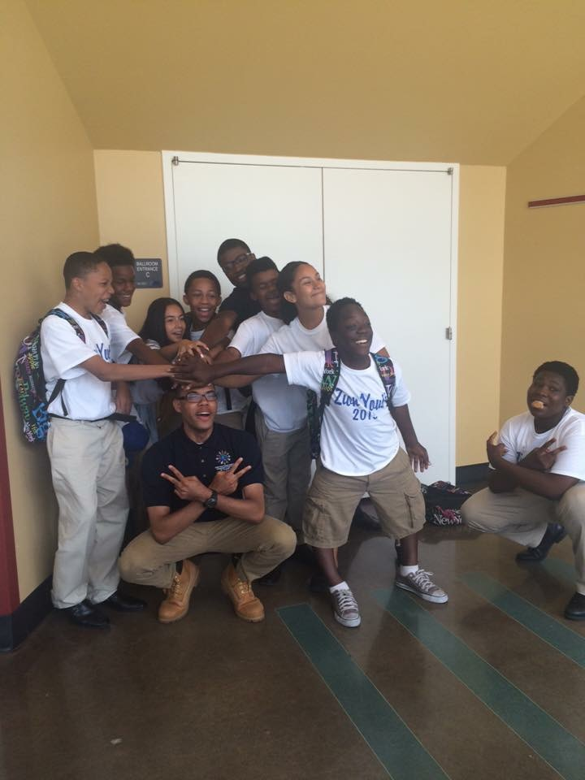
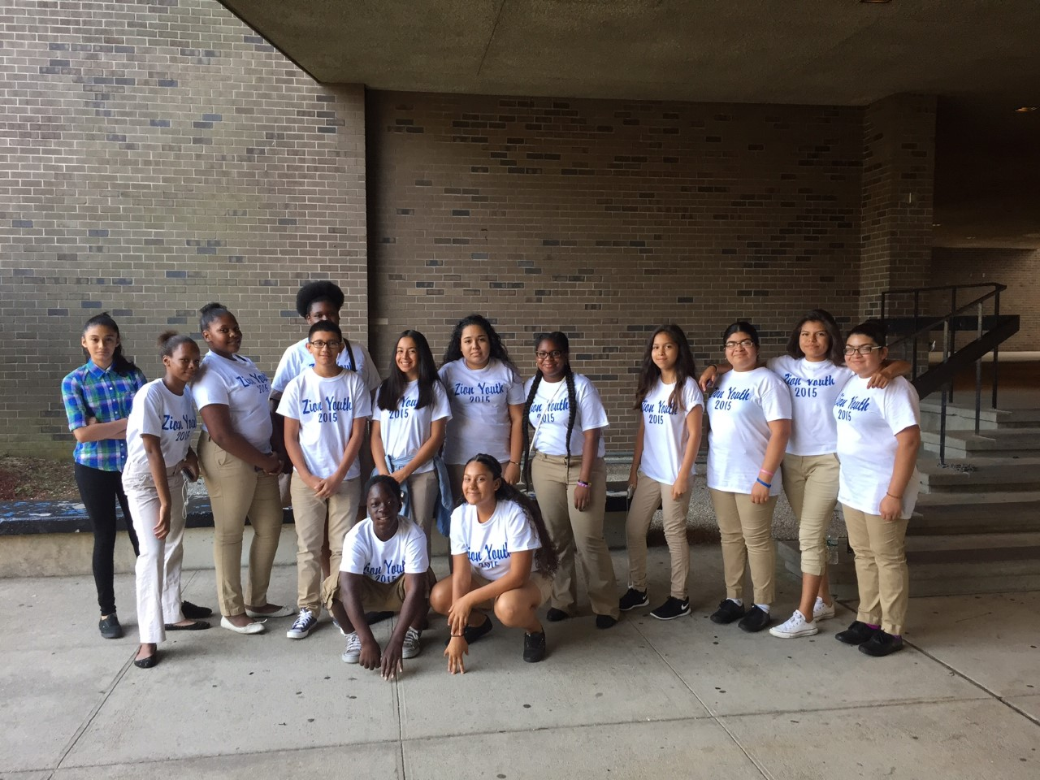
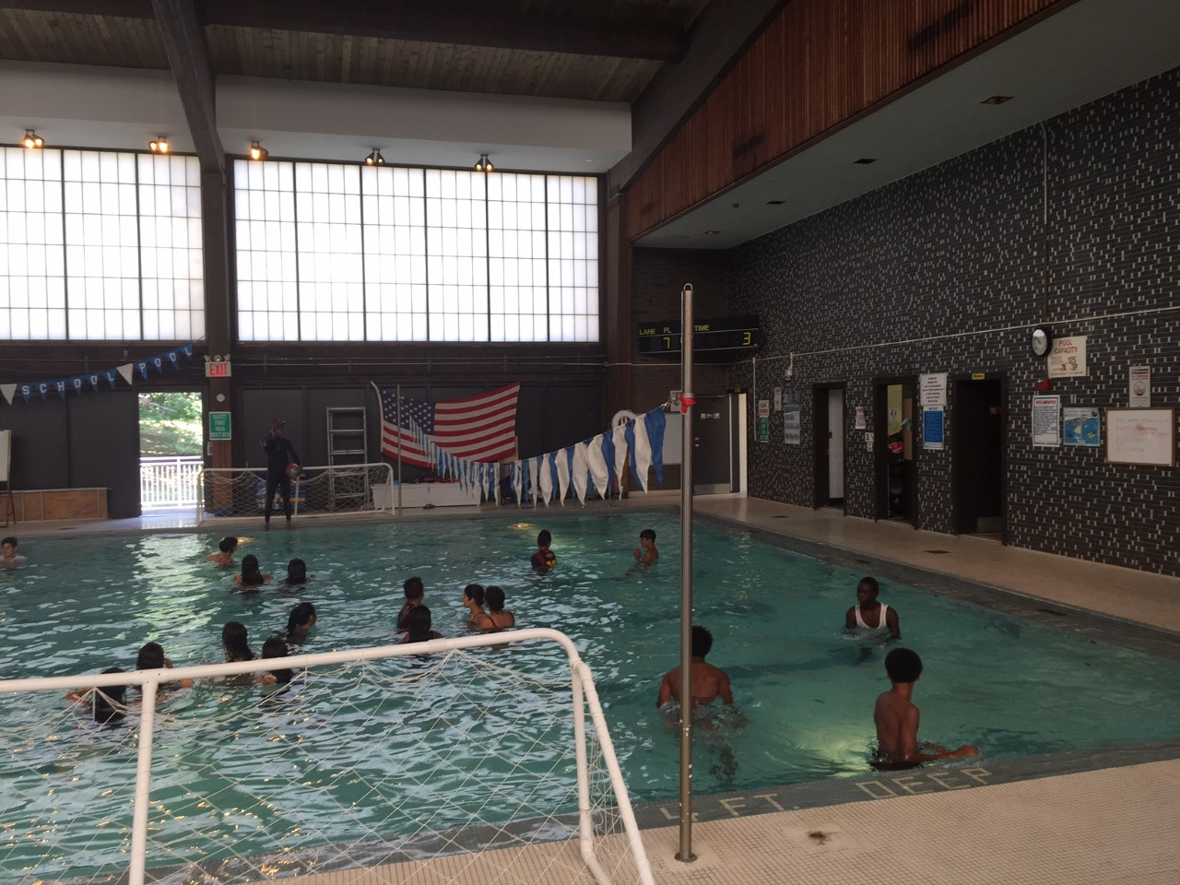
Enrichment
Zion Stem Program with Farmingdale University
Swimming
Notes:
Speaking points: college exposure, project based learning and collaboration

Slide 40
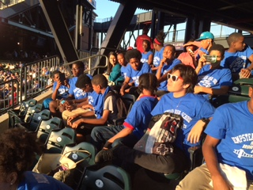
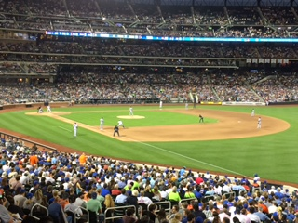
Incentive Activities
80 Students attended Mets game
Attendance reward activity

Slide 41
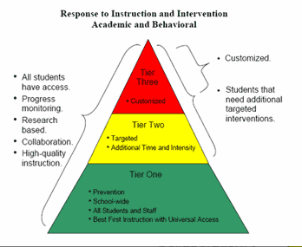
Professional Development
Cooperative Planning
Unified Classroom Expectations and Routines
Early Warning Interventions Based on Indicators
Incentive Planning
Parent Meeting
Scheduling for 2015-2016 School year
Data Collection

Slide 42
Best Practices Implemented
Before Transition
After Transition Implementation
Vision for Students who failed
Academic focus for remediation
Reuse of materials
Teachers working in isolation
System lacking intervention
Teachers neglected in planning
Vision for all learners
Academic focus for repair, rigor & relevance
Material reflecting CCLS, character education and project based instruction
Teachers collaborating and differentiating (horizontal and vertical)
System created to foster proactive means to ensure academic success
Collaborative planning
Notes:
Students retaking the regents exam: Provided instruction by teachers in the HS summer school program.

Slide 43
progress

Slide 44
Graduation Rate Progress

Slide 45

Class of 2016’s “Graduation Preparedness”
Approx. 55% (Cohort 2012) are on track to graduate
Increase of 14% increase from previous year’s cohort

Slide 46
Students Making Yearly Progress Toward Graduation

Slide 47
School Turnaround “Early Gains”
Successful hiring of the school-based SIM and math and ELA coaches
Successful organization of SLCs (Freshman Academy, International Academy, and Career Academies)
Creation of a block schedule that allows for double-dose acceleration courses in math an ELA, and Freshman Seminar for 9th graders
Successful Town Hall meeting in August to communicate the Transformation Plan to students, teachers, families, and other stakeholders
Revamping of school website, up and running by August 15
Creation of a school-wide Early Warning data system, with all teachers trained in its use
Early functioning of EWI meetings in all SLCs, with appropriate tiered interventions at academy, classroom, subgroup, and individual levels (e.g., parents of absentee students receive a phone call the same day)

Slide 48
“Early Gains”(continued)
Successful implementation of after-school Tiger Academies
Successful Back-to-School night, parent-teacher conferencing, and Report Card Conference
Timely submission of 1st quarter EWI data, showing evidence of appropriate and effective interventions provided to students slipping off-track
Successful pre-implementation and 1st quarter tiered professional development, including TA from TDS instructional facilitators and onsite support from math and ELA coaches
Implementation of curriculum resource sharing through NY Learns
Naviance for student college and vocational preparation.

Slide 49
“Early Gains”(continued)
This year’s planning for next year’s implementation of Elevation (compliance of the PART154).
Upgrades in our network for better dissemination of information.
Providing the staff with laptops to assist them with planning.
Upgrade of student computers in the media center and increase 1 to 1 device usage
Renewal of Castle Learning software: Educational web-based software for student assessments
Increase in professional development in technology

Slide 50
Questions

